Slide 1
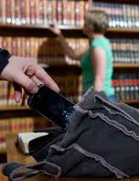
Dealing with Challenging Patrons: Safety and Security In Our Libraries
Dr. Steve Albrecht, PHR, CPP, BCC, CTM
Monument, CO
866-261-5150
DrSteve@DrSteveAlbrecht.com

Slide 2
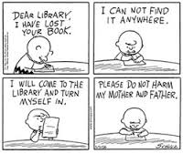

Slide 3
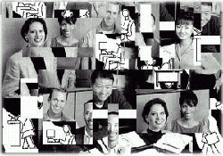
What’s Happening in the “New” Library?
Entitled or angry patrons (who miss the “old” library).
Frustrated patrons who don’t know or ignore our rules.
Uncertain times, more stress, less money, for all.
Employees who must do more, with less, and faster than ever before.
Our “72 / 7” world mirrors their world.

Slide 4
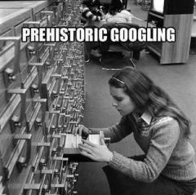

Slide 5
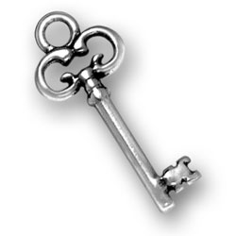
Posted Codes of Conduct
Firm, fair, consistent, and assertive approaches.
Creative customer service skills
Notes:
Blythe: Made font bigger and changed to Calibri to make it easier to read

Slide 6
Your Secrets to a Safe Workplace
Self-Protection: You can’t take care of others if you’re not safe from harm.
Stress and Anger Management: You can’t take care of others or yourself if you’re losing it. Manage your breathing. QTIP
Working Smart: Know what to say, what to do, when to stay or go, who to call, and how to get help.

Slide 7
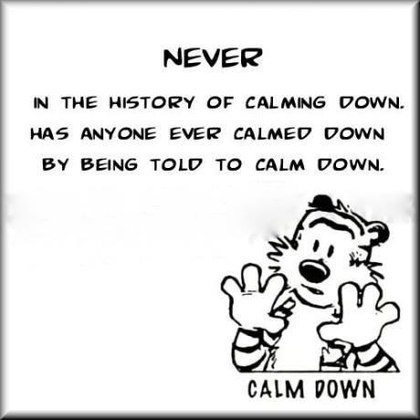

Slide 8
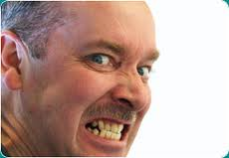

Slide 9
Some Themes . . .
Profiles or behaviors?
Peace or justice?
What should asking for help mean?
Do your job or do your job safely?
Chain of command or not?
How do we align with patrons?
If there are no consequences . . .
Acting skills . . .
If it’s measured, it can be managed.

Slide 10
Tough Situations
Entitled, angry, threatening, or eccentric patrons.
Service animals versus comfort animals
Unruly children and teenagers (or their parents).
Stalking or sexual behaviors by patrons.
Domestic violence comes to the library.
No security and missing police.
Door dashers, gate crashers, and thieves.
The chronically homeless and the mentally ill.
Criminals, substance abusers, gang members.
Internet hogs and Internet creeps.
Stinkers, talkers, smokers, bathers, eaters, and sleepers.

Slide 11
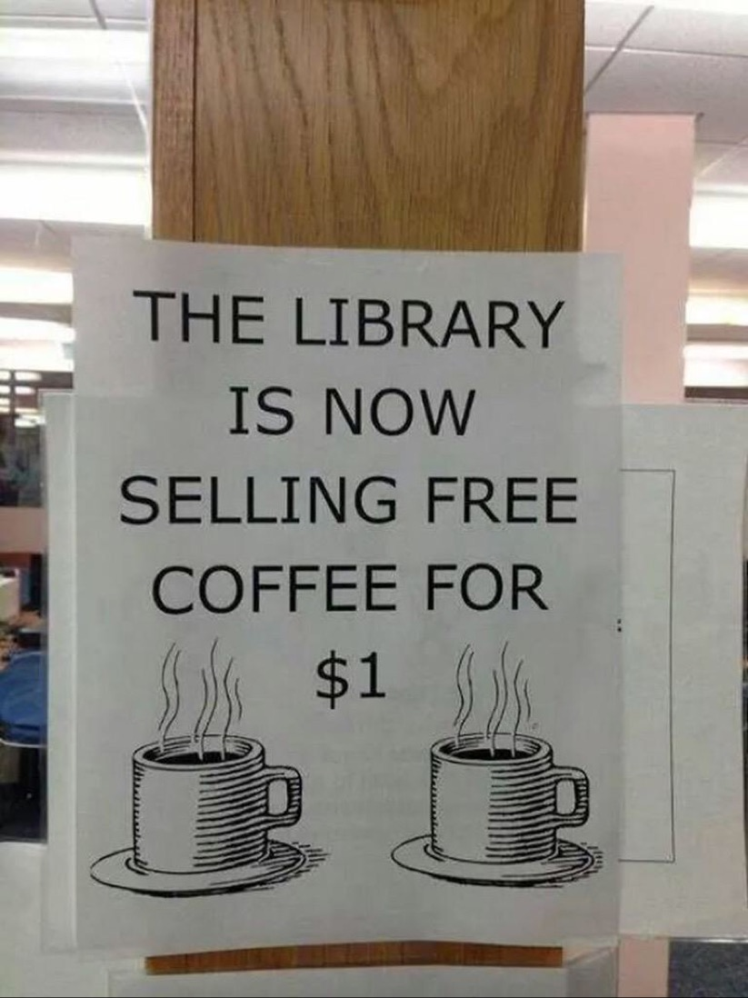

Slide 12
Perpetrators of Workplace Violence per OSHA
Type 1: Criminals.
Type 2: Taxpayers, customers, students, patients, passengers, vendors, etc.
Type 3: Current or former employees.
Type 4: Current or former spouse/partner of an employee.

Slide 13
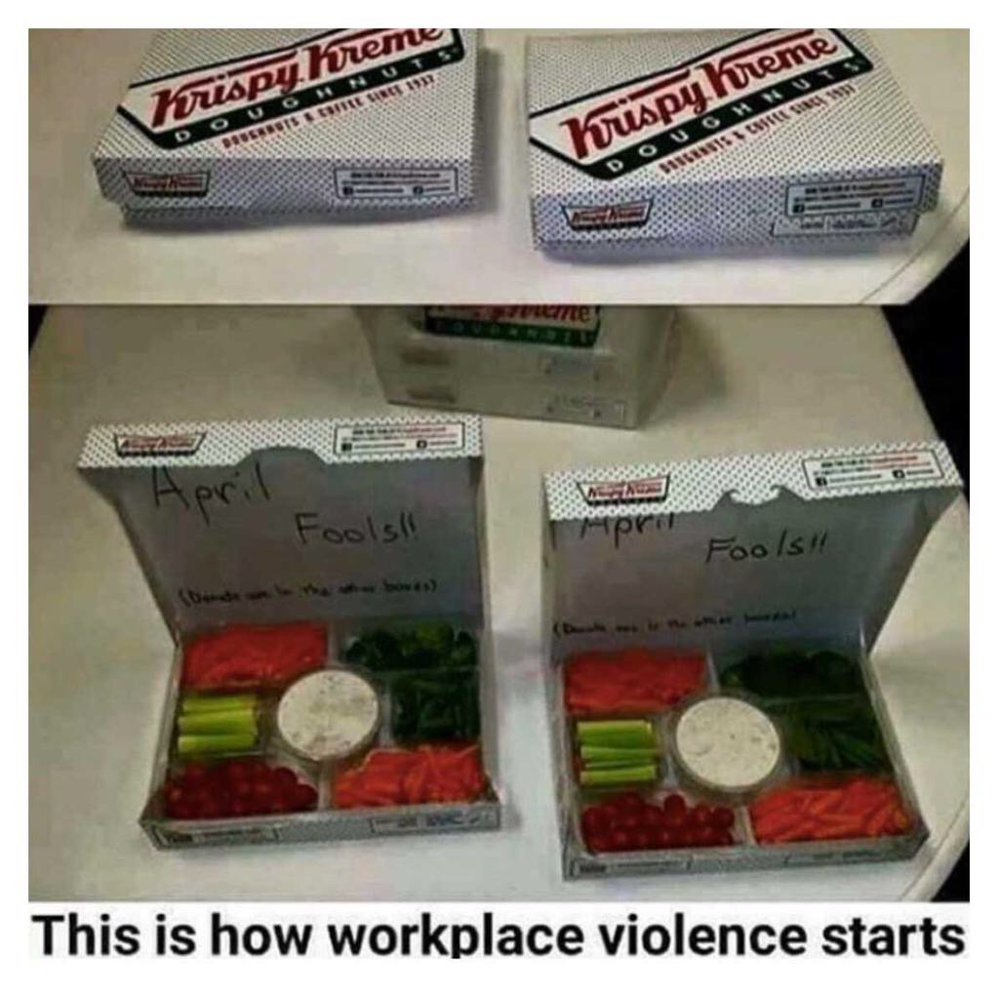

Slide 14
Code of Conduct
In my Perfect Library World, your facility would post the Code of Conduct in many visible locations, in poster-sized versions.
Putting the Code of Conduct on a clipboard behind the Circulation Desk or only on your web site, is not enough.
Code of Conduct language needs to be written positively, and in plain English, not legalese.

Slide 15
The Need for Rules: Business Impact
Smoking (E-cigarette and vaping policy?).
Soliciting for money.
Interfering with the safe use of the library.
Religious zealots.
Misusing the Internet.
Bikes or skateboards.
Theft or vandalism.
Misuse of restrooms.
Shirts and shoes?

Slide 16
The Need For Rules: Business Impact
Unattended children.
Service animals versus “comfort” animals.
Sleeping.
Food and drink.
Electronic devices – use or noise.
Hygiene.
Unattended belongings.
Blocking aisles and exits.

Slide 17
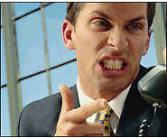
Don’t Rationalize Irrational Behavior
I’m probably overreacting. . .
I’ll stop it if he or she does “X”. . .
They’ll go away soon. . .
Maybe if I just wait her out. . .
It’s not really that bad. . .
It’s not my job to handle that. . .
I’m not a cop, psychologist, or a social worker. . .
Asking for help means I can’t do my job . . .

Slide 18
Introduce / Explain / Ask
Introduce yourself. Try to get the person’s name.
Explain: “I noticed that . . . “ “The reason I’m here is . . .” “I’m sure you already know this, but . . .”
Ask: “I need to ask you to . . .”

Slide 19
Law Enforcement Support: ATM
In my Perfect Library World, a police officer or sheriff’s deputy would visit your facility nearly every day, at different times.
Have staff put the Dispatch numbers into their cell phones.
Have your Director(s) call the Watch Commander and ask for regular or extra patrols.
Create a hangout environment for the officers or deputies.
Write Security Incident Reports with victim, suspect, witness information.

Slide 20
Homeless, Mental Health, Social Services Support
In my Perfect Library World, we can working partnerships with public and private advocacy groups that specialize in dealing with your most challenging patrons:
County Behavioral Health Services / Hospitals or Clinics
County Social Services
Substance abuse treatment facilities
Adult and Child Protective Services
Faith-based and grant-funded homeless outreach

Slide 21
Suspicious Activities: See Something? Say Something!
Look for people:
loitering in unauthorized or restricted areas;
not wearing ID, uniforms, or safety gear;
who act like they are lost;
who seem too interested in our employees;
who scare others with threatening or irrational behavior;
who leave quickly after abandoning a package;
taking photos or videos;
who seem too interested in our activities;
who seem like “vendors,” but are in the wrong place;
who leave cars in odd locations, or overloaded cars.

Slide 22
George Thompson’s Verbal Judo: The L.E.A.P.S.™ Model
Listen actively: Introduce yourself; get his or her name if possible.
Empathize: “I can see you’re upset . . .”
Ask questions: “What can I do . . .?
Paraphrase: “If I hear you, you said . . .”
Seek solutions: “Why don’t we . . .?” or “What if you and I go over and . . .?”

Slide 23
Face-to-Face or Over-the-Counter
Assess people. Read the body language signs of anger versus cooperation.
Think about past encounters.
Move closer to build rapport. Stay back if they are angry.
Use space and distance and proxemic barriers.
Practice venting and validation.
Use physical movement and the Assertive Whisper.

Slide 24
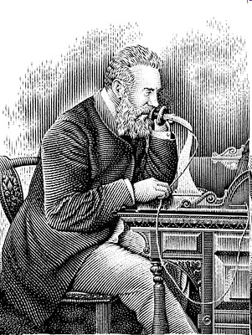
Telephone Skills
Over the phone, body language is missing, so tone is all we have.
Neutral, friendly, polite.
Get permission to put them on hold.
Get a callback number.
Under-promise and over-perform.
Set boundaries for their bad behavior.

Slide 25
What Not to Say: Here’s What Usually Doesn’t Work
“You need to calm down!”
“That’s not our policy.”
“What you need to understand is . . .”
“I can’t help you. I don’t know who can.”
“I’m going on my break. You’ll have to call or come back later.”
“You didn’t read the instructions or directions.”

Slide 26
Phrases That May Work
“You can’t do that if you want to stay here . . .”
“Our insurance won’t let you do that . . .”
“I can see you’re upset . . .”
“I’m sorry. I’m not trying to make you mad.”
“You could be right . . .”
“It’s not me, it’s the computer . . .”
“Please help me do my job for you. . .”
“I can take your name and cell number for my supervisor if you’d like . . .”

Slide 27
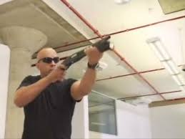
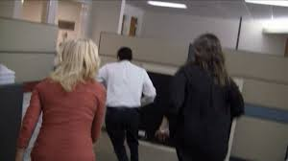
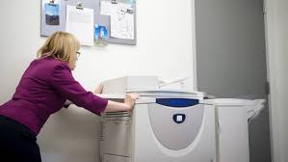
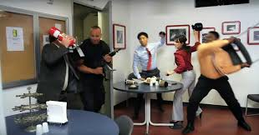
Filmed July 2012, just two weeks before the Aurora, CO movie theater shootings that left 12 dead.
A joint project with DHS and the City of Houston, TX.
Nearly 31 million views on YouTube.

Slide 28
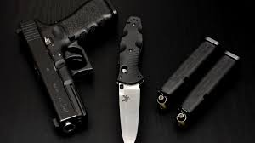
The “Active Shooter or Armed Attacker” Response
Knowing the Outs:
Where?
Run (Get Out, Evacuate)
Hide (Lock Out, Barricade)
Keep Out
Spread Out
Fight (Take Out, Protect)
Cover vs. Concealment?
A 15-minute Drill

Slide 29
Keeping it Special
Greet each patron immediately or when passing by.
Give each patron you meet your complete attention.
Make the first 30 seconds count for our patrons.
Play your part to be real, not phony or bored.
Show your energy with sincere friendliness.
Be the patron’s problem-solver.
Use your common sense.
Bend the rules when the situation calls for it.
Make the last 30 seconds count for our patrons.
Take good care of yourself.

Slide 30
Closing Themes
Always assess the Business Impact.
Update and post your Code of Conduct.
Stay firm, fair, consistent, and assertive.
Change your vocabulary about patrons from “difficult” to “challenging.”
Create on-going working relationships with police, mental health, homeless, social services, and security agencies in the public and private sector.

Slide 31
Closing Themes
Develop creative answers to common patron questions, behavior problems, or complaints.
Document new, on-going, or chronic problems with Security Incident Reports.
Use more civil stay-away orders, both verbal and served.
Try a lighter touch first; you can always get tougher.
Have courage.

Slide 32
Dealing with Challenging Patrons: Safety and Security In Our Libraries
Dr. Steve Albrecht, PHR, CPP, BCC, CTM
Monument, CO
866-261-5150
DrSteve@DrSteveAlbrecht.com

