Slide 2
Best of the Web
Winter 2018
Richard Byrne
FreeTech4Teachers.com
PracticalEdTech.com

Slide 3
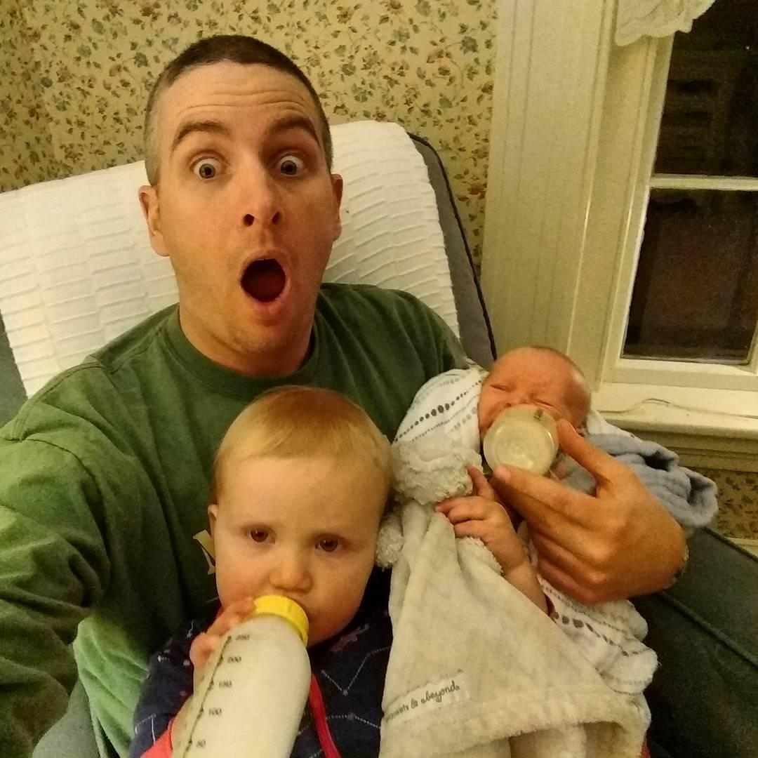
Richard@byrne.media
Twitter.com/rmbyrne
Google Me

Slide 4
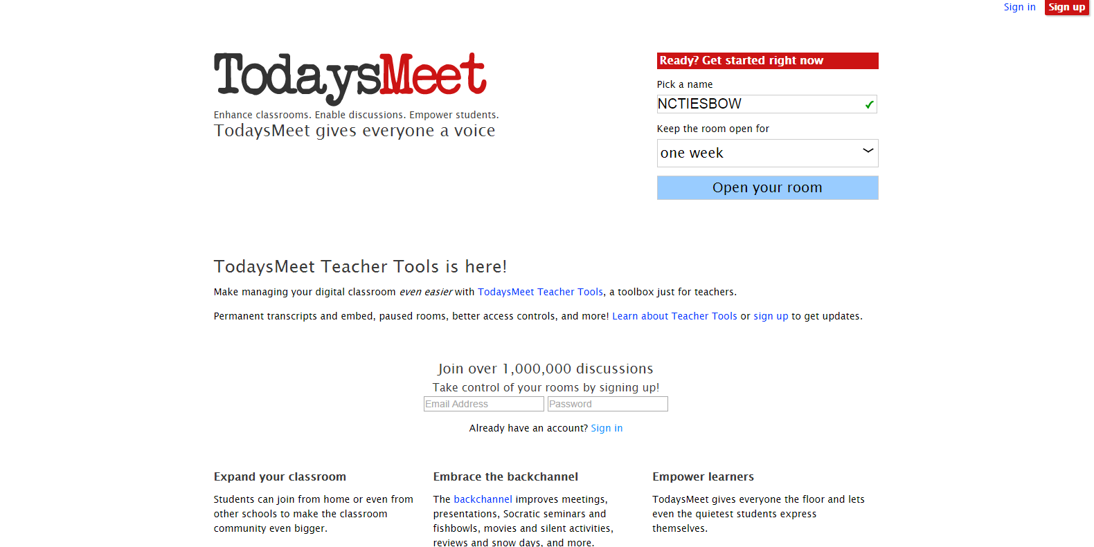
TodaysMeet.com

Slide 5
Creating & Remixing

Slide 8
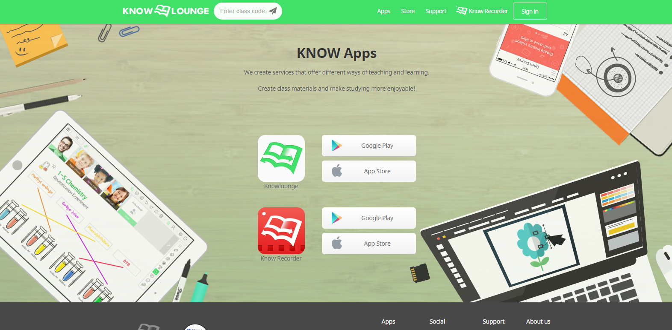
Notes:
http://stoodle.ck12.org/

Slide 9
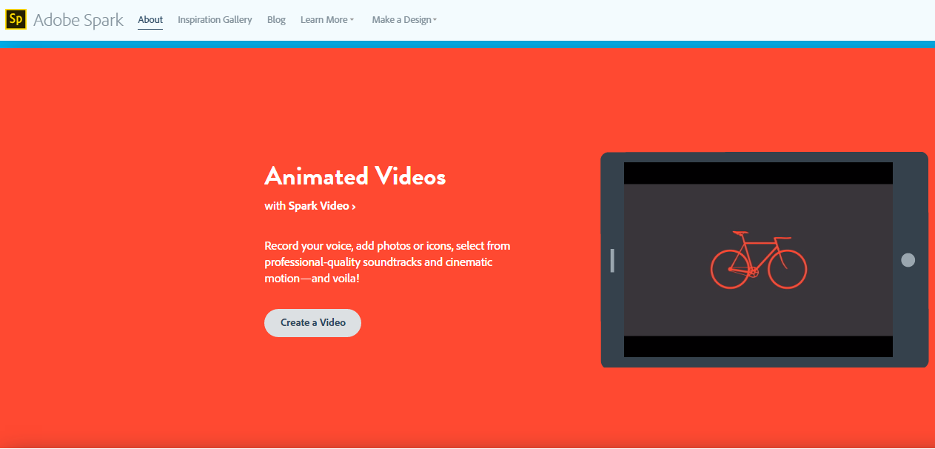
Video Within Video
bit.ly/topspark

Slide 13
papersignals.withgoogle.com

Slide 14
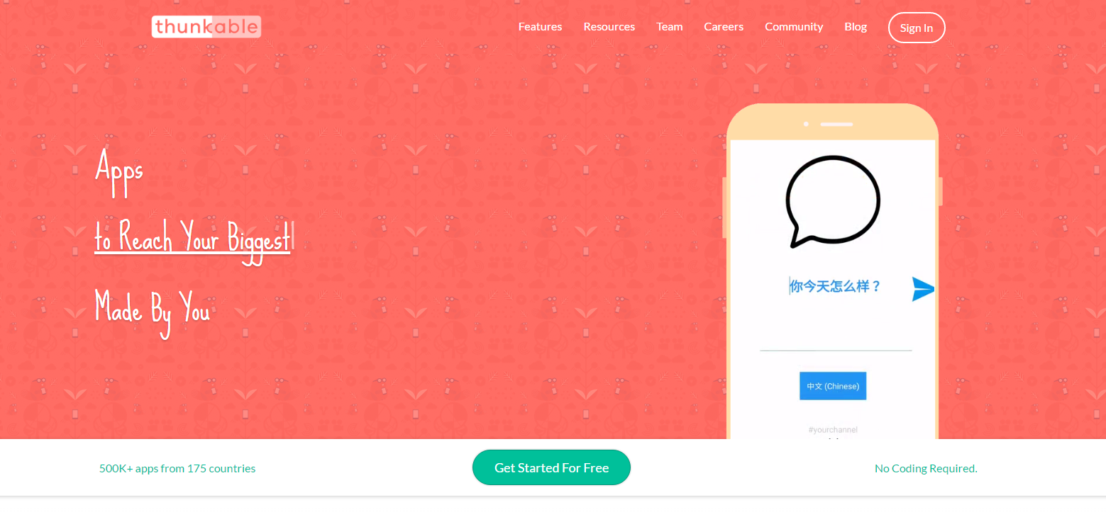
Thunkable.com

Slide 15
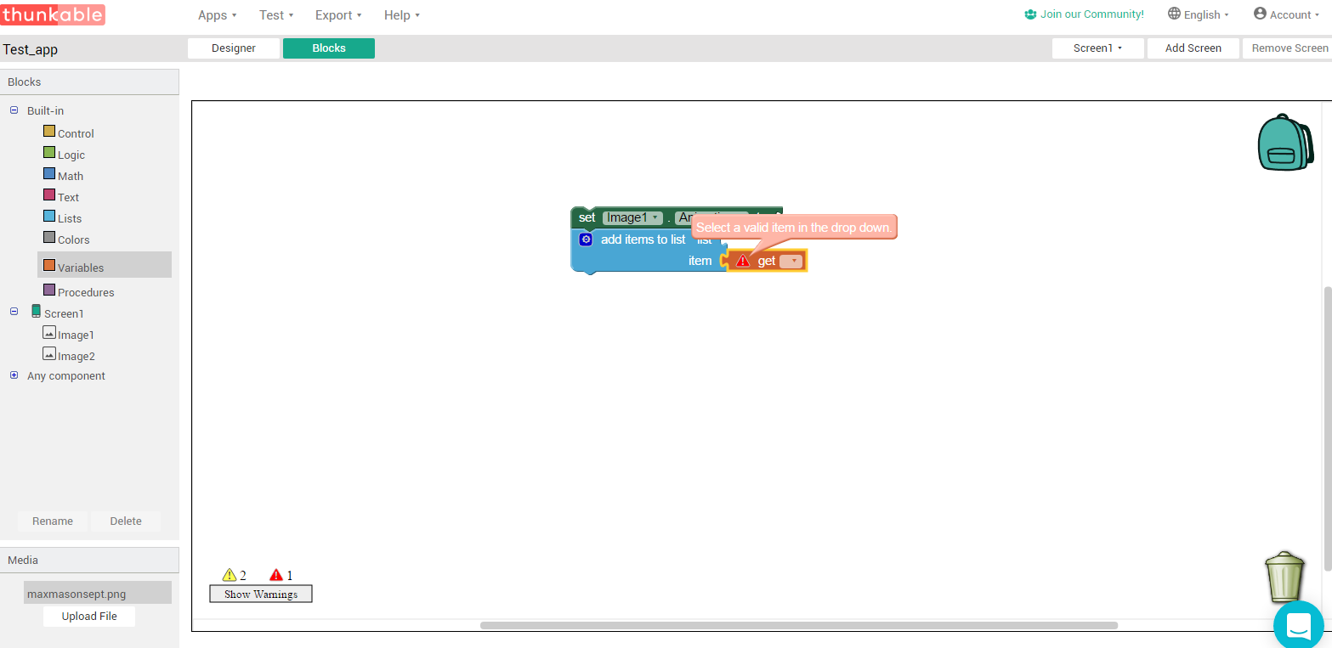
Notes:
Thunkable warning

Slide 16
Patches.Vizor.io
Notes:
The history project

Slide 17
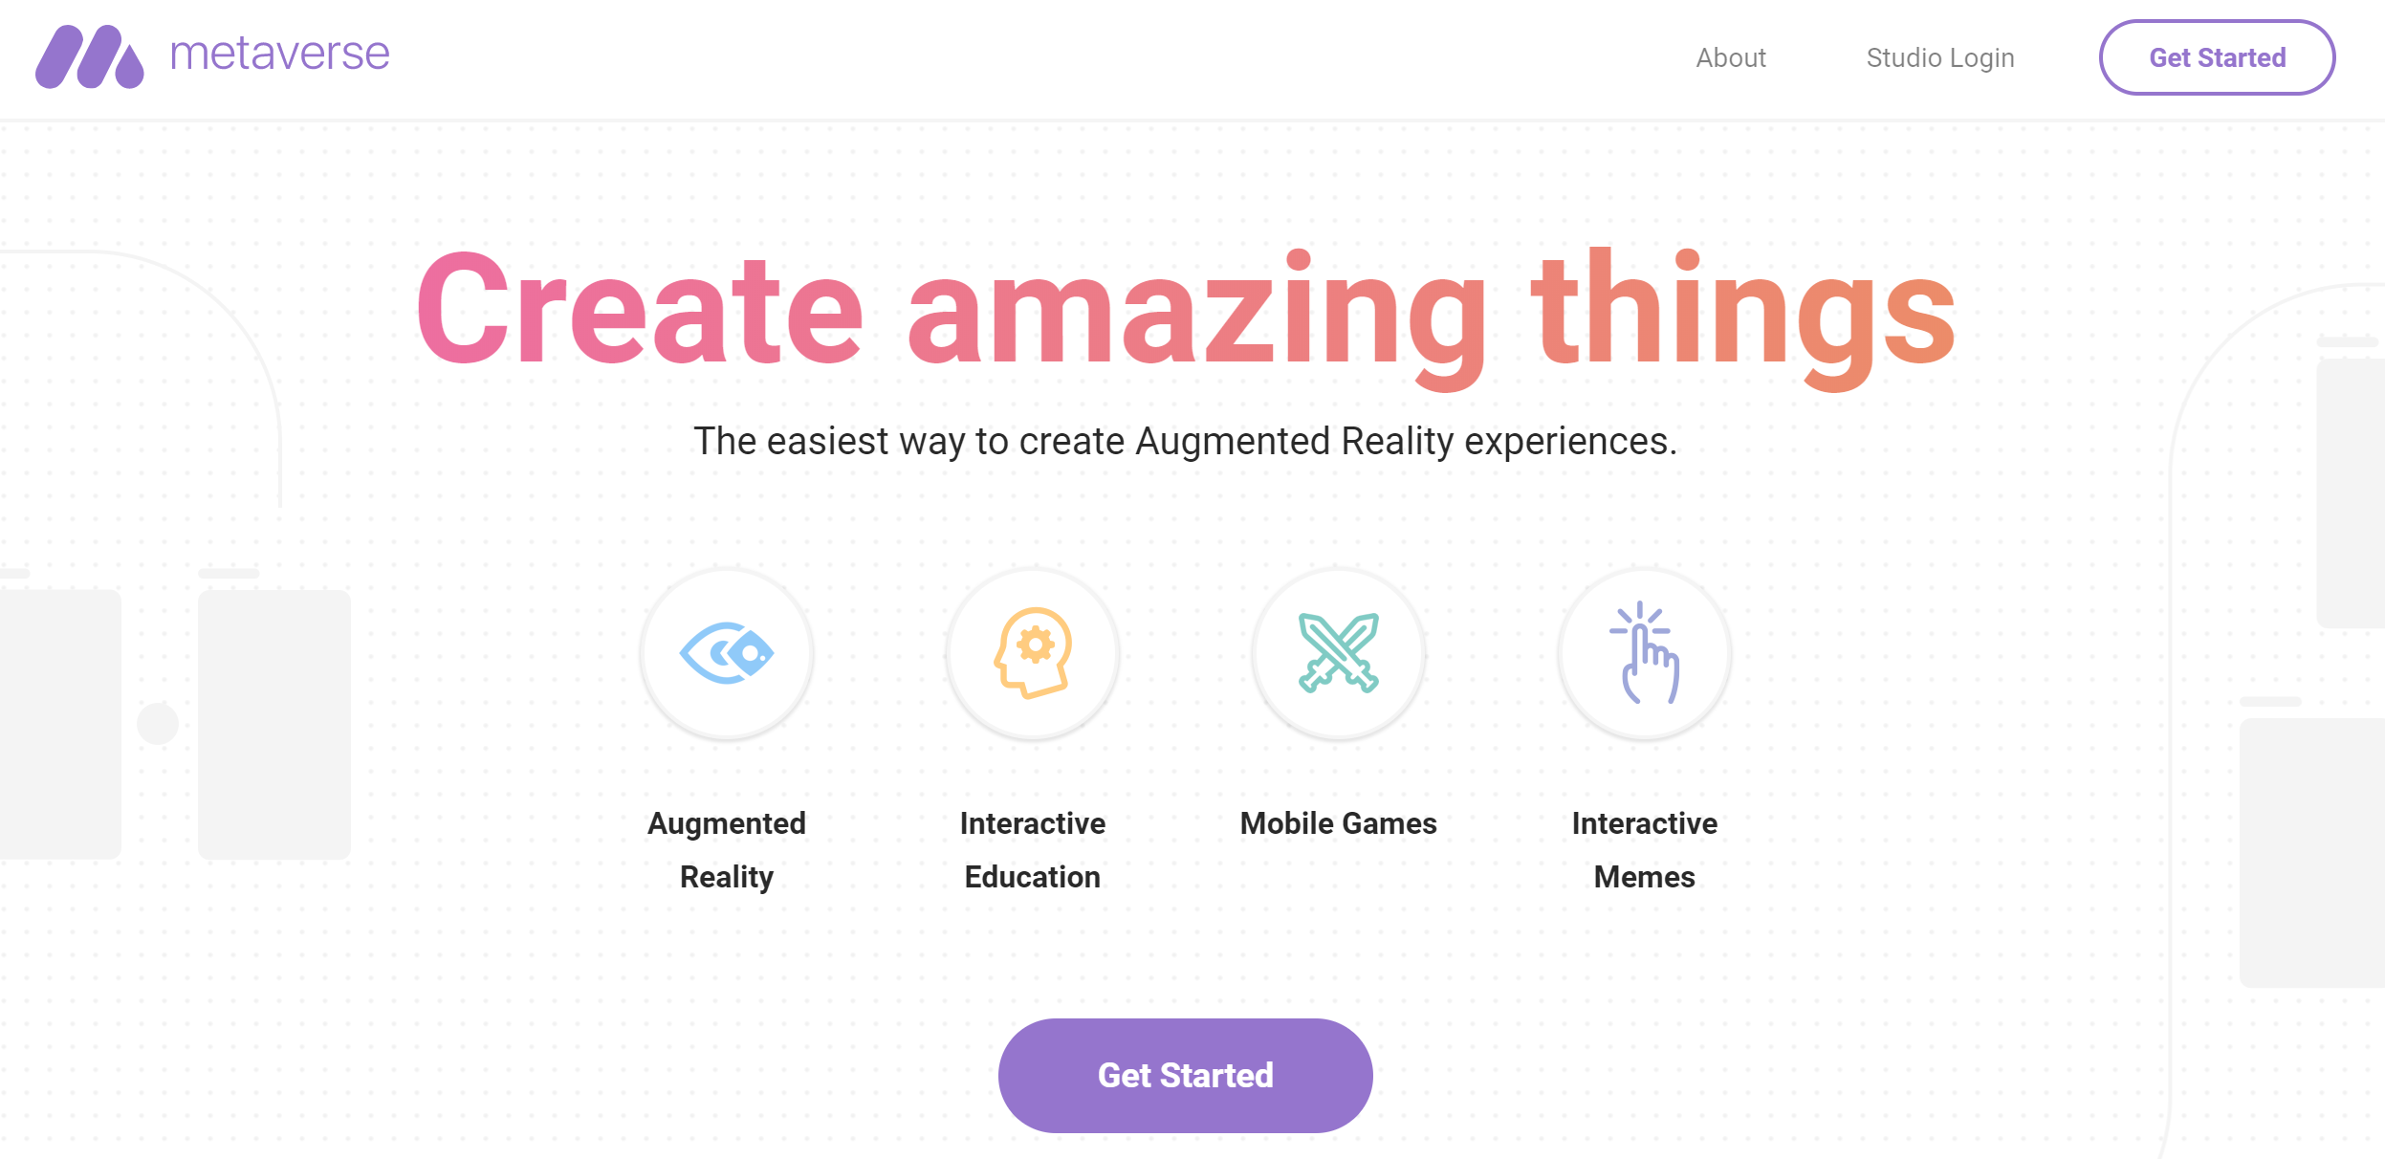
GoMeta.io
Notes:
splashapp.co

Slide 18
DIY Virtual Reality Headset
bit.ly/diyvr

Slide 19
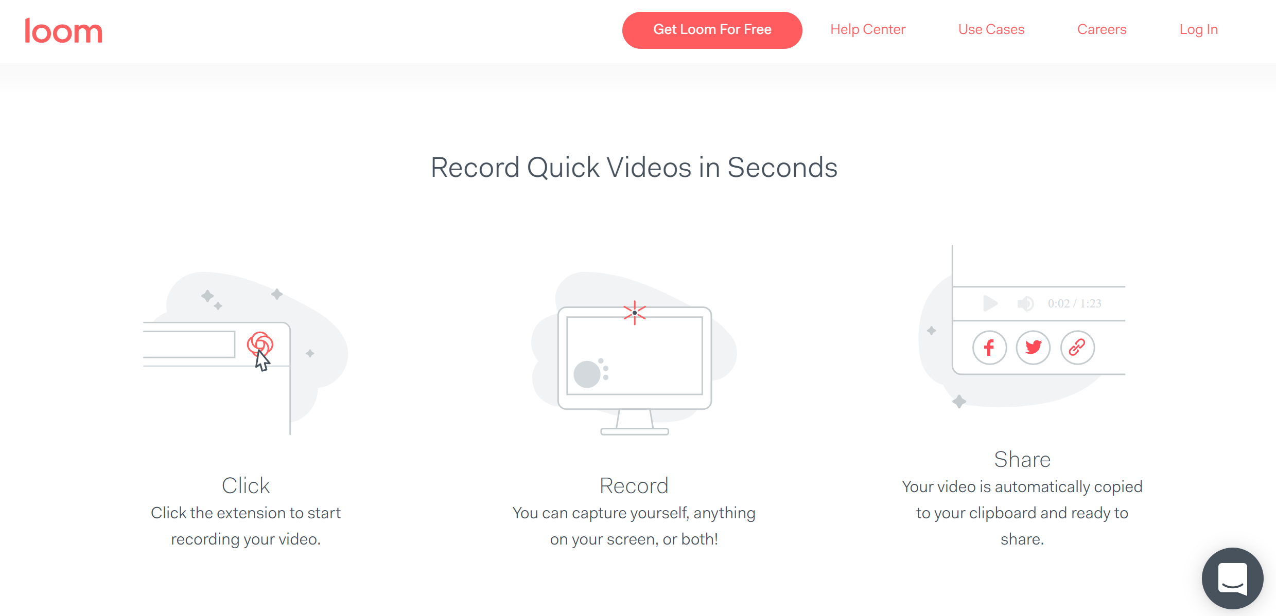
UseLoom.com
Notes:
https://cospaces.io/

Slide 21
Workflow
&
Classroom Management

Slide 22
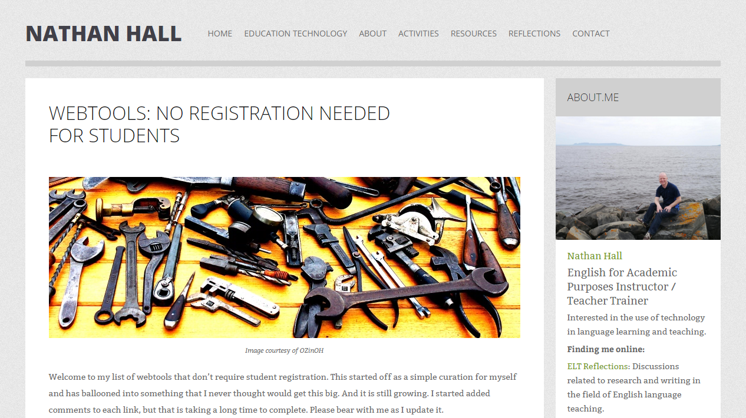
Notes:
https://nathanghall.wordpress.com/webtools-no-registration-needed-for-students/

Slide 26
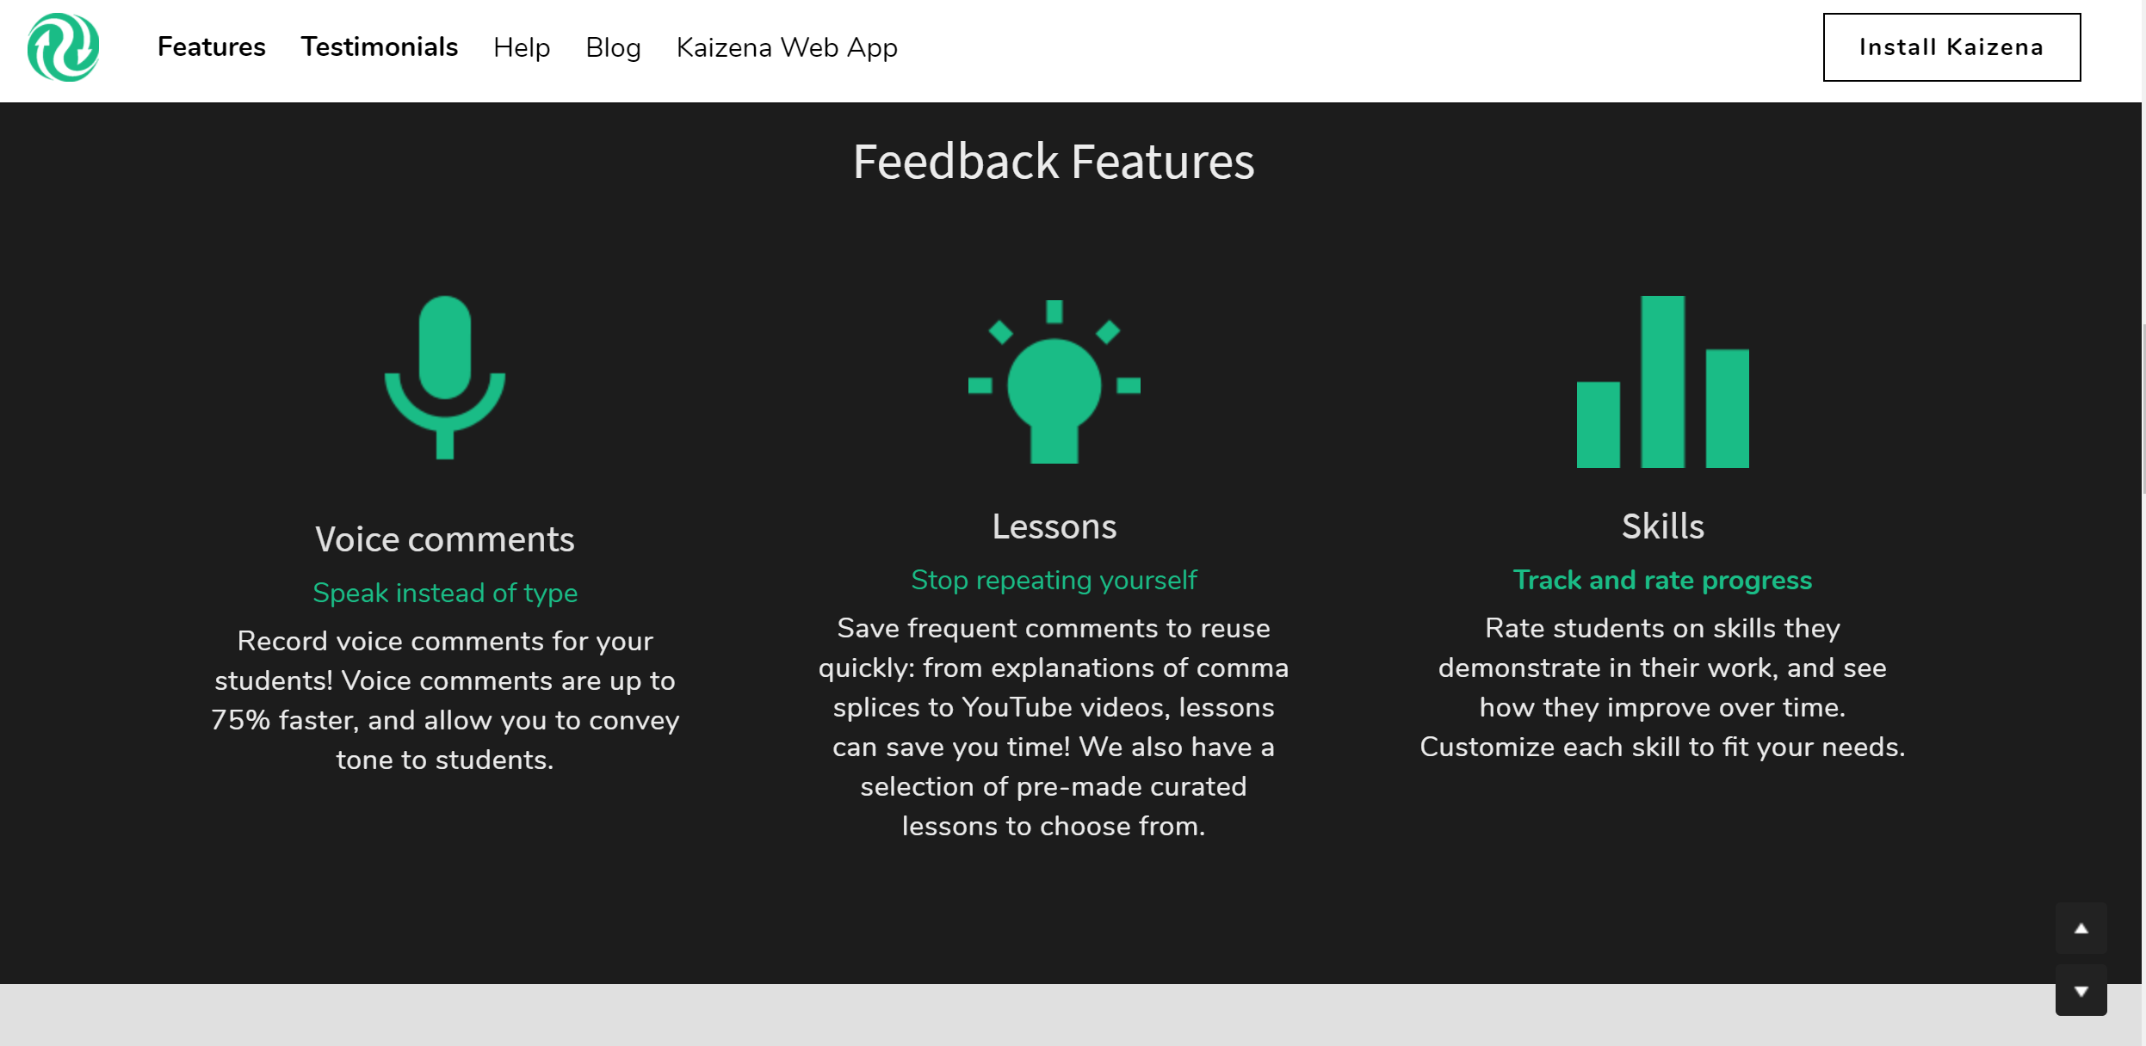
Kaizena.com

Slide 27
QuickKey

Slide 29
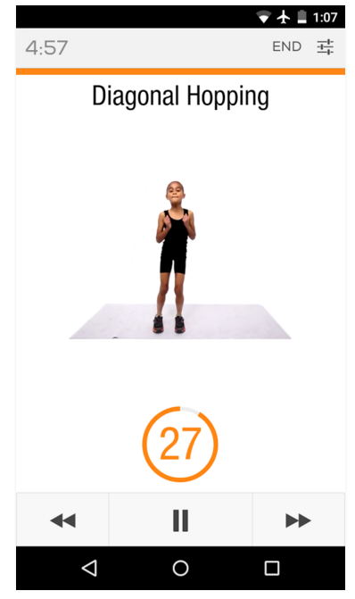

Slide 30
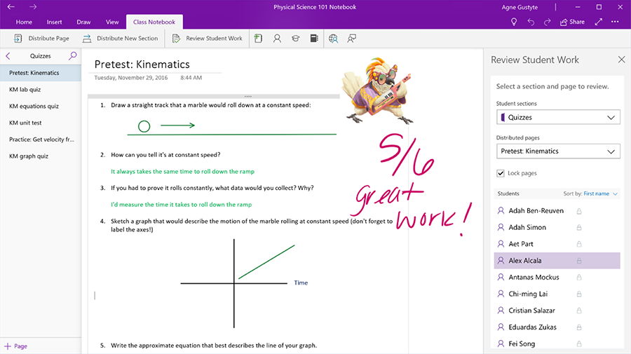
OneNote Page Locking
Notes:
Voice and Picture messages

Slide 31
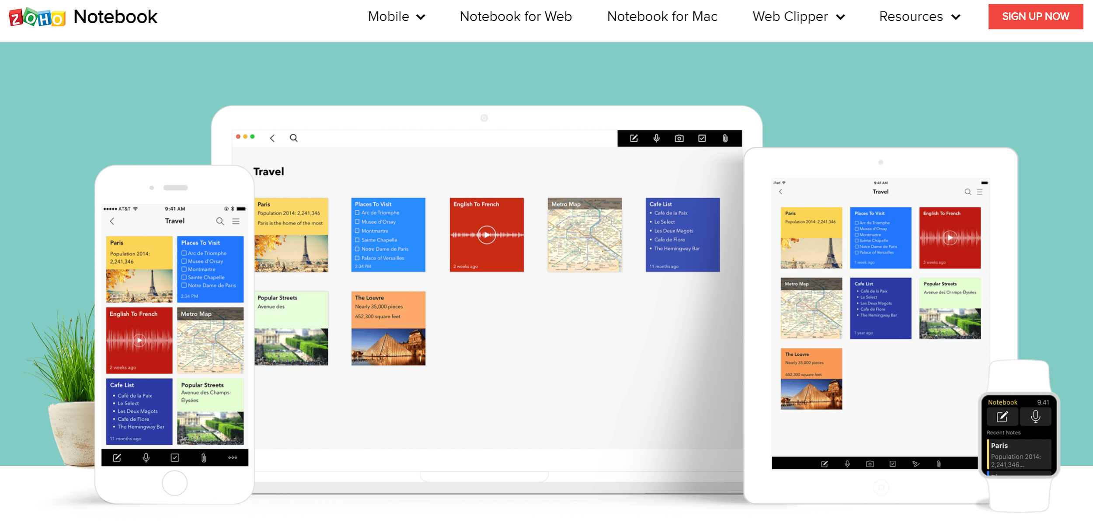
Zoho Notebook

Slide 32
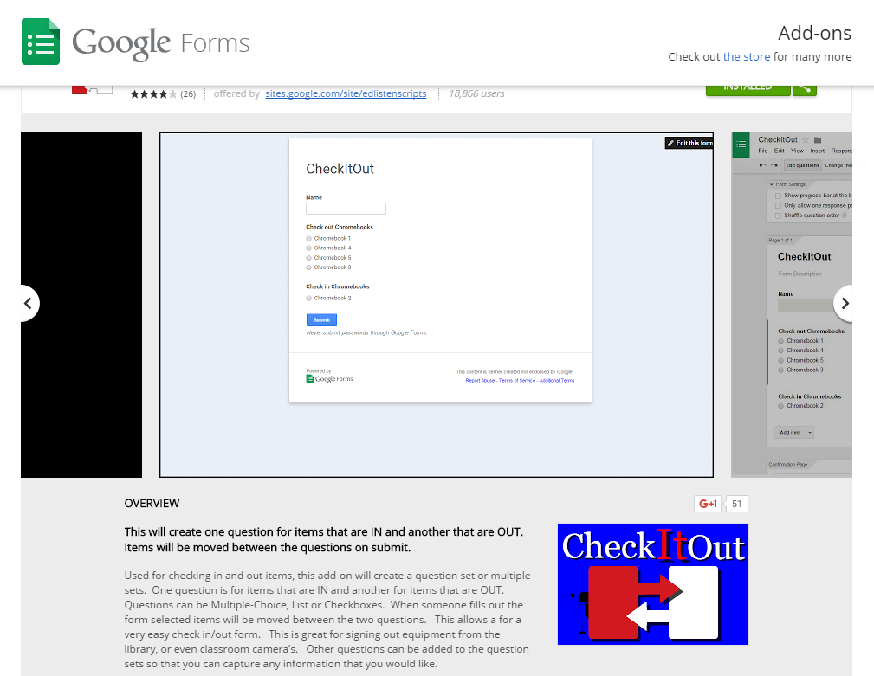
Notes:
Check-in, check-out Google Forms Add-on

Slide 33
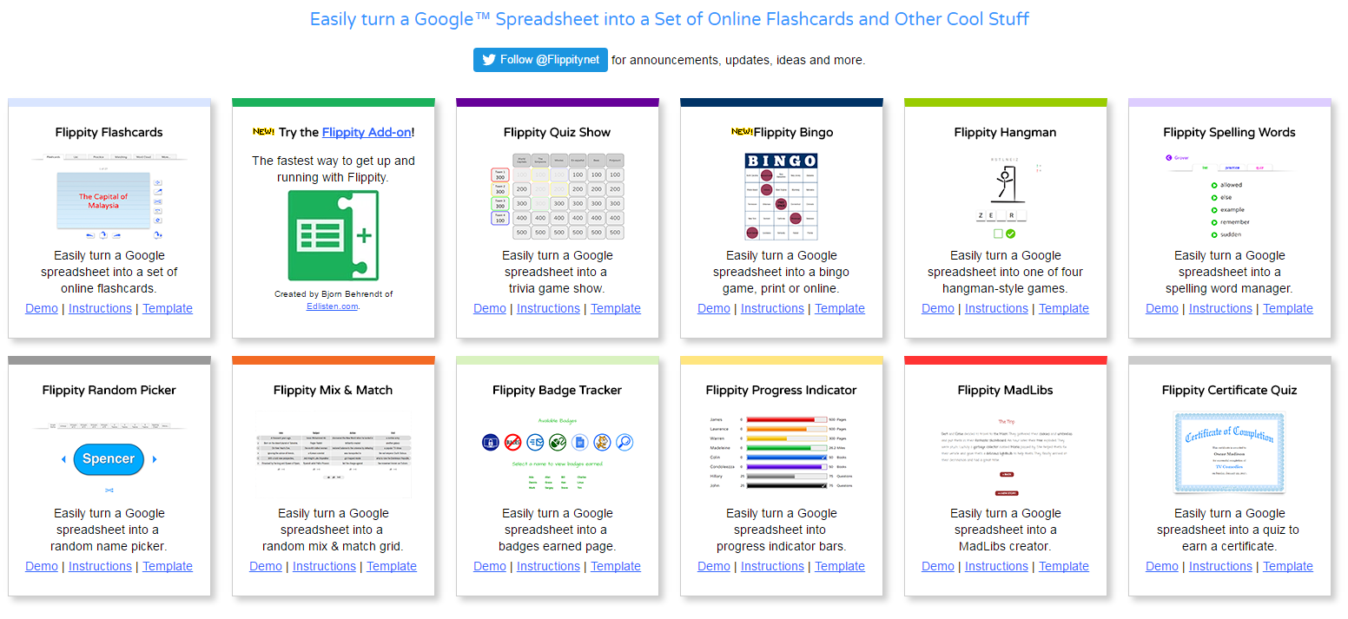
Flippity.net

Slide 34
Exploring & Learning New Things

Slide 35
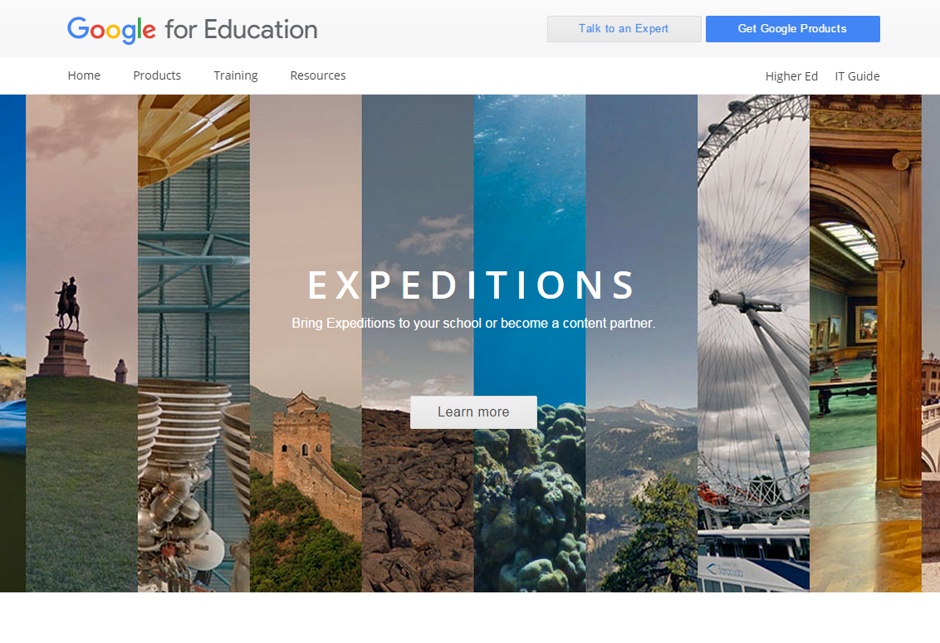

Slide 36
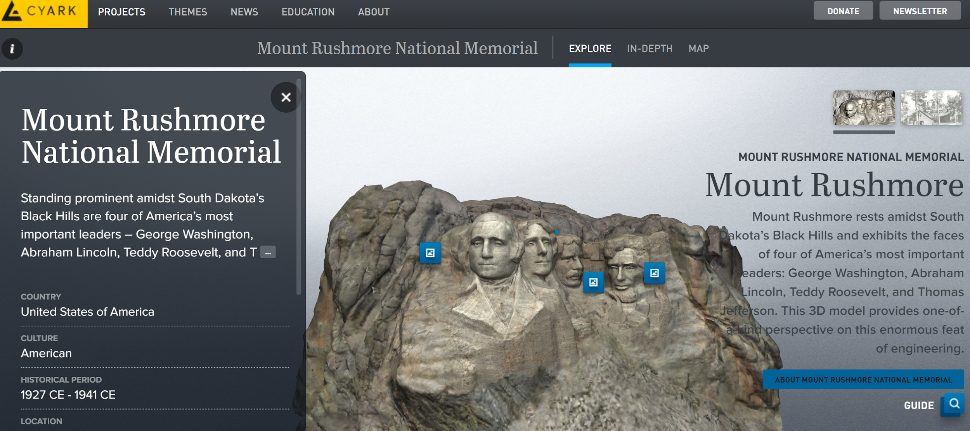
cyark.org/education

Slide 37
bit.ly/xdegrees18

Slide 39
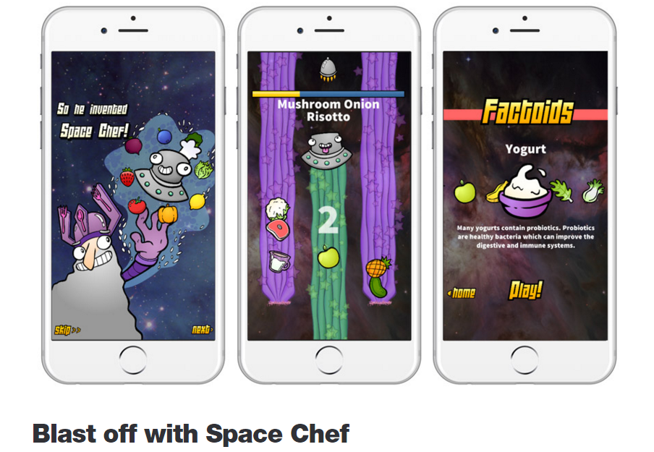

Slide 40
Teach Your Monster to Read
Notes:
https://www.teachyourmonstertoread.com/minigames

Slide 41
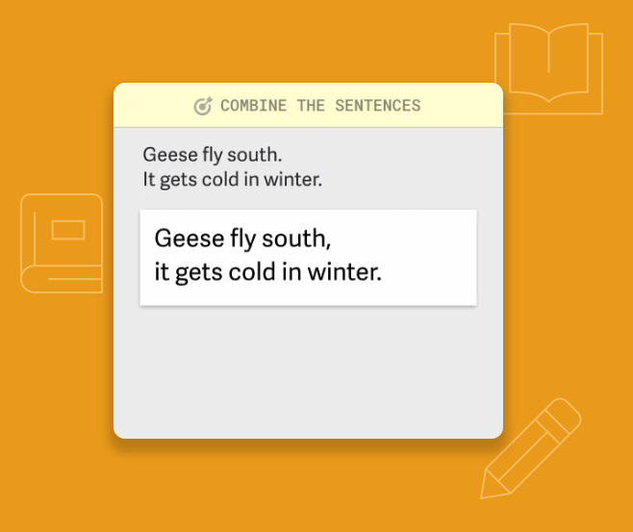
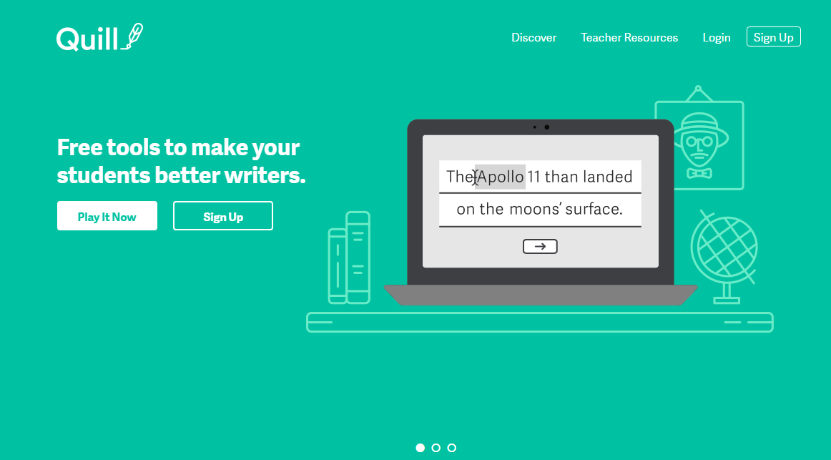
Quill Connect

Slide 42
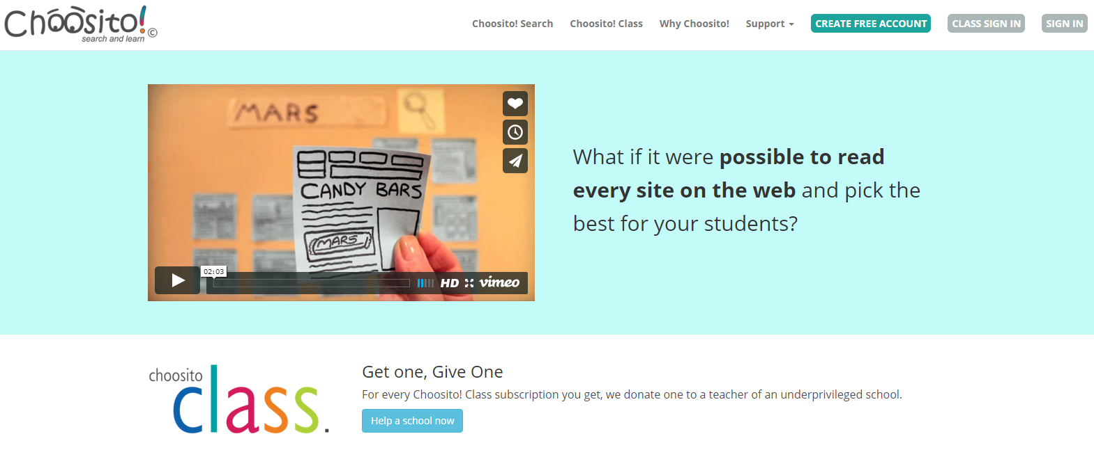

Slide 43
bit.ly/lobster18
bit.ly/woodstovebb

Slide 44
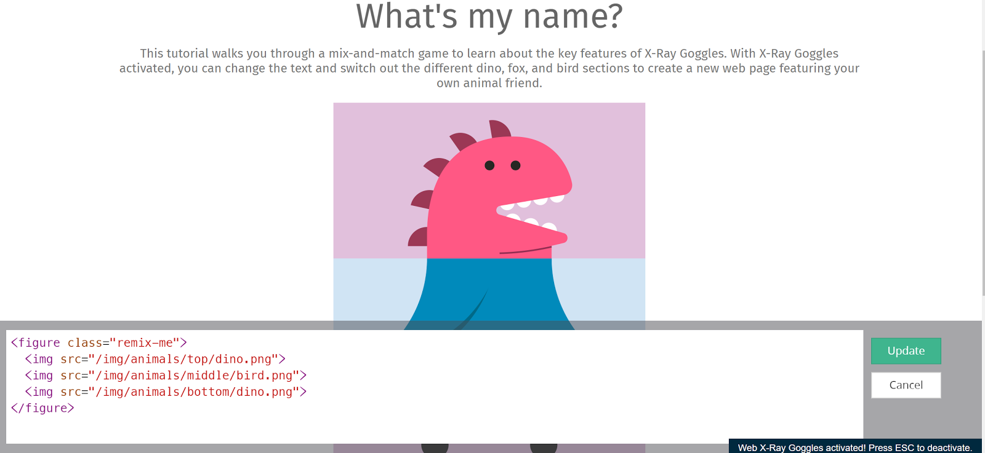
goggles.mozilla.org

Slide 45
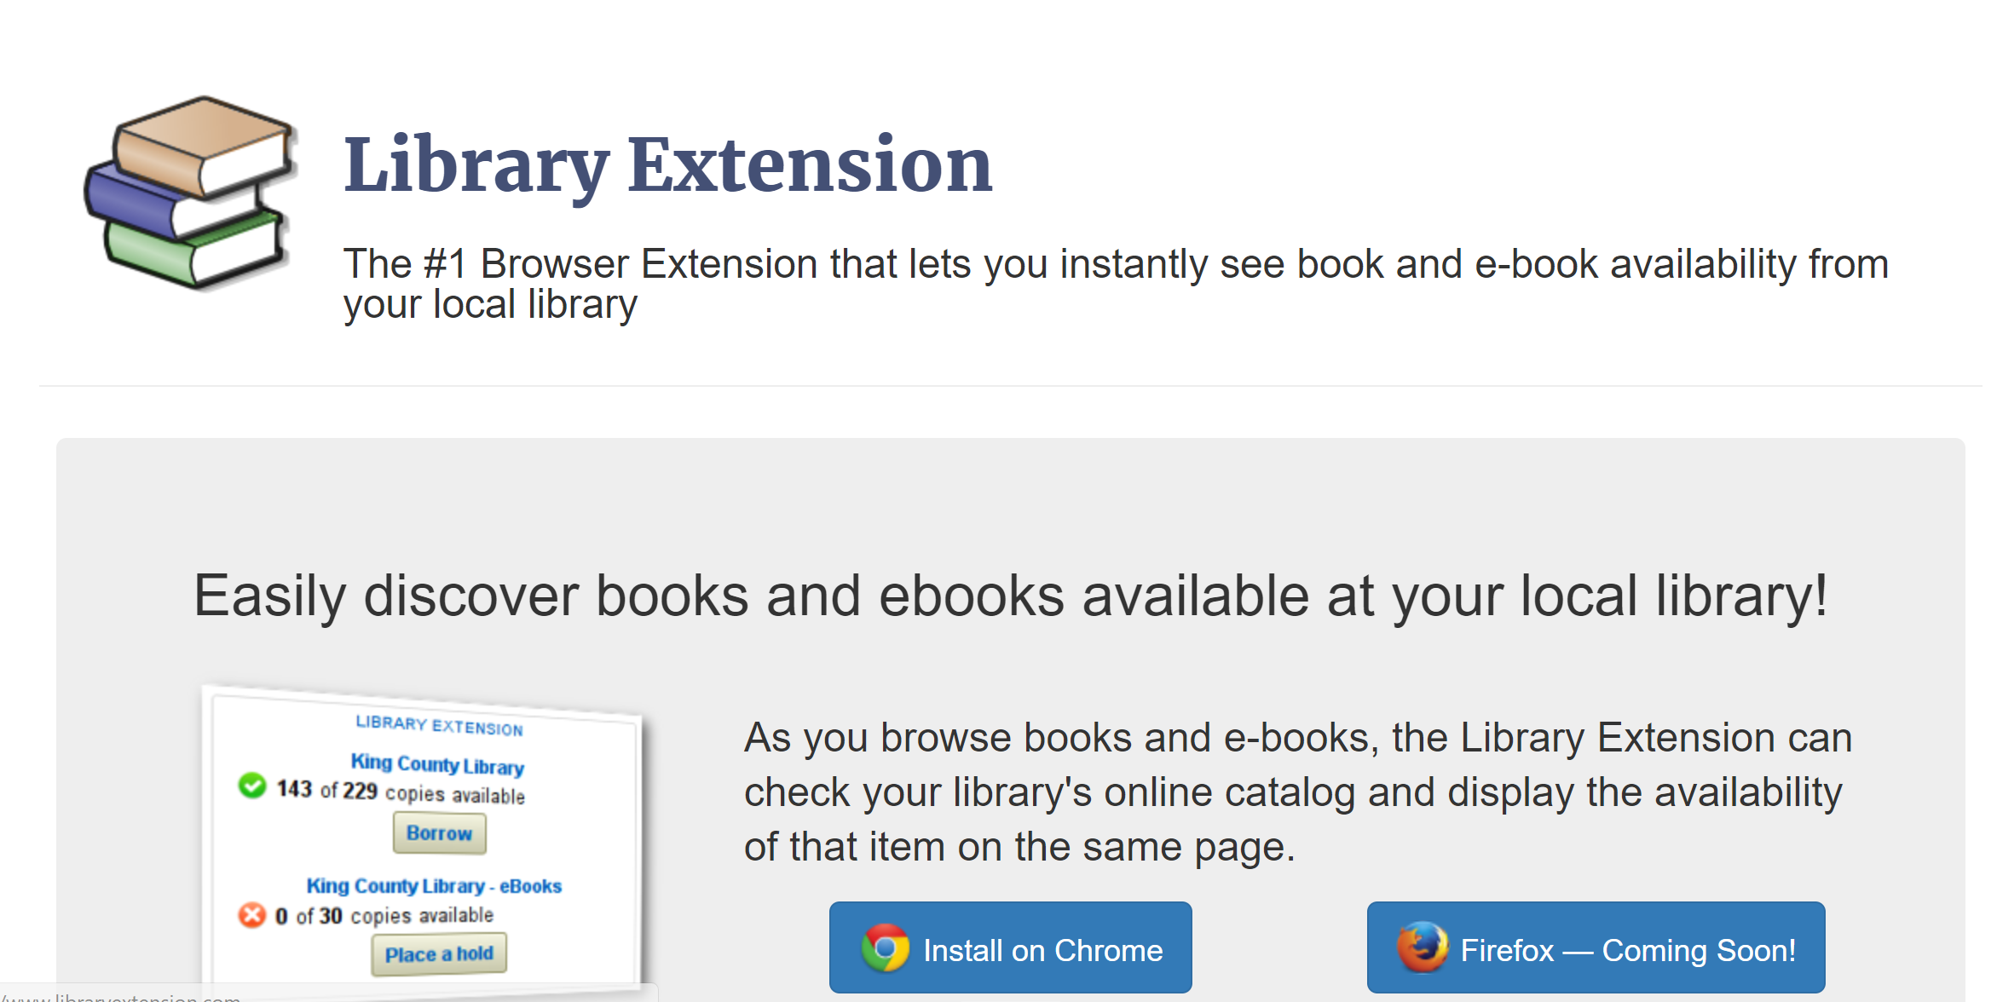

Slide 46
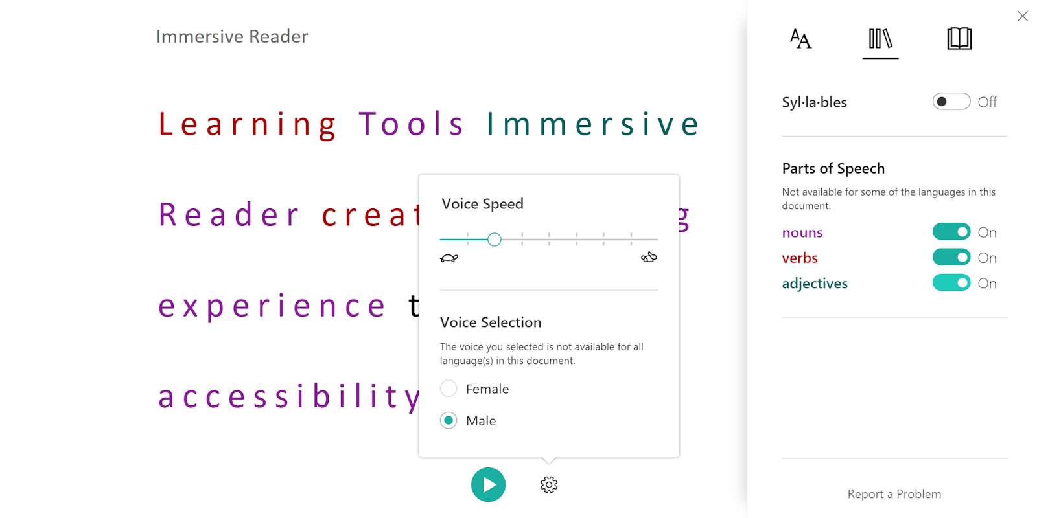

Slide 47
Checking for Understanding

Slide 49
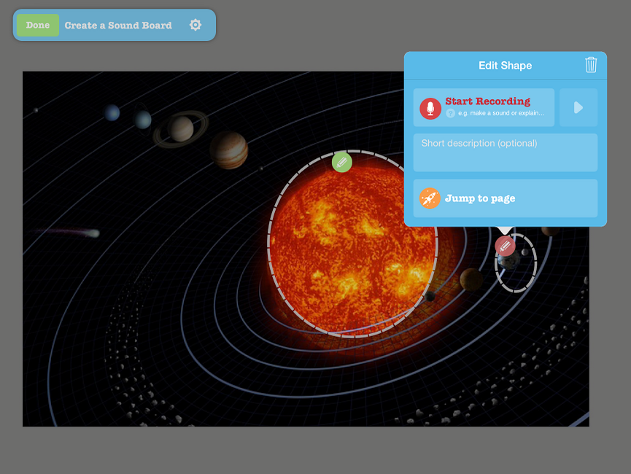

Slide 50
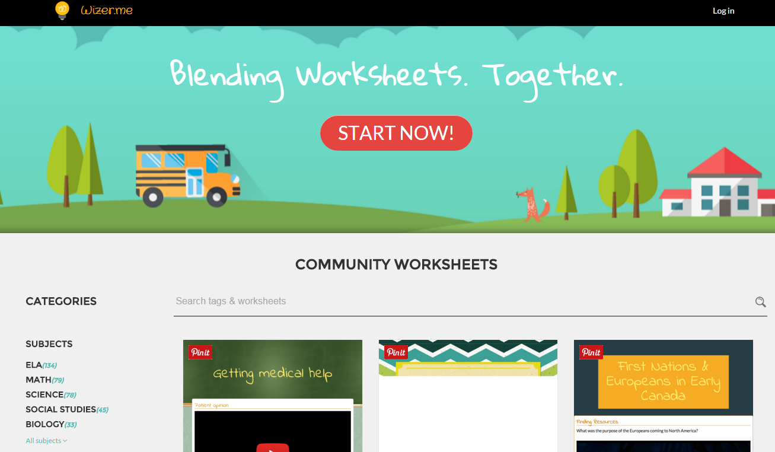

Slide 51
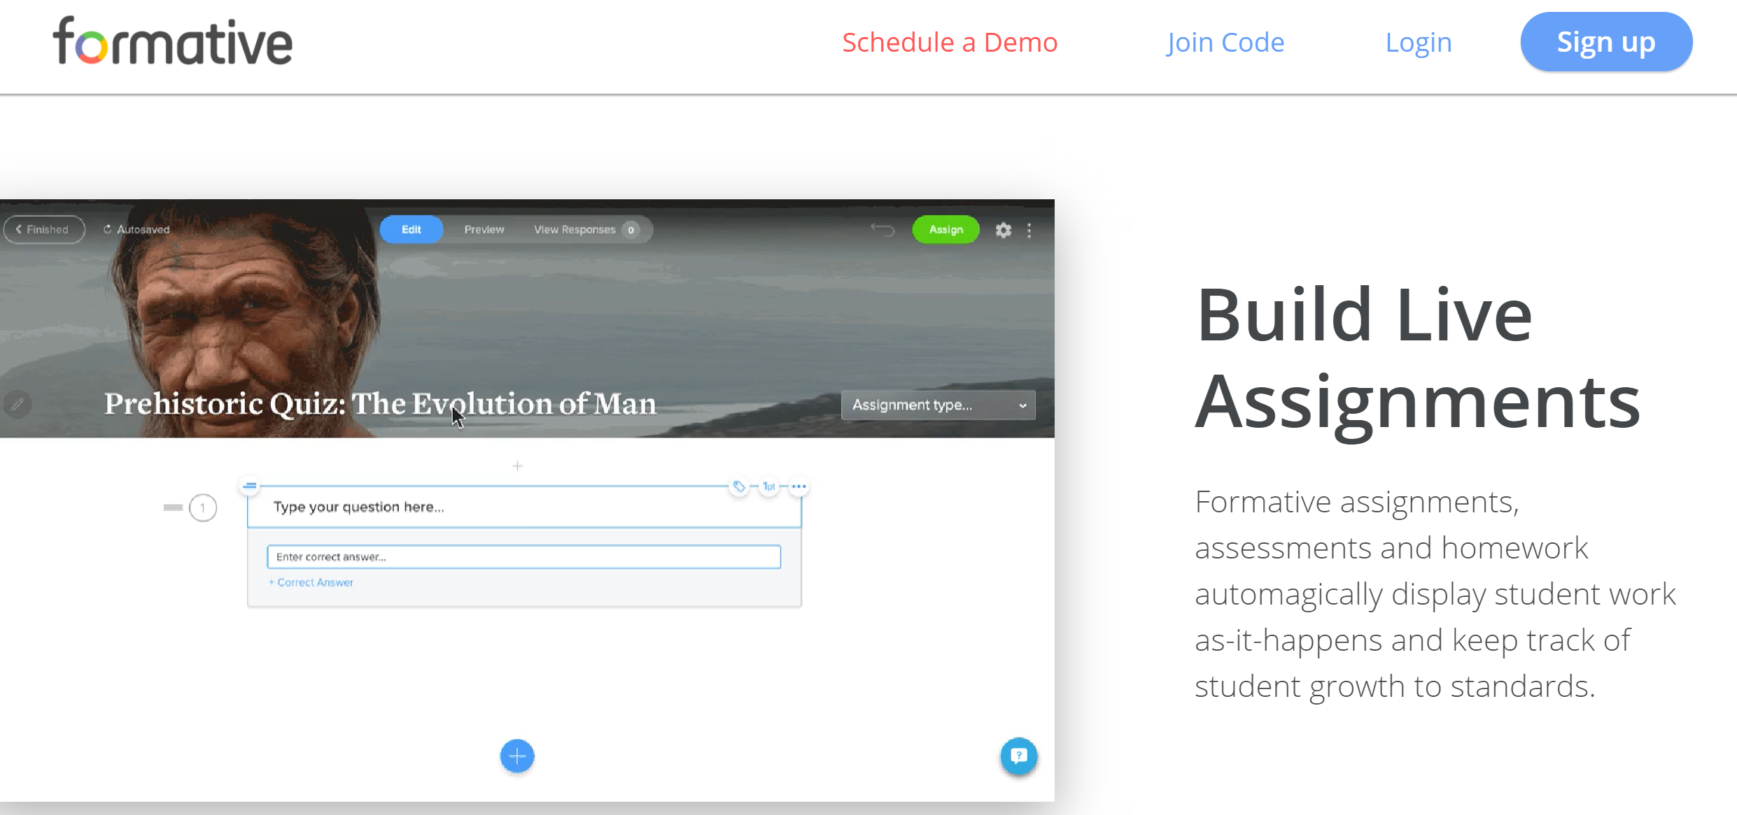
GoFormative.com

Slide 53
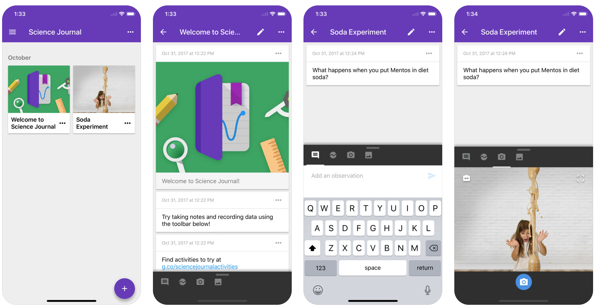
Google Science Journal App

Slide 54
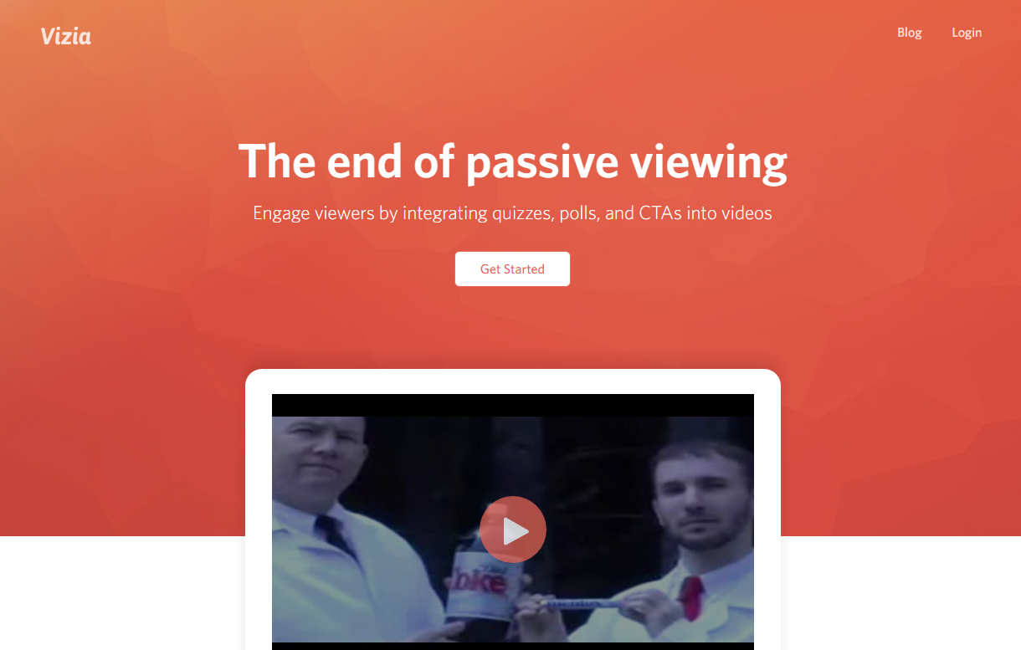

Slide 55
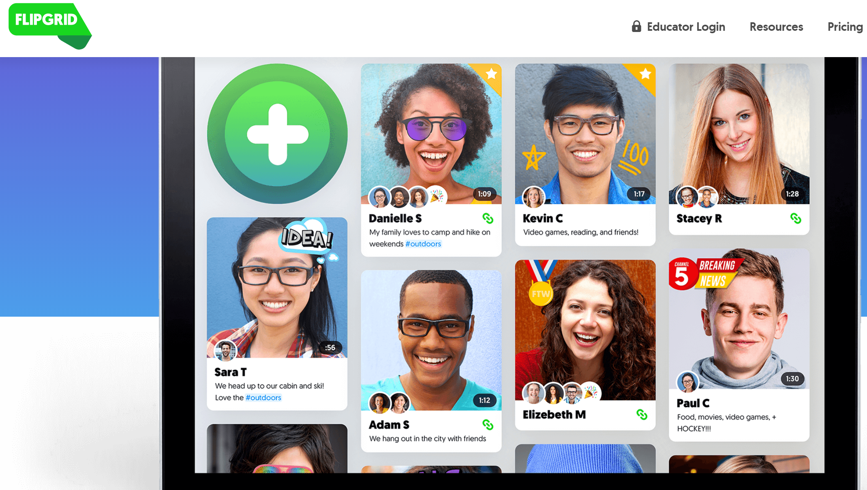
Flipgrid.com

Slide 56
Share your favorite web tool or app for students.
flipgrid.com/b6112f

Slide 57
Get a copy of these slides.
bit.ly/petbow18

