Slide 1
The Myth of the Work/Life Balance for Directors of Small Libraries
Wild Wisconsin winter web conference 2017

Slide 2
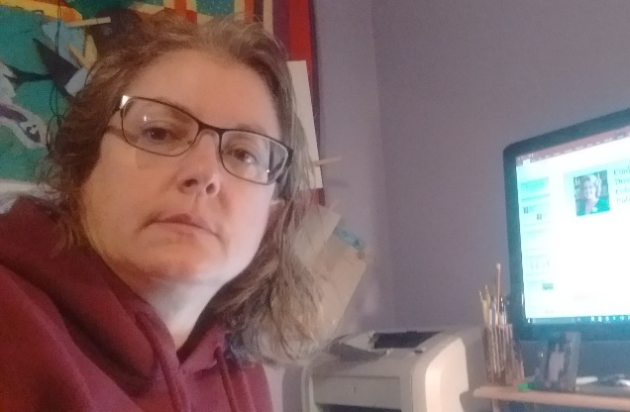
Cindy Fesemyer Director, Columbus Public Library
Cindy Fesemyer everything else
Me
Also me

Slide 3
The day I didn’t create this Powerpoint
It was Friday. I had the day off cuz I had already worked my 40 hours that week and I knew the staff could mange just fine with out me.
The day started with a breakfast meeting to discuss a class SLIS wants me to teach. I walked to the café cuz it was a REALLY nice November day.
I walked home and had just enough time to do a tiny bit of library work before then walking to the salon to get my hair done. Gotta cover that grey.
I started to write this webinar in my head as I walked home from the salon, knowing the whole afternoon was set aside to get it done.
Our friend Scott was home when I got there. We pay him $50 to clean our kitchen and bathrooms every two weeks.
I feel bad being home when Scott is there. Did I mention the beautiful fall weather?
I scrapped the webinar plan and went for a long, slow walk at a nearby State Park, trying out walking meditation for the first time. I was dubious, but actually sorta got into it.
I got home just as the kids were getting home from school.

Slide 4
I had the day off cuz I already worked 80 hours that pay period Work your required weekly hours
30 hours
A lot of hours, at least 50

Slide 5
I had the day off cuz I already worked 80 hours that pay period Work your required weekly hours
I plan my work hours in advance and share them with my staff & family.
I change those hours all the time to accommodate meeting times and last minute opportunities and adjust the rest of the week as necessary.
I like to make my drive worth it by putting in at least 4 hours.
I will work long days (12-15 hours) when necessary. And take a day off sometime in that pay period.

Slide 6
Your turn!
Which organizational tools help keep you sane?

Slide 7
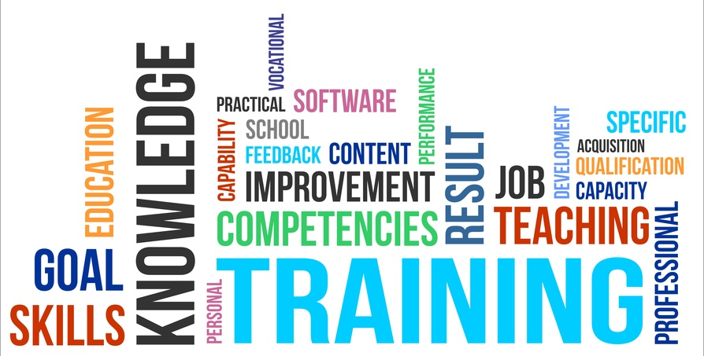
I knew the staff could mange just fine with out me Train early and often
Make sure you have dedicated staff or volunteer or trustee training time
Create a training checklist or manual
Have other staff do trainings, too
Creates staff leaders
Trainees learn different approaches to tasks

Slide 8
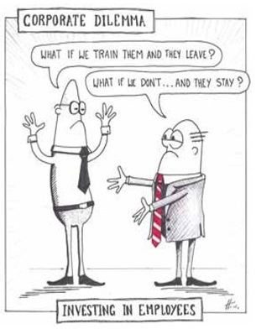
I knew the staff could manage just fine with out me Cross train
Staff can cover for each other
Cross training increases collaboration
Helps everyone see a bigger picture
Update written procedures for a good training outcome
Can you cross train a trustee or municipal employee to do a part of your job that isn’t appropriate for staff to do?

Slide 9
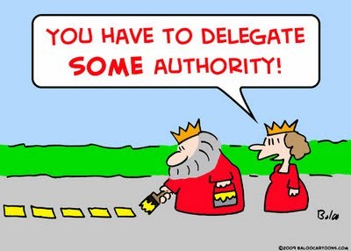
I knew the staff could mange just fine with out me Delegate
Who’s in charge when you’re away?
Can they help patrons and keep the place from burning down?
Trust them to do their job.
What are you doing that someone else can easily do instead?
Be smart about it. Can staff reach you when you’re out of the building?

Slide 10
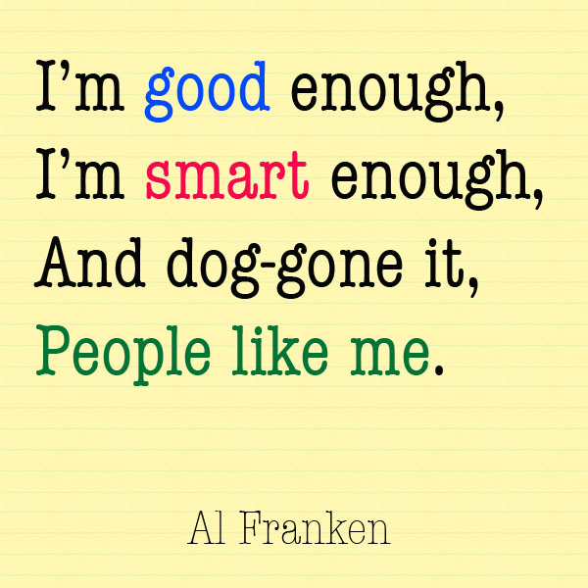
I knew the staff could mange just fine with out me Embrace good enough
So what if a staff person didn’t do that thing the same way you would have?
“Good enough” is just fine if it gives you some well-earned time away
“Good enough” can be “great” if you use this as a teaching moment for next time.

Slide 11
Your turn!
What tasks are important for multiple people to know how to perform?
Do you have a great training manual, template or list that you’d be willing to share with us?

Slide 12
The day started with a breakfast meeting to discuss teaching a class Feel like a professional
Important to keep small libraries on the professional stage
Find time to develop your professional interests
On work time if there’s a good tie in
On your own time if there isn’t
What are you good at that you don’t get to do enough of at the library?
What do other library pros ask you for advise on? Pitch a WAPL session on it!

Slide 13
Your turn!
How are you professionally awesome?
What session should you pitch for WAPL or WLA?

Slide 14
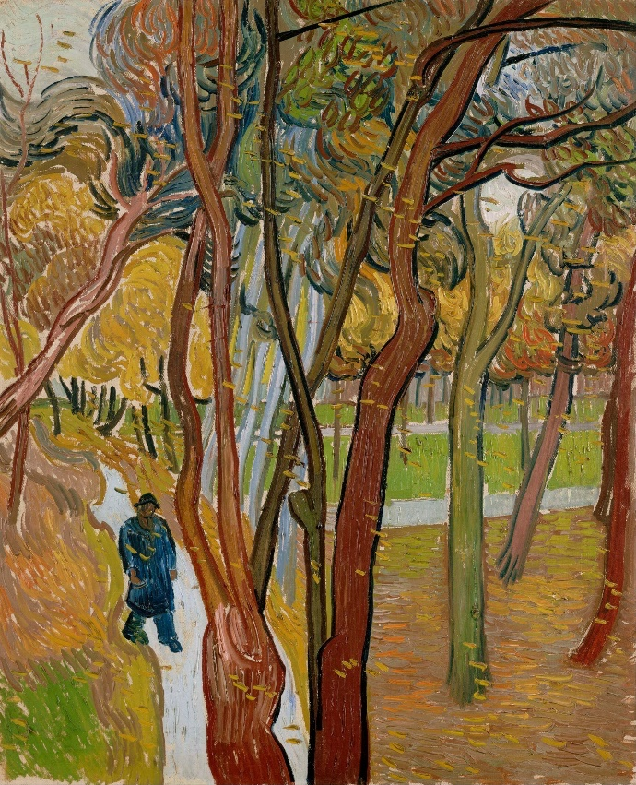
I walked to the café cuz it was a REALLY nice November day.
Enjoy your own company now and then
Find small moments for yourself by building them into stuff you have to do anyway.
Walk there
Grab your favorite coffee drink along the way
Read a great book while you lunch between meetings
Take the dog on a long walk while you ponder your WAPL session pitch

Slide 15
I had just enough time to do a tiny bit of library work . . . Limit working hours when off the job
Keep up with the library on days off when things are happening that need your attention
Check in sparingly
Don’t make it easy to check your work email on your phone
Add that time to your 40 hours that week. Work from home is work.
If there’s nothing pressing at the library, don’t check in

Slide 16
. . . before walking to the salon to get my hair done. Keep up on your own needs & wants
Use your time off to do the things that makes you feel a little more human.
Nobody likes a martyr who can’t take care of themselves.
Build some me-time into errands.
Coffee and news headline break
Indian buffet for lunch

Slide 17
Your turn!
What’s a little thing you do for yourself that makes you feel like you finally have your shit together?

Slide 18
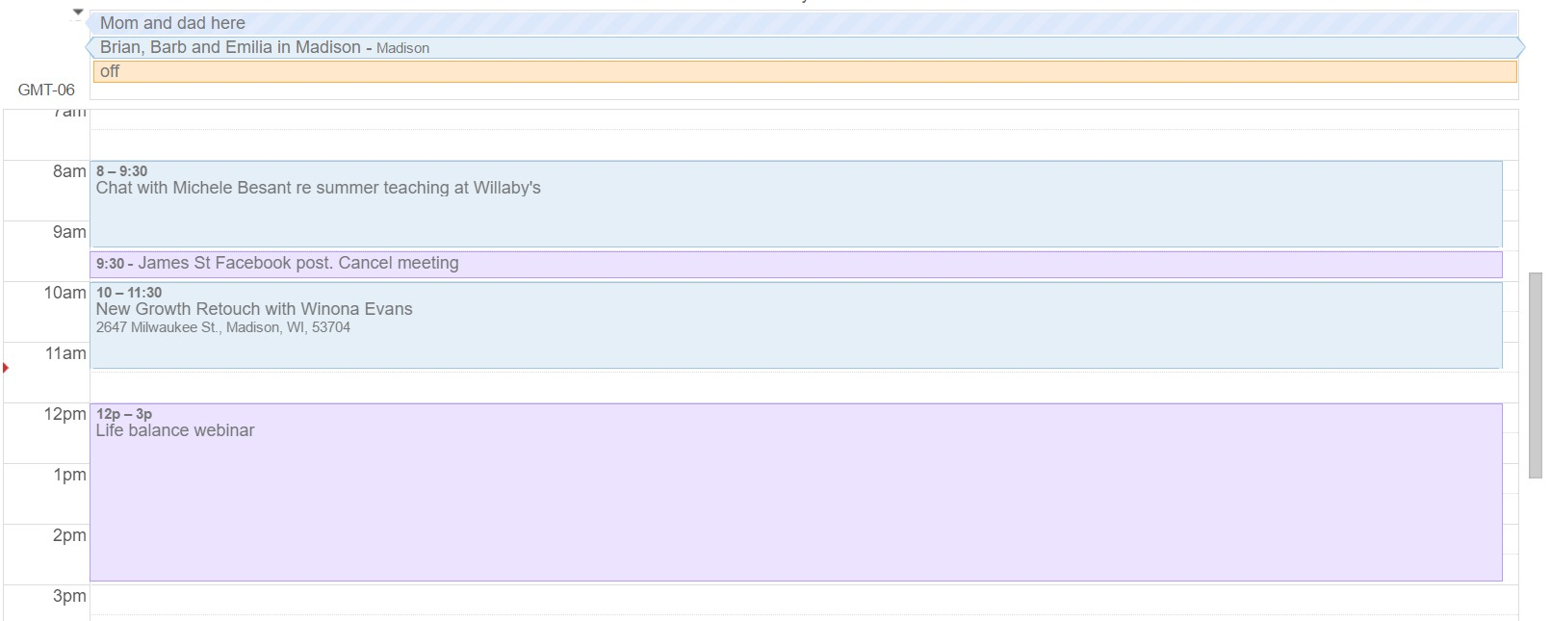
I started to write this webinar in my head as I walked home from the salon, knowing the whole afternoon was set aside to get it started. Plan how you’ll use your time off

Slide 19
We pay Scott $50 to clean our kitchen and bathrooms every two weeks Delegate & cross train in your personal life, too
Who can help you at home?
Partner
Kids
BFF
Neighbors
Paid help
Be ok with “good enough”

Slide 20
I feel bad being home when Scott is there. Get over the guilt
This is something I WANT to know how to do. I have no platitudes or “wise” words for ya’.

Slide 21
Did I mention the beautiful fall weather? I scrapped the webinar plan and went for a long, slow walk at a nearby State Park, trying out walking meditation for the first time. I was dubious, but actually sorta got into it Take a chance on something new
Ask people you respect what they do to relax or have fun or learn something new. Whatever it is you want more of in your life.
Keep an open mind
Put a new spin on something you already know you like to do
Try hard to not think of the library or the house or the kids or your cat or the holiday party or what you’ll make for dinner

Slide 22
Your turn!
What’s something you kinda want to explore that might help you enjoy your downtime more? Or something your closest friends keep telling you to check out?

Slide 23
I got home just as the kids were getting home from school Make time for the truly important stuff in life
My list of important stuff that has nothing to do with libraries
Family
Bitches Collective
Travel
Nature
Reading
Good coffee
What’s on your list?

Slide 24
Questions? Thoughts? Tips?

Slide 25
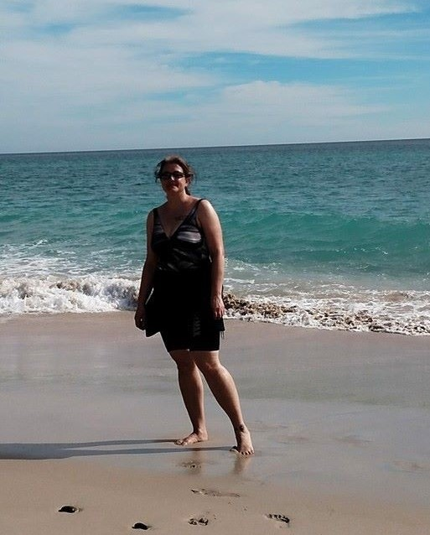
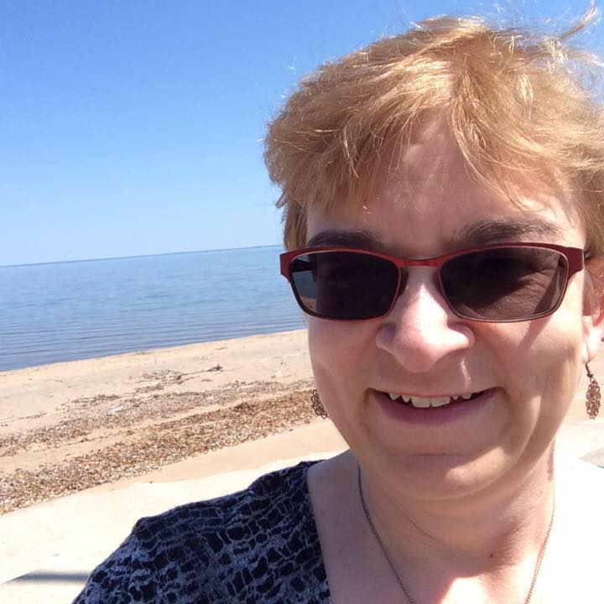
Thank you!
Cindy Fesemyer
cindyLfes@gmail.com
Jean Anderson
Jean@scls.info

