Slide 1
“Always say ‘yes’
to the present moment...
“Say ‘yes’ to life and see how life
starts suddenly to work for you
rather than against you.”
- Eckhart Tolle

Slide 2
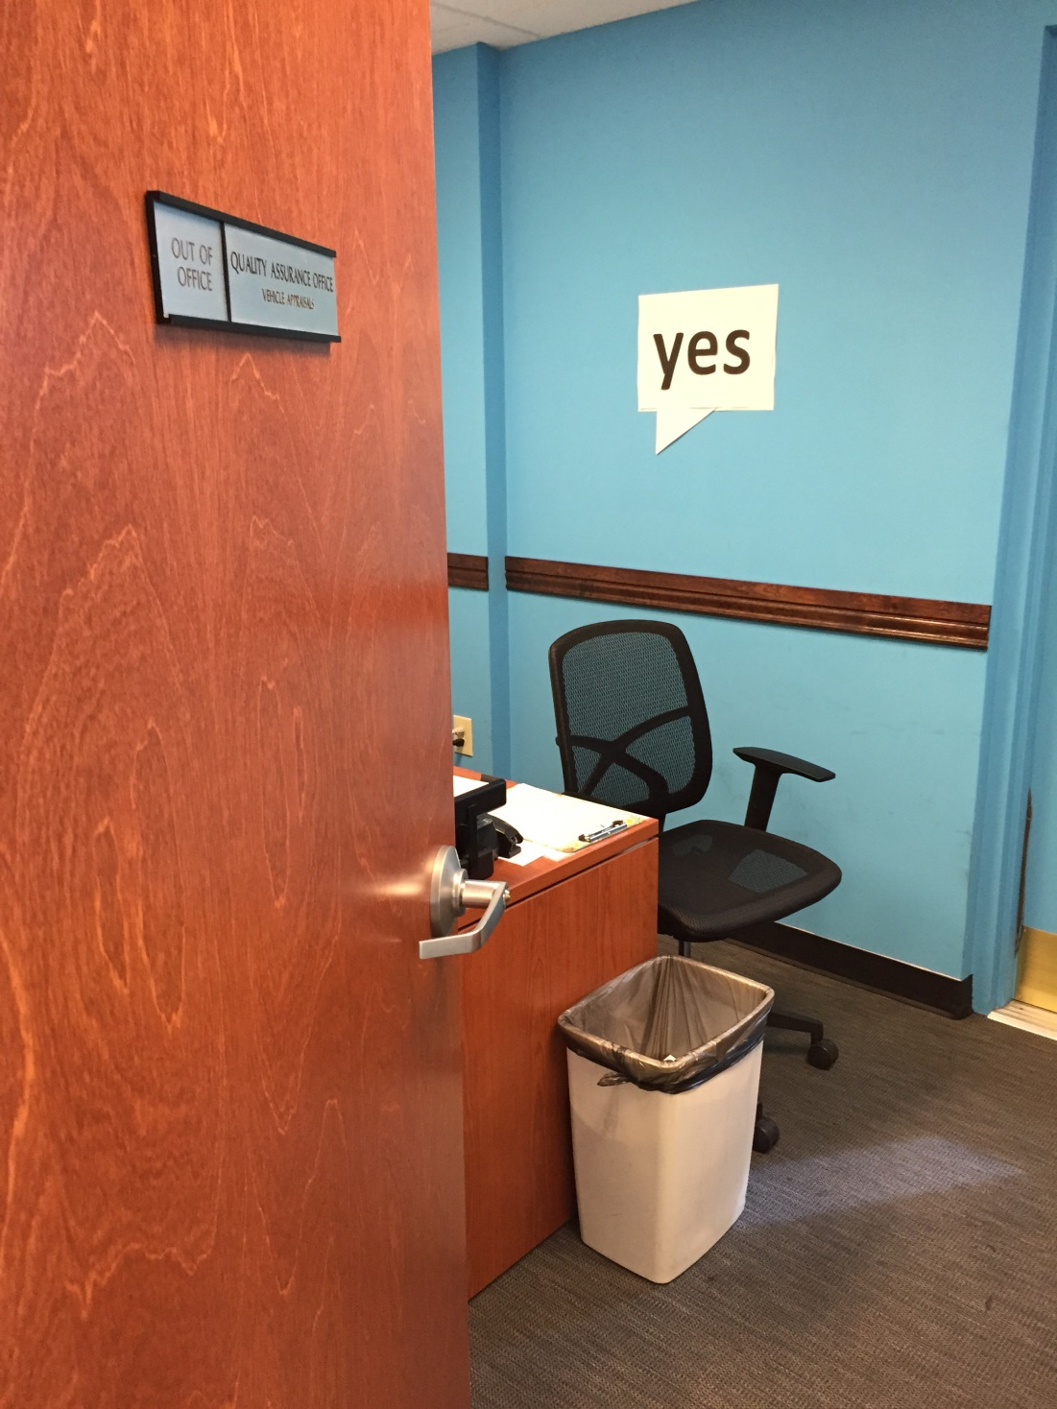
Creating a ‘Culture of Yes’ at Your Library and In Your Community
Kieran Hixon & Sharon Morris Colorado State Library

Slide 3
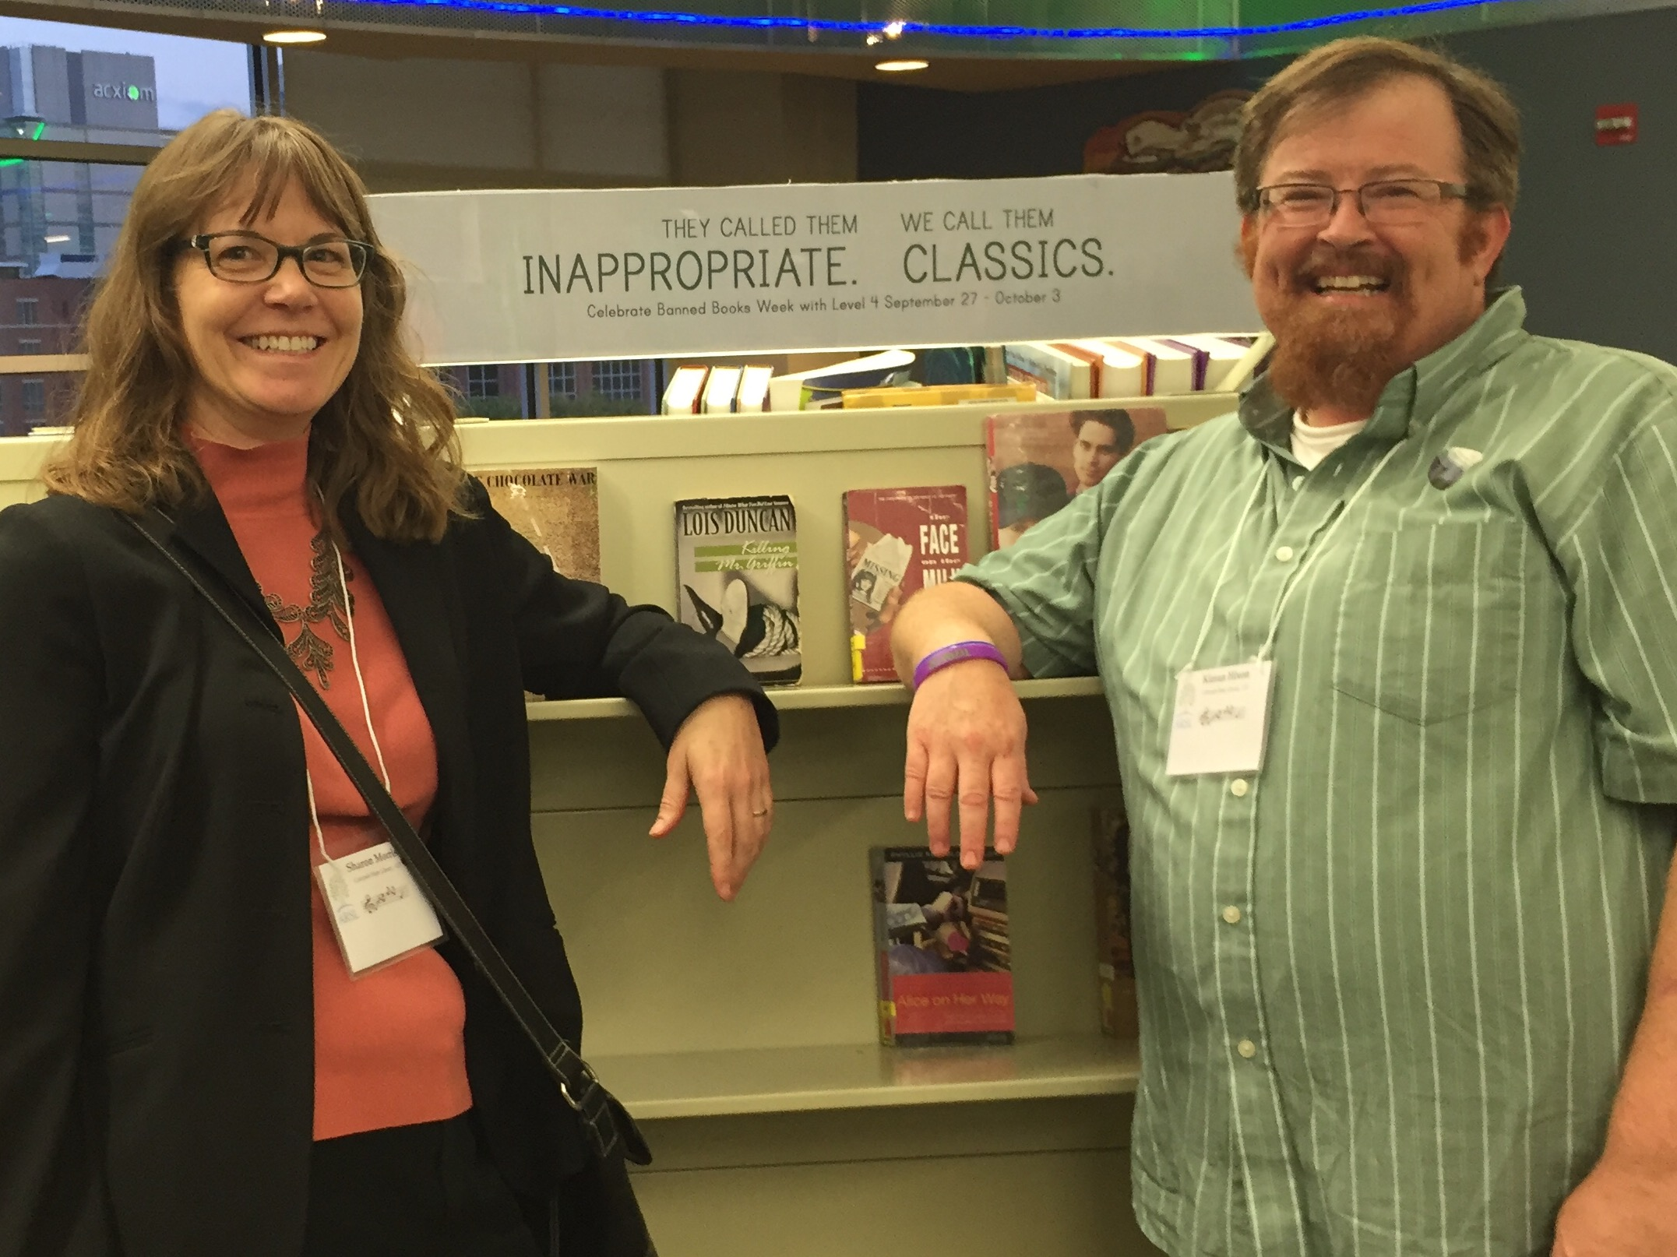

Slide 4
Observed at a library…

Slide 6
First Impressions?

Slide 7
Library First Impressions

Slide 8
Library – Yes, but

Slide 11
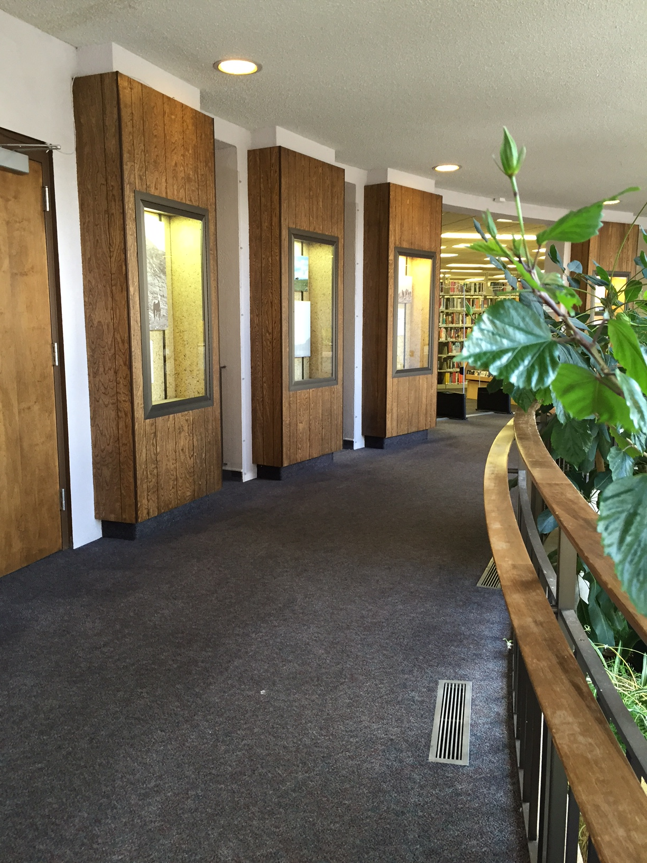

Slide 15
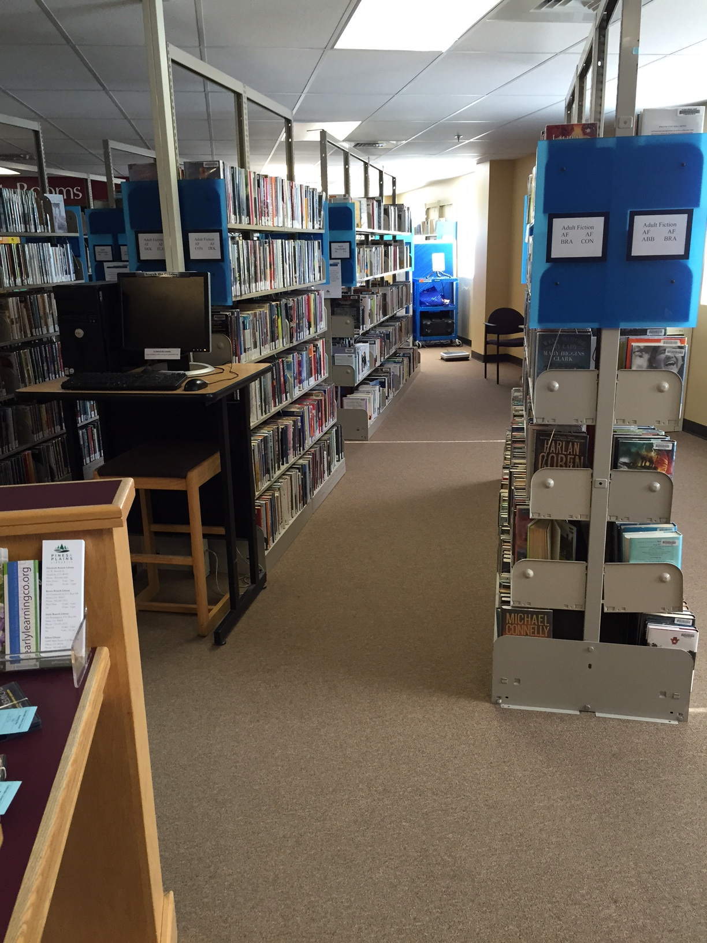
Collections

Slide 16
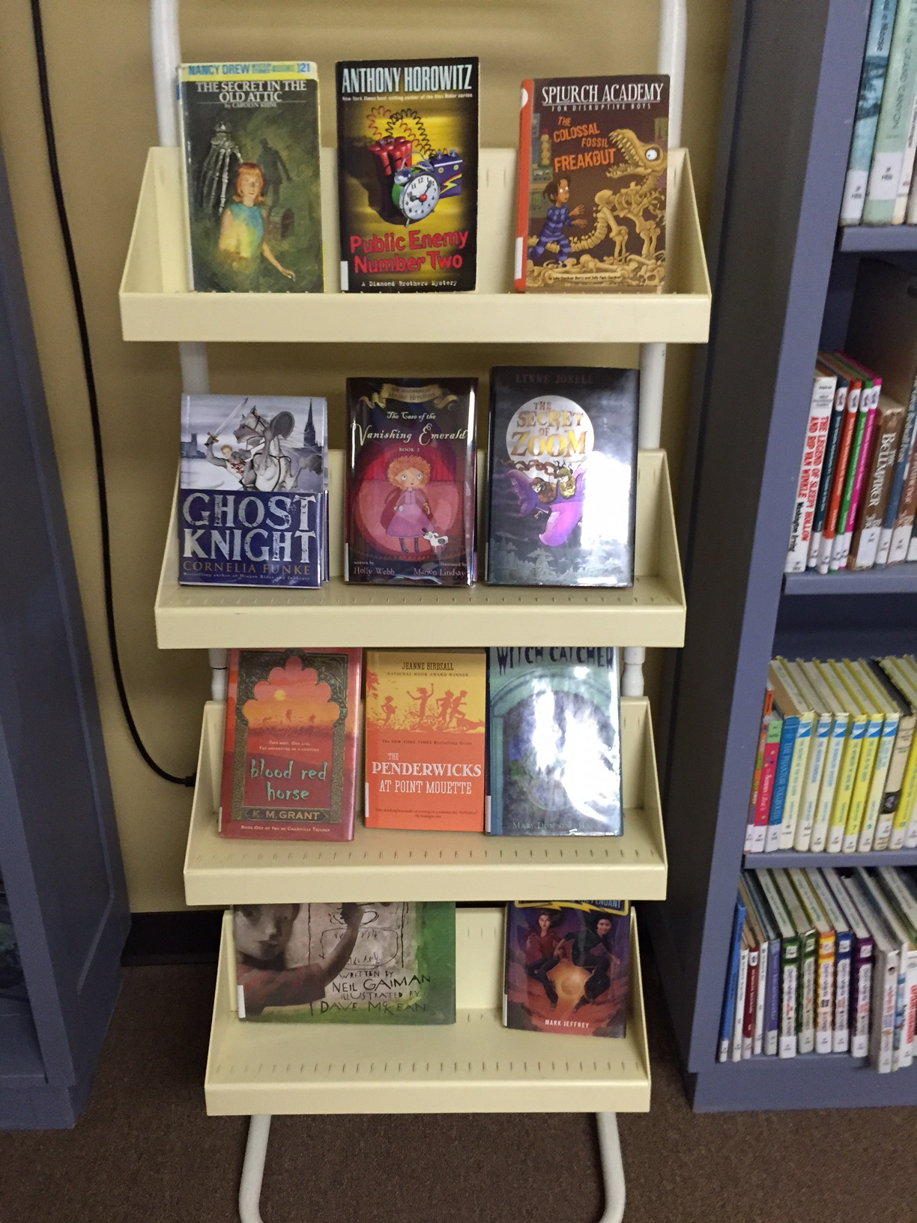
Yes, but …

Slide 17
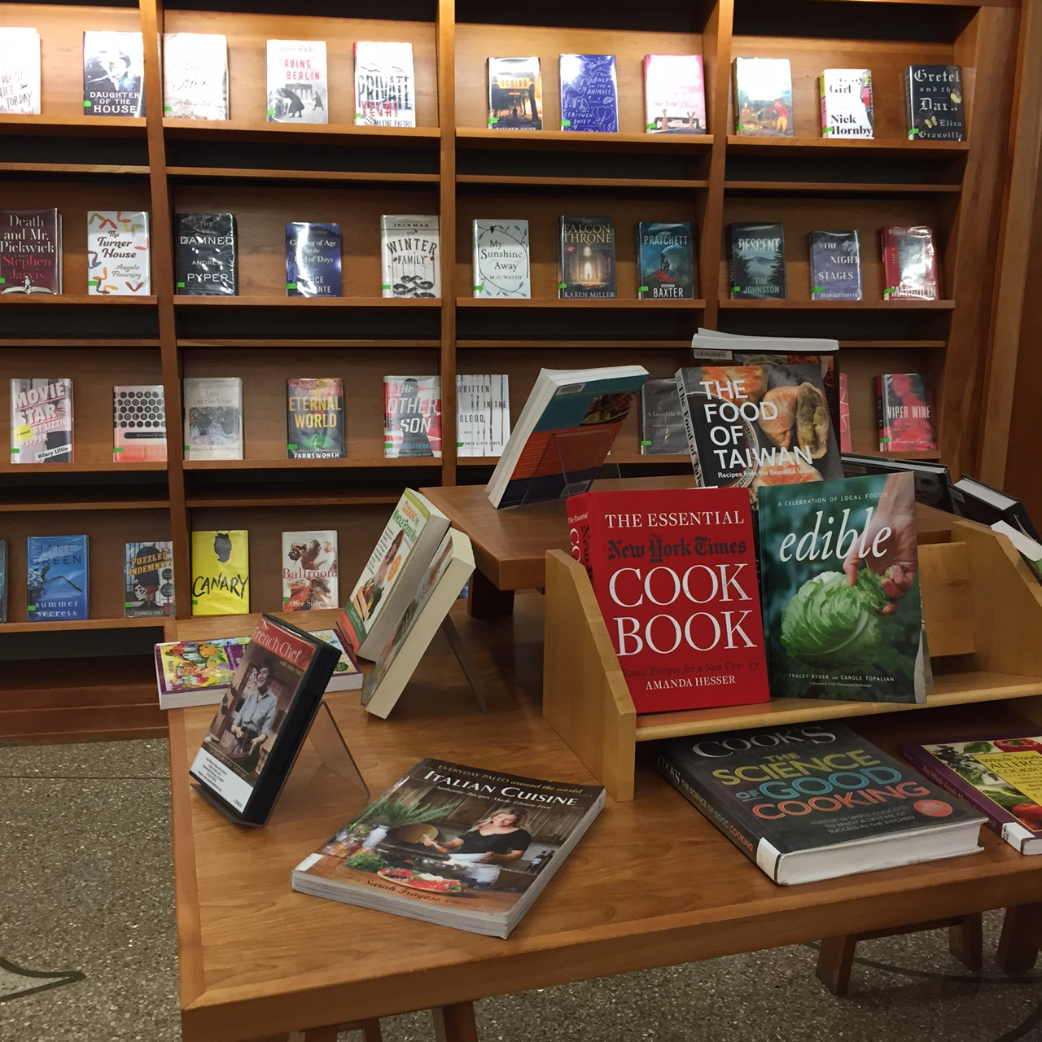

Slide 18
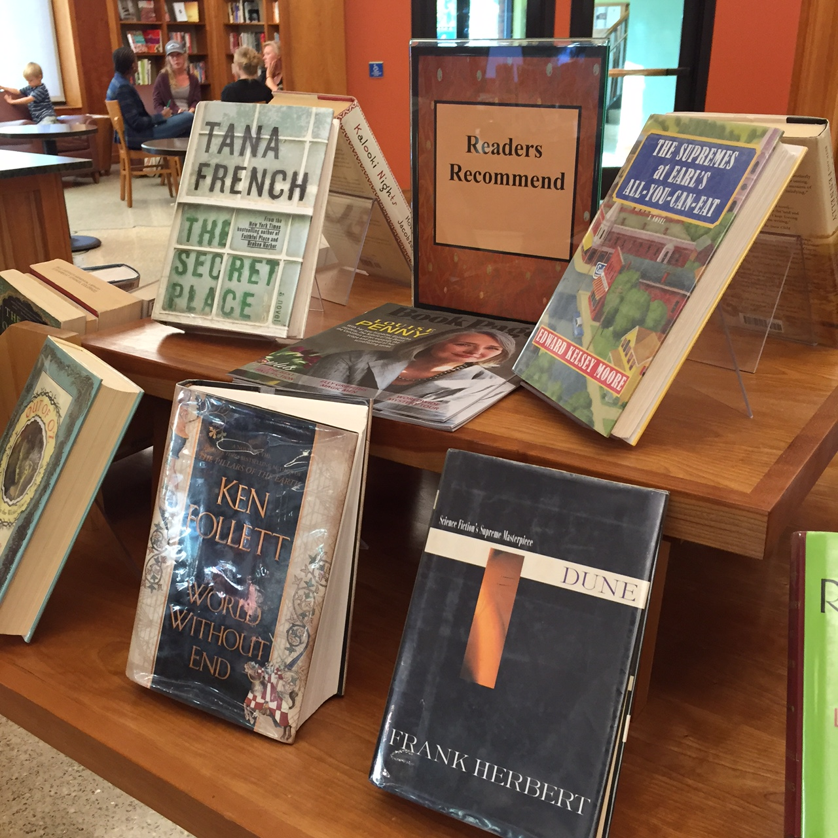

Slide 19
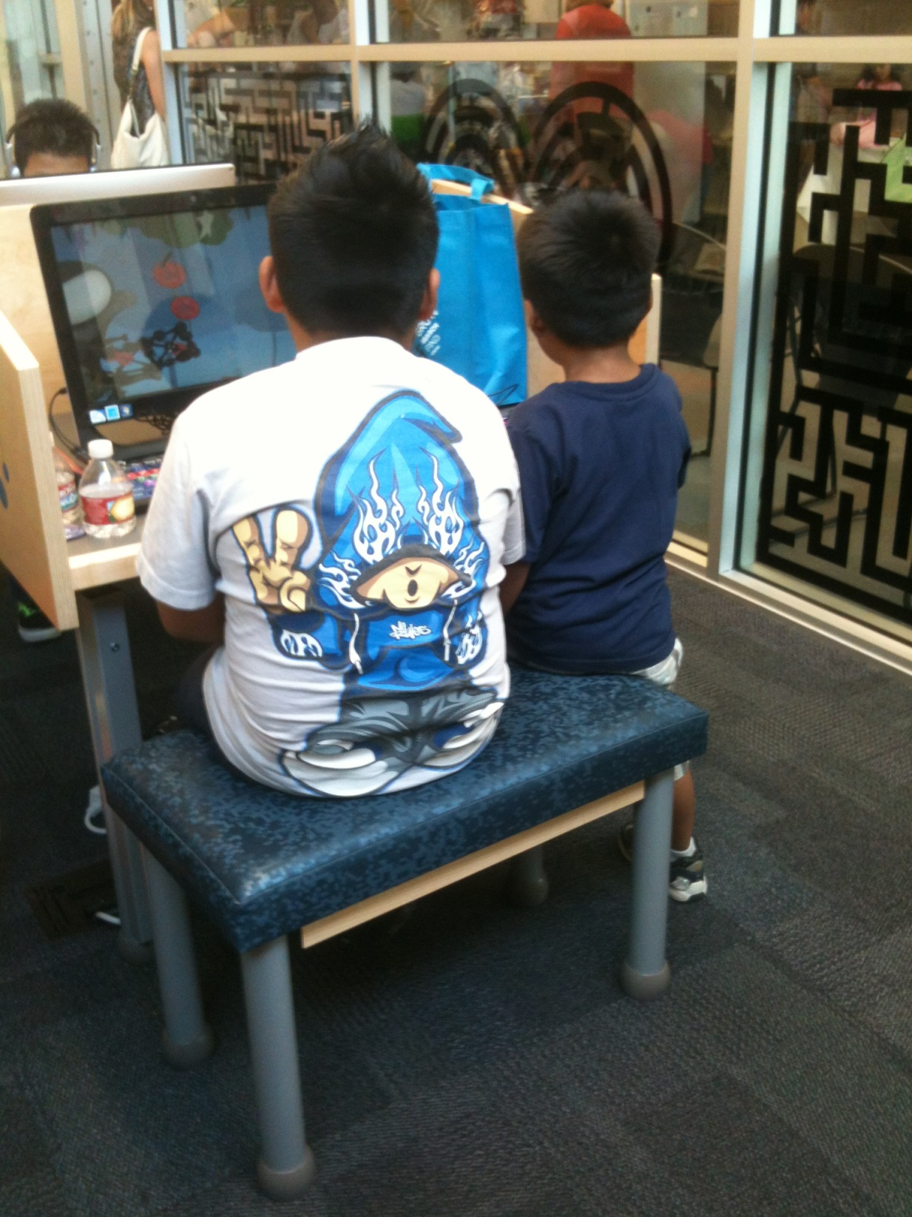
Customer
Service

Slide 20
Empowering
Engaging
Encouraging
Predictive
Responsive

Slide 21
Policies

Slide 22
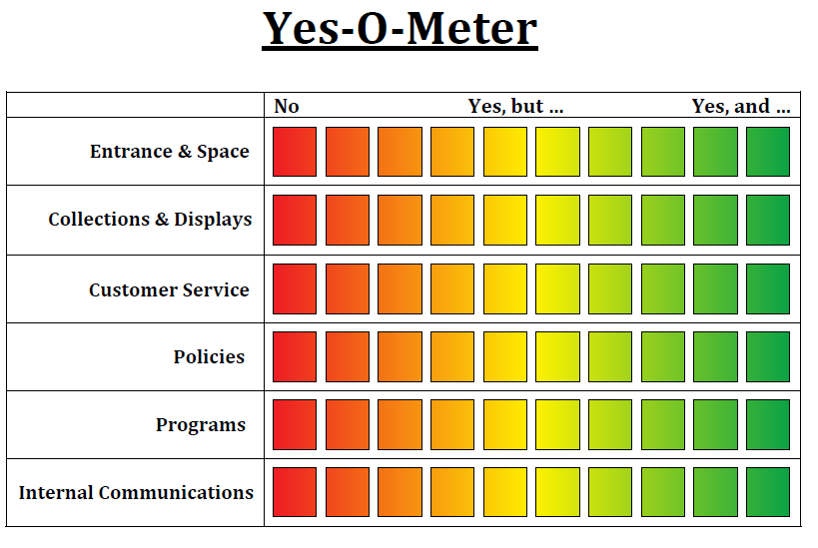
On Your Own – Three Things

Slide 23
Summary & Outcomes
Discover at least three ways to go from good enough to unexpectedly amazing
Look at the value of “Yes, and…” as it applies to displays, policies & services at libraries
Reflect and apply techniques for shifting your library culture to invigorate the relationships between your staff and your community

Slide 24
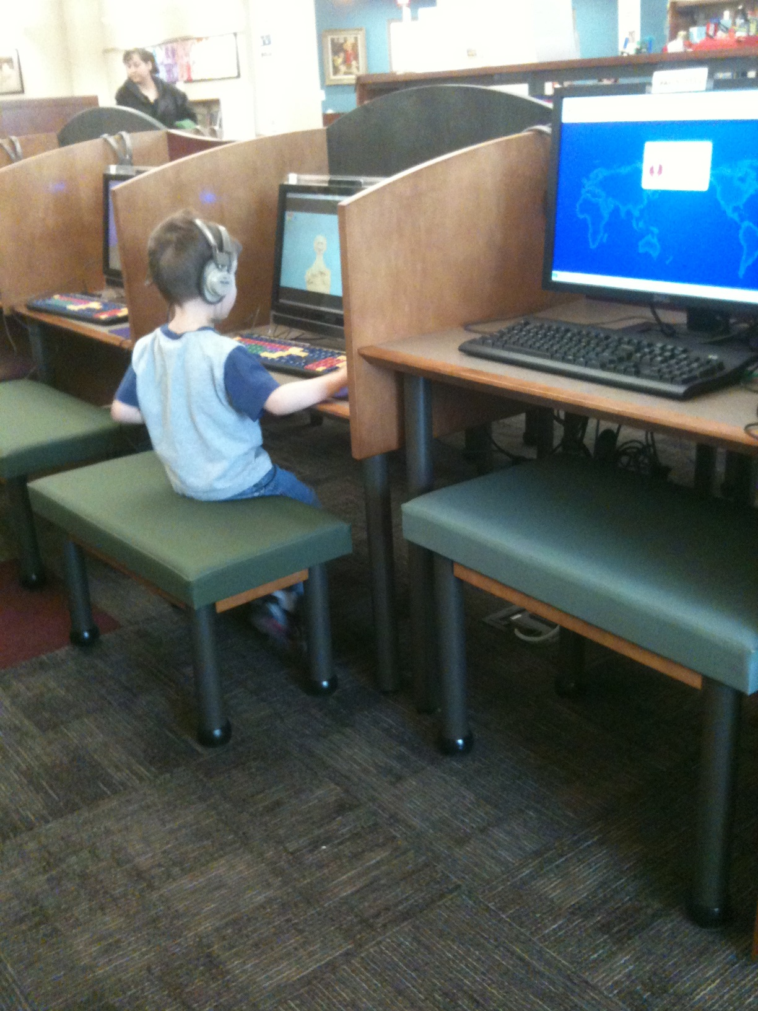
“The America
I love still
exists at the
front desks
of our public
libraries.”
- Kurt Vonnegut

Slide 25
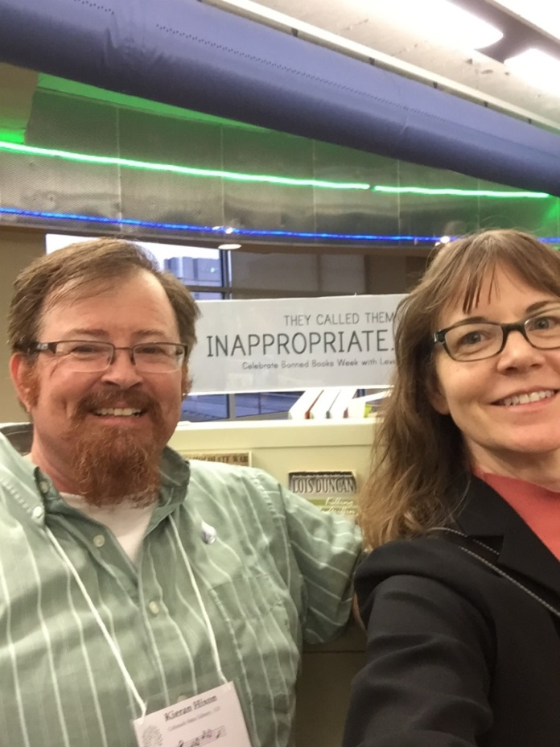
Thank you!
Kieran Hixon
kieran@coloradovirtuallibrary.org
Sharon Morris
Morris_s@cde.state.co.us

