Slide 1
You Need WLA & A Mentor Tips and Advice for a New Librarian
Katharine Clark
Adult Services Librarian
E.D. Locke Public Library – McFarland WI

Slide 2
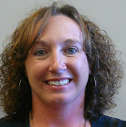
Who? More about me
What is WLA?

Slide 3
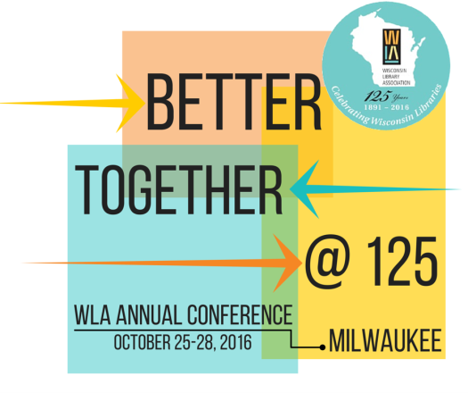
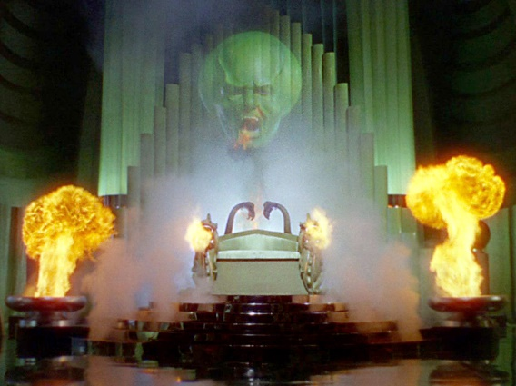
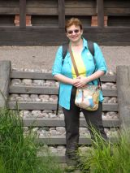
Where? Why?
Current WLA President
Jean Anderson – Continuing
Education Coordinator South
Central Library System
WLA Staff-
Plumer, Tom, Brigitte and Vanessa

Slide 4
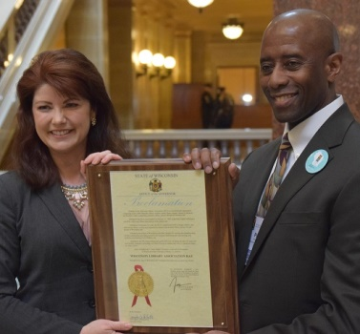
Become a Member & GET INVOLVED
Conferences
Committees
Boards
Awards
Library Legislative Day
Continuing Education
Lt. Governor Rebecca Kleefisch &
WLA Executive Director Plumer Lovelace

Slide 5
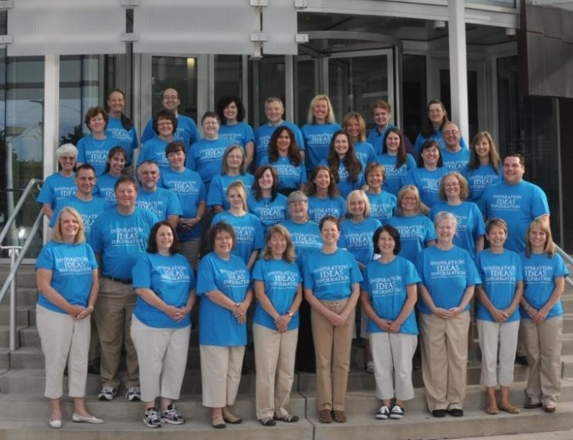
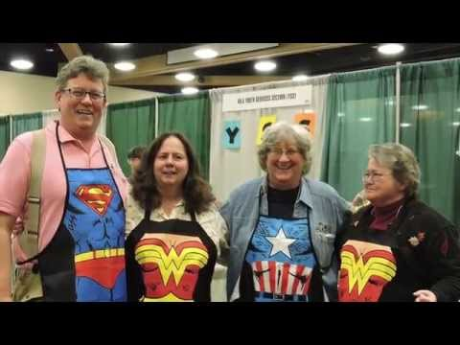
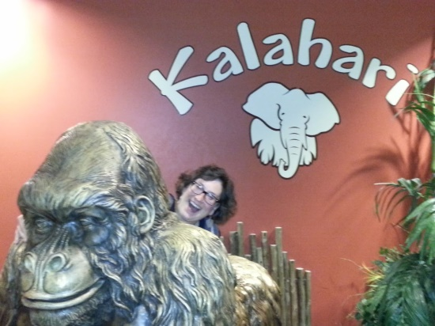
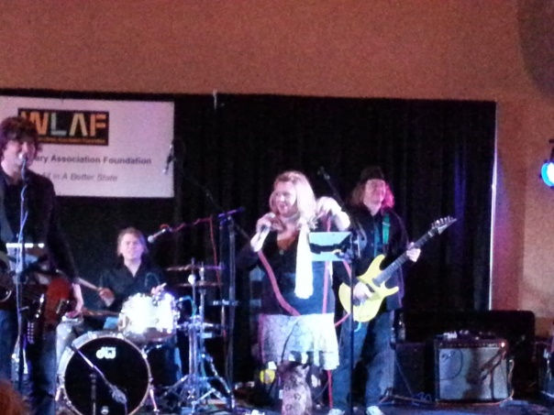
WLA Conferences ROCK
Exhibits Hall
Library of the Year Award
Waukesha – 2011
MARK YOUR CALENDARS -
Oct 17-20
Wisconsin Dells
WLA fundraiser

Slide 6
Mentors – Where to get one?
professional organizations
Library schools
PLA President Felton Thomas “stalking” advice

Slide 7
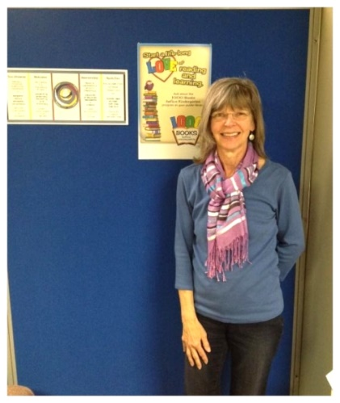
Mentoring 101
Learn about their life outside of library world
Work at different library
What are your goals for the experience?
How often should you meet? Email? Lunch?
Share about values
Respect their time
Be yourself and be active
My mentor: retired staff
Bridges Library System - Claudia Backus

Slide 8
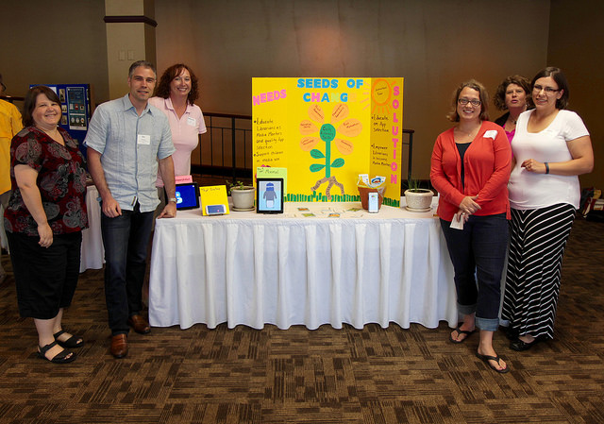
Mentoring = Collaboration +Networking
Examples:
Graphic design position
Facebook readers advisory program
ILead participation
Conference planning committees

Slide 9
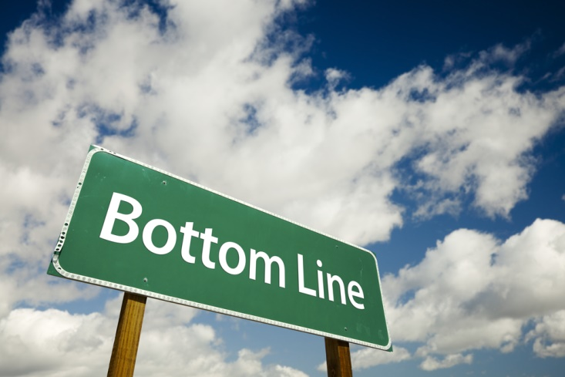
STAY CONNECTED
Katharine Clark – kclark@mcfarlandlibrary.org
@sequoyagal sequoyagal

