Slide 1
Implementing Core Competencies for Your Library Staff Penny L. Talbert Executive Director Ephrata Public Library Ephrata, PA

Slide 2
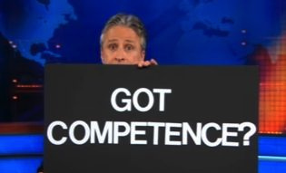

Slide 3
Defining your competency program
WHY WOULD YOU WANT TO DO THIS?

Slide 4
Transliterate Environments Transform!
Transliteracy is the ability to read, write and interact across a range of platforms, tools and media from signing and orality through handwriting, print, TV, radio and film, to digital social networks.”
Thomas, S. with Joseph, C., Laccetti, J., Mason, B., Mills, S., Perril, S., and Pullinger, K. Transliteracy: Crossing divides, First Monday, Volume 12 Number 12 – 3 December 2007

Slide 5
“We have an amazing opportunity!”

Slide 6
How Do you know if you need competencies?
Surveys (anonymous, please!)
Examples:
Which program is needed to open a .pdf file?
What is the difference between the internet and the world wide web?
List 3 search engines.
What is the default time limit for patron computer use?
What is the name of the
library’s public wireless
network?
List 2 common web browsers.
Observe as a patron
Secret Shop

Slide 7
CONSIDER…
Your library’s website
Your library’s social media accounts
Your library’s OPAC
Your library’s ILS
All databases available to patrons (include System, District & State) and how to use them
All extra services available to patrons
All devices loaned out
All platforms of devices which can access services
All programs on the public PCs
All programs on the staff PCs
And on and on and on…

Slide 8
Stakeholder Buy-In
Board of Directors
Friends of the Library
Staff
Volunteers
Donors
Government Officials
Patrons
Community Members

Slide 9
LEARN OR LEAVE?
IS IT FAIR?

Slide 10
Building your program: quick tips
Don’t reinvent the wheel.
Make sure you include skills related to special services at your library.
Pay attention to organization and
recordkeeping.
Competencies have to be flexible.
Assemble your team. Carefully.

Slide 11
GET READY
Introduce online processes to employee’s regular work week.
Train from a very basic level.
Include instructional step-by-step handouts.
Ensure the security of all staff passwords.
Introduce tools & devices one at a time.

Slide 12
Some great tools to incorporate into the
work week:
On The Clock
Internal Wiki
Departmental Wikis
Asana
Dropbox
Google Docs
Doodle

Slide 13
GET READY
Include competencies in the library’s strategic plan
Procedure manual for all policies
Create an Employee Learning & Growth Plan
Adoption of guidelines defining “successful completion”
Include “successful completion of annual competency training and exams” in job descriptions
Social media policy

Slide 14
GET READY
Develop Competencies
Select Design Team
Create Training/Testing Timeline
Introduce Staff to “The Big Idea”
Alleviate Fears

Slide 15
GET READY
Content
Delivery
Who will be the project lead?
Who will contribute?
Timeline considerations
Who, within your organization, has the knowledge & skill set to act as mentor?
Are multiple learning styles considered?
What method will be used?
How will it be monitored?
Who will be in charge of recording participation?

Slide 16
Your delivery method should:
Use several techniques and platforms
Take into account many learning styles
Allow feedback, discussion and file submission
Support video, file storage and polls
Allow for easy navigation

Slide 17
EXPLORING Delivery
HTTP://EPHRATAPUBLICLIBRARY.LIBGUIDES.COM/COMPETENCIES

Slide 18
Get competent!
Self-Directed Learning
Measuring Learning
Webinars
Conferences
Inservice Days
Staff Meeting Instruction
Games
Computer Classes
Universal Class
Skillsoft
Webjunction
Written Competency Exam
Demonstrative Competency Exam
Competency “Practice”
Surveys…Lots of Surveys

Slide 19
TIMELINE YEAR 1
Introduce staff to competencies and outline new requirements for employment
Introduce staff to delivery methods and 23 Things
Pre-competency survey
Competencies become part of everything!!
23 Things – 19 week program (can be more or less)
Pre-Inservice Survey
Inservice Day
Post-Inservice Survey

Slide 20
TIMELINE YEAR 1
Staff Book Discussion: “Diffusing The Angry Patron” – 8 week program
ENTIRE YEAR: staff is encouraged to explore competencies through a variety of self-directed learning activities
Annual Demonstrative/Written Competency Exam (Year 1)

Slide 21
ChangE Your Culture
ENCOURAGE LEARNING
Telework Policy
Paid Learning Time
Provide educational opportunities
Increase required CEUs for every level of employee

Slide 22
CHANGE YOUR CULTURE
ENCOURAGE COLLABORATION
Weekly Online Group Activities (23 Things)
Assign Group Projects
Promote staff-only social fund and events
Pay memberships & expenses for participation in community organizations

Slide 23
How do you collaborate?
What motivates you?
When are you most productive?
How do you resolve conflicts?
What is your passion?
How do you prefer to communicate?
REMEMBER THE MISSION

Slide 24
Starting your competency list
List the online services your library provides for patrons…all of them.
Prioritize!

Slide 25
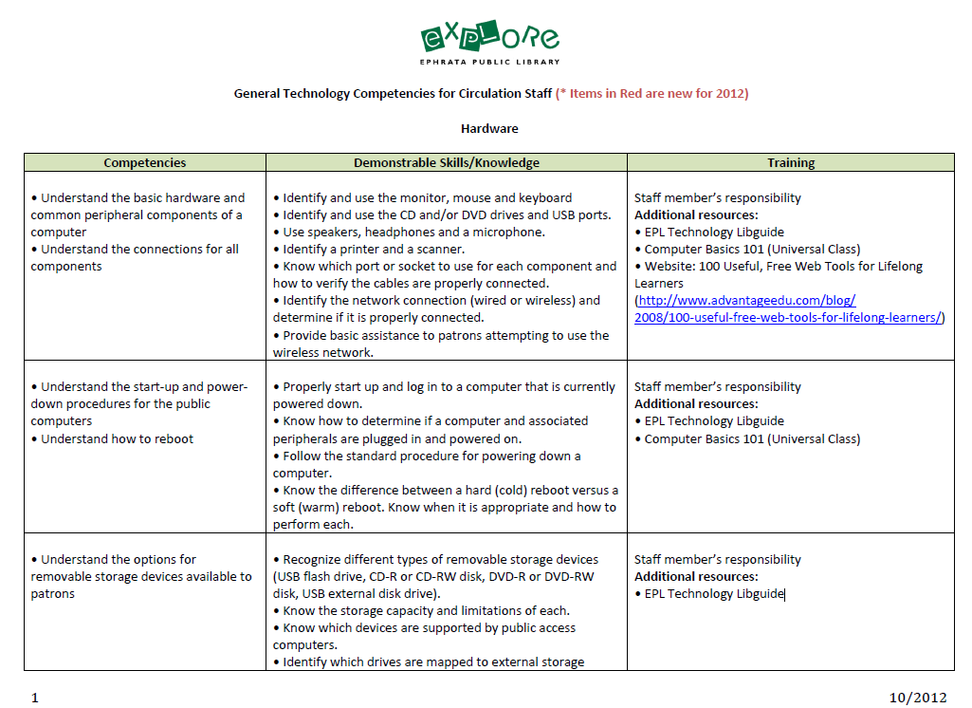
Notes:
A study guide: Giving us everything from the simple
to things that may not be familiar terms. This was actually a 12 page document. But it was very comprehensive. What I did…..

Slide 26
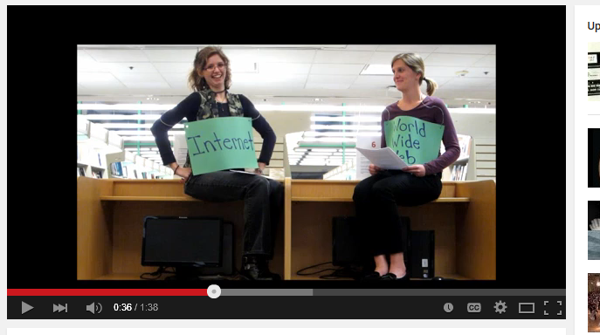
Notes:
Even videos shown during our monthly staff meetings
These are definitely some things to keep in mind to help ease staff anxiety and to assure success, if the staff is willing to take the time to look over the materials.

Slide 27
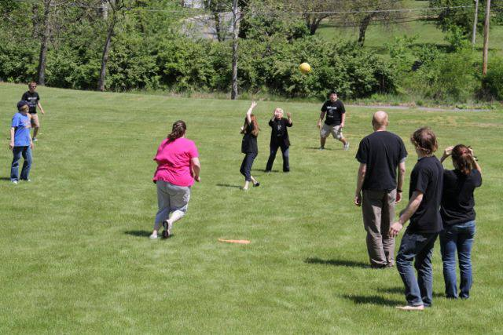
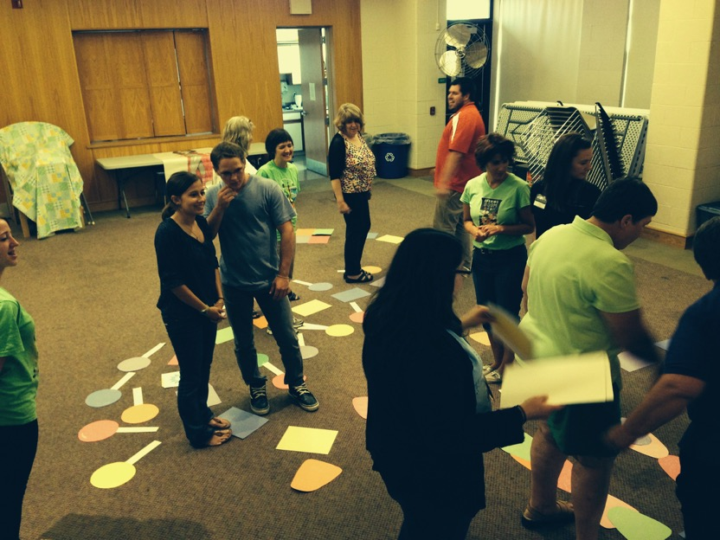
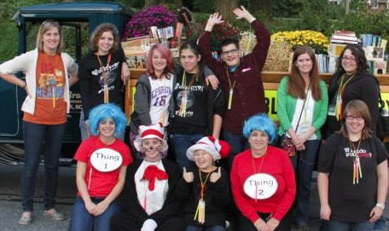
HAVE FUN!

Slide 28
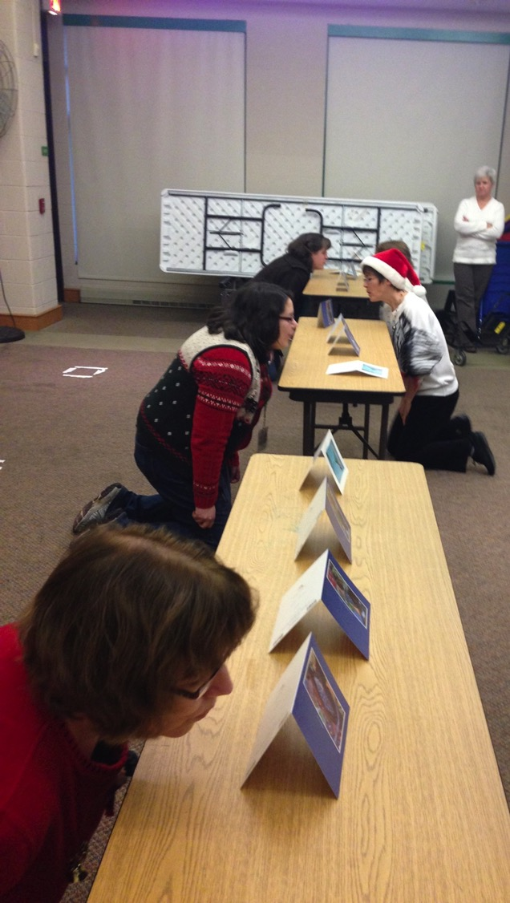
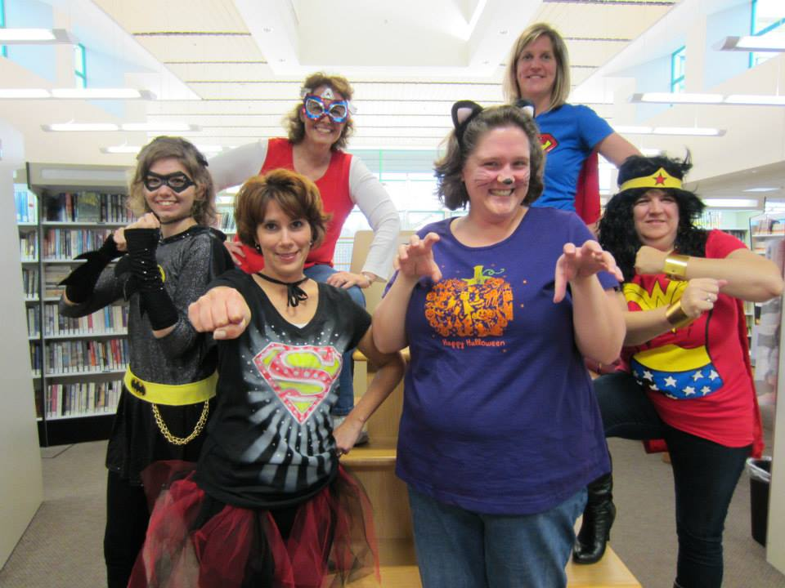
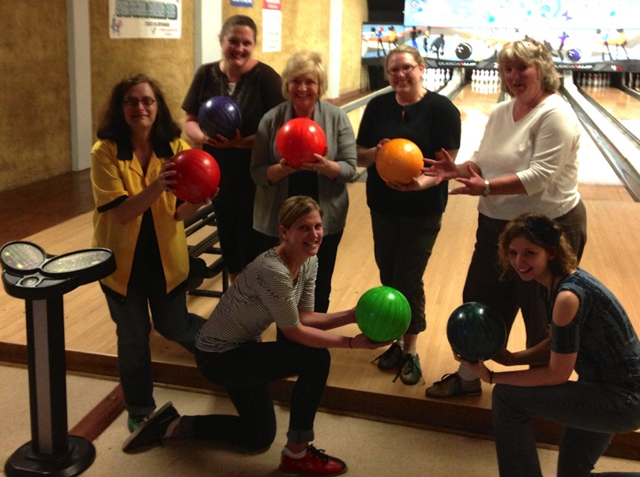

Slide 29
QUESTIONS?

Slide 30
KEEP IN TOUCH!
Penny Talbert
www.pennytalbert.com
ptalbert@ephratapubliclibrary.org
Competency Link
http://ephratapubliclibrary.libguides.com/competencies
Ephrata Public Library
www.ephratapubliclibrary.org

