Slide 1
Managing a Vibrant Volunteer Program
Meredith Lowe, UW-Madison iSchool

Slide 2
Setting the Scene
Why does your library have (or want to have) volunteers?
Why do people volunteer at your library?

Slide 3
Today’s Topics:
Policies
Training and Management
Recruitment
Appreciation
Challenges and Solutions

Slide 4
Volunteer Policies (can be fun!)
Four Key Elements
Definition of a volunteer
List of what volunteers can and cannot do
Rights and responsibilities of volunteers
Rights and responsibilities of the library

Slide 5
Volunteer Policy Functions
Welcome and Thank Volunteers
Introduce the Library’s Mission Statement
Bring Volunteers into the Library’s Story
Provide guidance for volunteers and volunteer managers

Slide 6
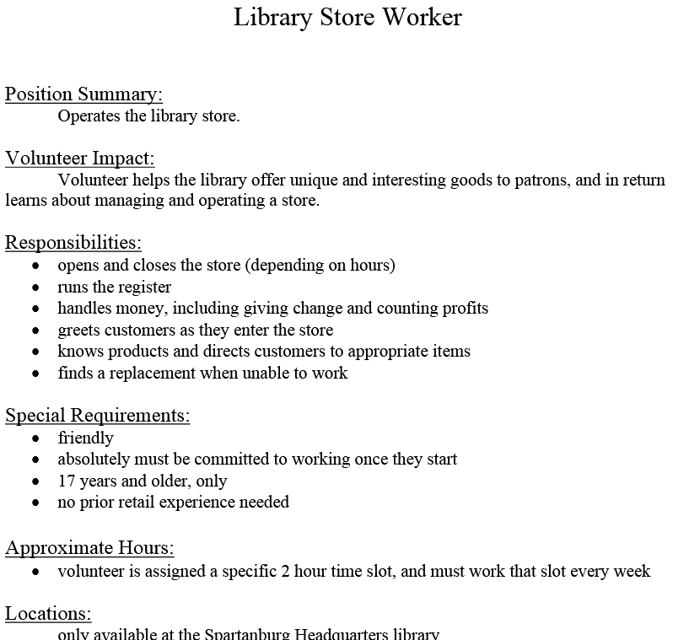
Recruitment tool: Job Description
This example is from Spartanburg Co. Public Library (SC)
Clear potential for linking to training and policy manuals
Clear expectations about duties, attitude, and time commitment.
Make one of these for every volunteer role.

Slide 7
Recruit Strategically
Mimic practical aspects of your employee hiring process
Use volunteer job descriptions
Volunteer Application
Spread the Word
Engage Skilled Volunteers if needed

Slide 8
Oak Park Public Library
This library lists the volunteer opportunities that they are seeking to fill, with short descriptive sentences about what kind of person would be a great fit.
This is an example of the job description presented in a way to attract volunteers.

Slide 9
Volunteer application
Think about what information you need to know about your volunteer applicants to make sure they’re a good fit.
Source: Oak Park Public Library

Slide 10
Recruit Strategically
Volunteer Application
Name, address, phone, email
Over/under 18 (Parent/guardian permission?)
Library experience?
Special Skills?
Why are they interested?
Time/date availability
References?
Fulfilling a requirement?
Background check permission (may be necessary for volunteers working with children or other vulnerable populations; check with your legal counsel)

Slide 11
Engage Skilled Volunteers
Graphic/web design
Marketing
Social Media
Event planning
Branding
Tutoring
Strategic planning
Grounds keeping
Specialized programming
Volunteers for Day of Service Events

Slide 12
Volunteer Training & Management
Training Manual
In-person training
Regular check-ins (frequent at first), and trainer is available.
Make sure their time spent matches what you have for them to do.

Slide 13
Thanking Your Volunteers
Volunteer Appreciation ideas:
Party or social
Honor volunteers with book plates
Mention them in the newsletter/local paper/Library website/Library social media (if they are they type of person who would welcome this!)
A thank you note
Small gifts (such as a bookmark or nice pen, or a mug, or maybe a small gift card)
And the list goes on….

Slide 14
Challenges
“A Bad Fit”
Disciplinary Challenges
Staff buy-in
Should you go of a long-time volunteer who is not getting anything done?

Slide 15
Solutions
Refer back to your policy for disciplinary procedures.
Would the volunteer be a better fit at another organization?
Have the difficult conversations – treat this as a management situation.
Have conversations with resistant staff.
Re-framing perspective: with some volunteers, completing tasks may not be the goal for your library.

Slide 16
Any other questions?
Meredith Lowe, mclowe@wisc.edu
http://ischool.wisc.edu

