Slide 1
Weebly for Libraries
Amanda Burns
Algoma Public Library
Algoma, WI

Slide 2
Old & Outdated

Slide 3
New & Clean

Slide 4
Why Weebly?
Low Cost
Continued use of your URL
Customizable
Group Use
Support

Slide 5
Low Cost
Recommend Pro Version
Prices Drop with longer subscriptions

Slide 6
Your URL
Bring your currently owned URL with you
Migration Help
Minimal Down Time

Slide 7
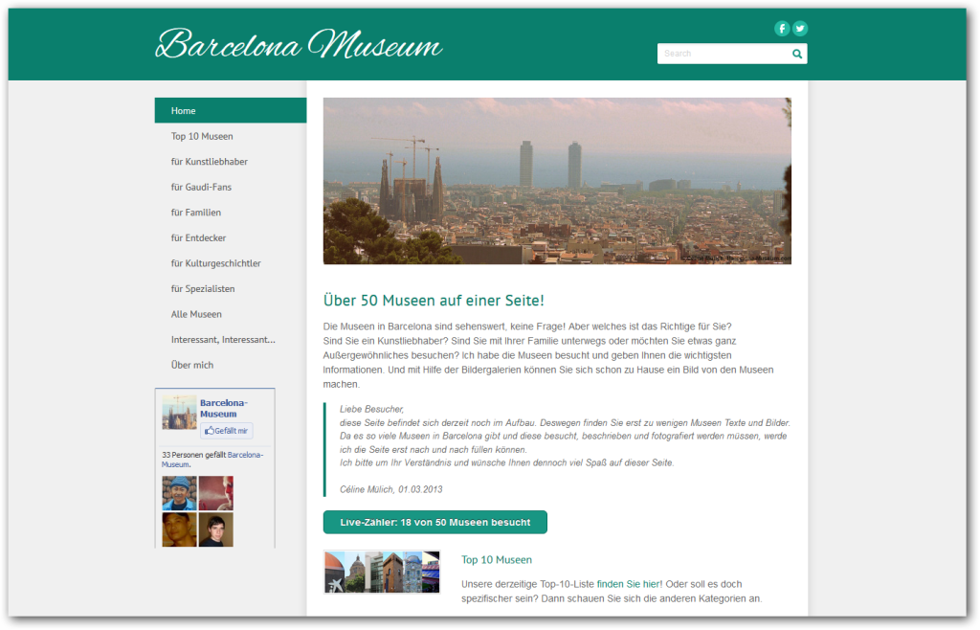
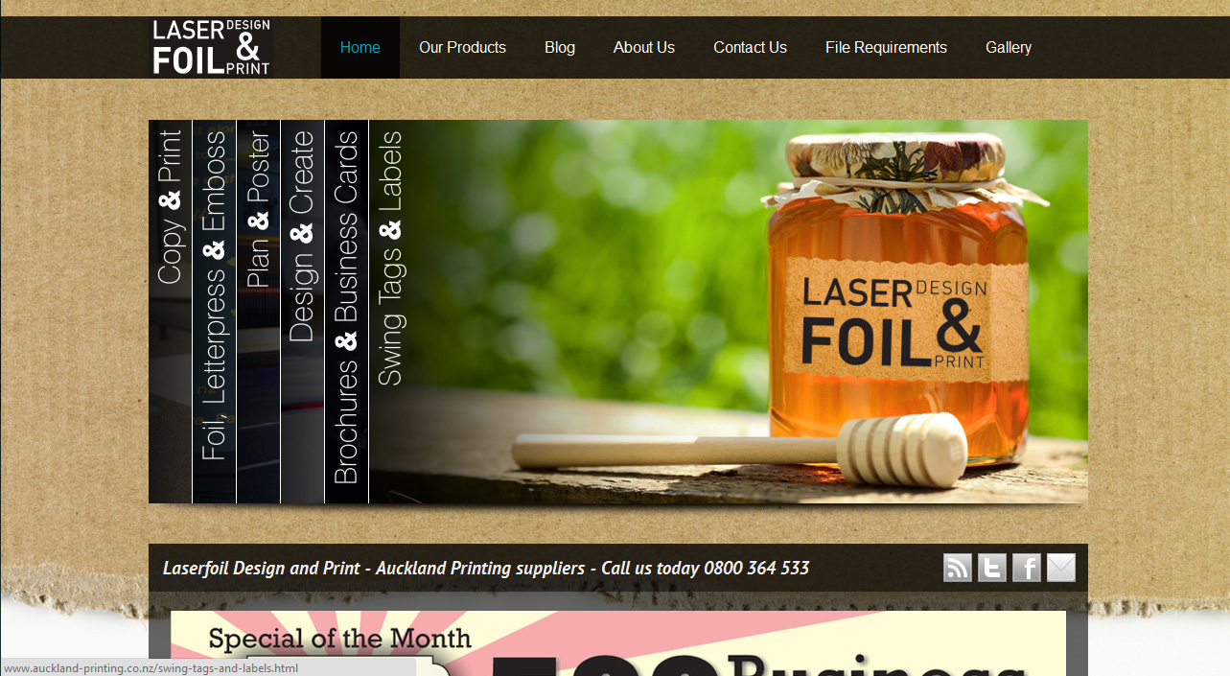
Customizable

Slide 8
Group Use
Multiple Users
Individual Log In Creditials
Different Roles
Dashboard
Author
Administrator

Slide 9
Support

Slide 10
Weebly Libraries
Algoma Public Library
www.algomapubliclibrary.org
Suring Area Public Library
www.suringpubliclibrary.org
Florence County Library
www.florencecountylibrary.org
Shawano City-County Library
www.shawanolibrary.org
Coming Soon:
Farnsworth (Oconto) Public Library

Slide 11
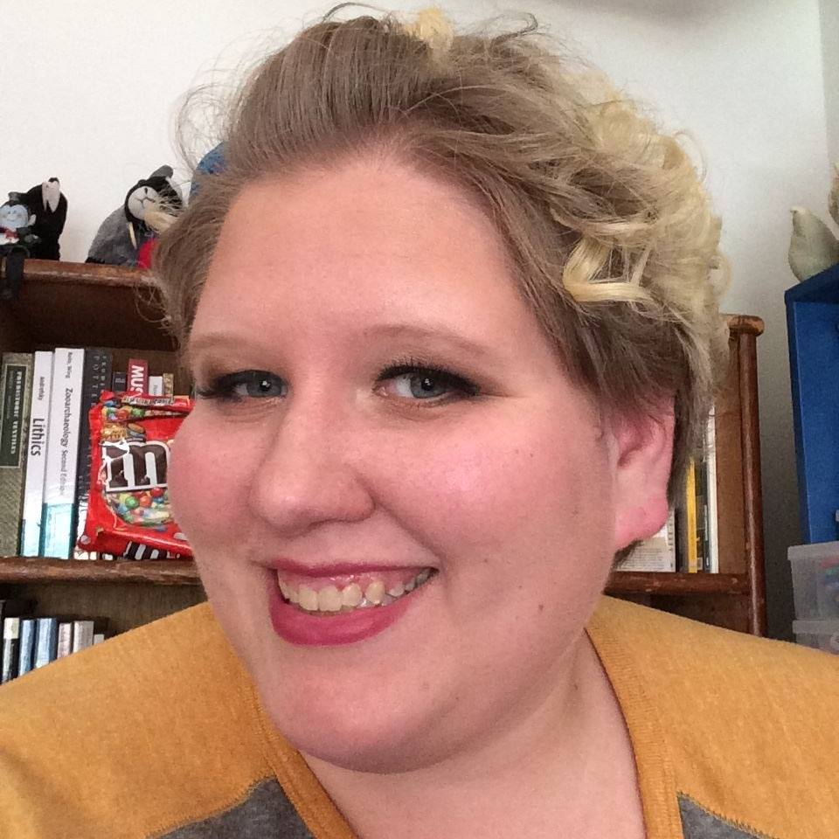
Contact Information
Amanda Burns
aburns@mail.nfls.lib.wi.us
920-487-2295

