Slide 1
Snapchat, Facebook, Twitter Video, Video, Video: Or, Using Video to market library Services
Anne Hamland
WVLS
Communications Coordinator

Slide 2
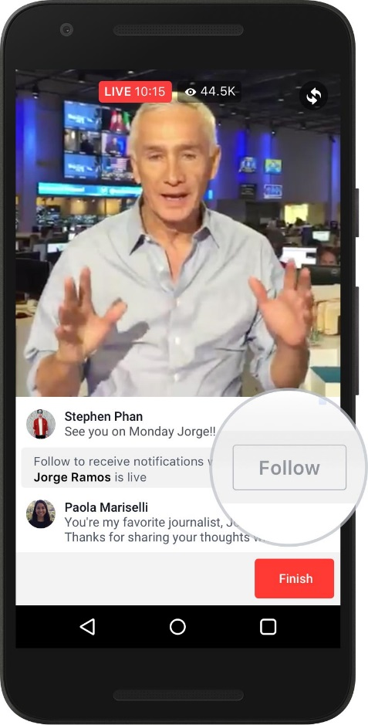
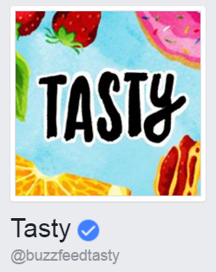
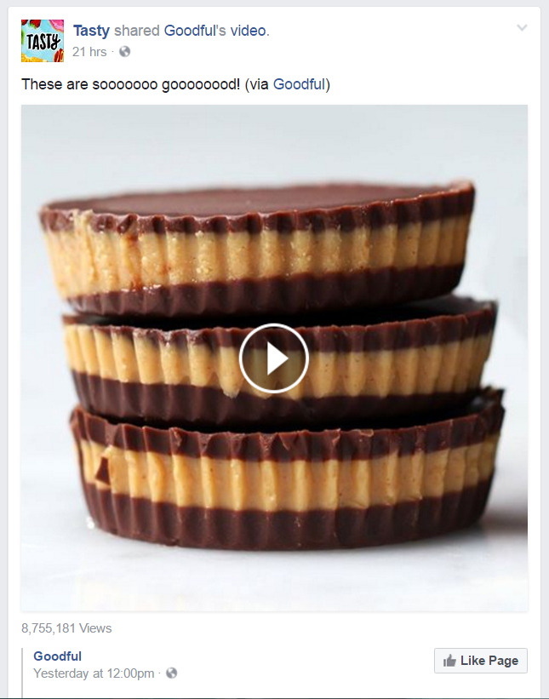
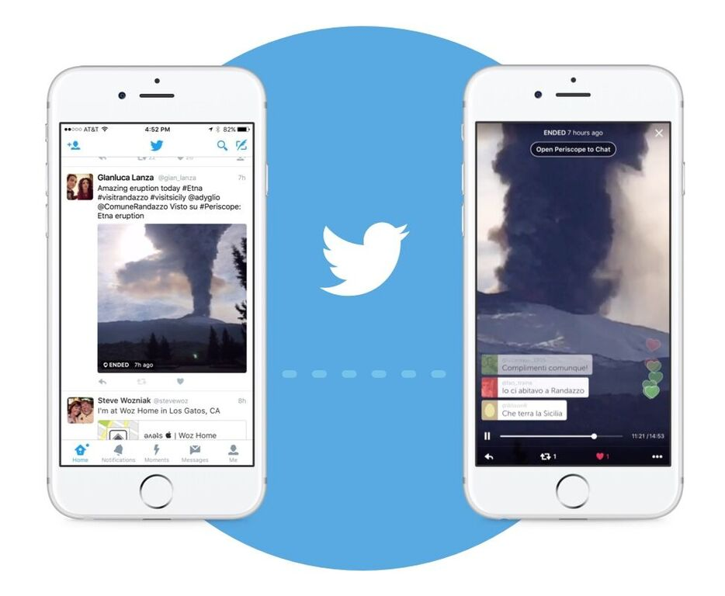
What’s Hot right now?
Videos, videos, videos!
Soundless
Facebook Live
Twitter Live
Snapchat
Photoshopped/edited images
Dec 2016 Forbes

Slide 3
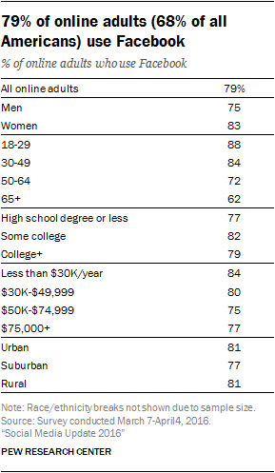
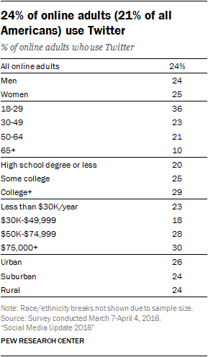
Facebook vs. TWitter

Slide 4
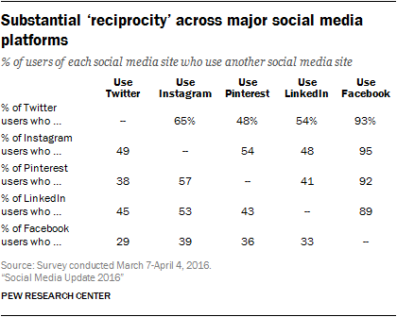
Social Media Use
56% online adults use more than one of the five social media platforms.

Slide 5
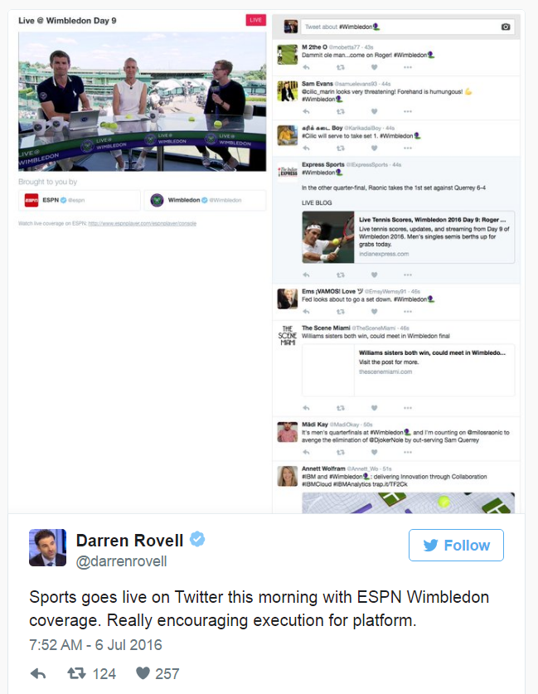
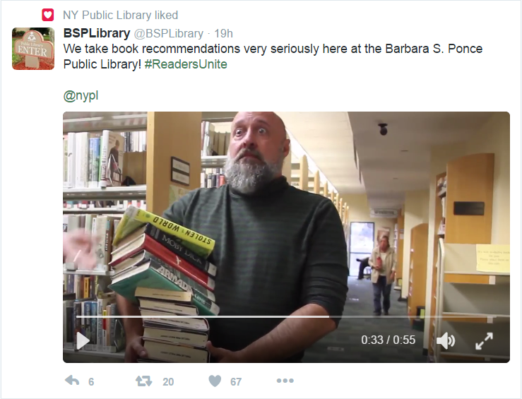
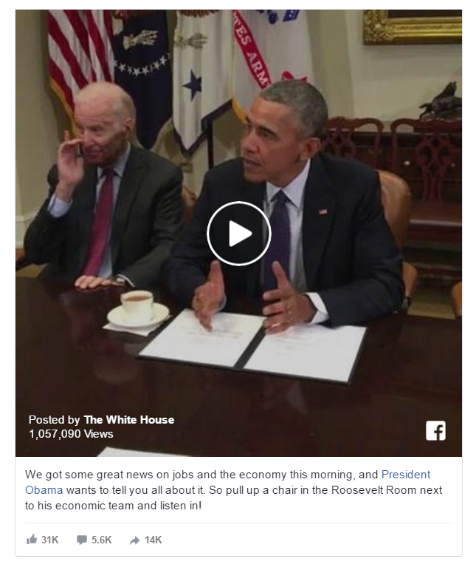
Tool: Facebook and Twitter live
Barbara S. Ponce Lib. Pinellas Park, FL
Tips for going live:
Tell people when you’re going live.
Use strong wifi.
Write a great description to capture attention and outline your broadcast.
Ask viewers to follow you.
Acknowledge comments and reactions live.
Be creative and go live often!

Slide 6
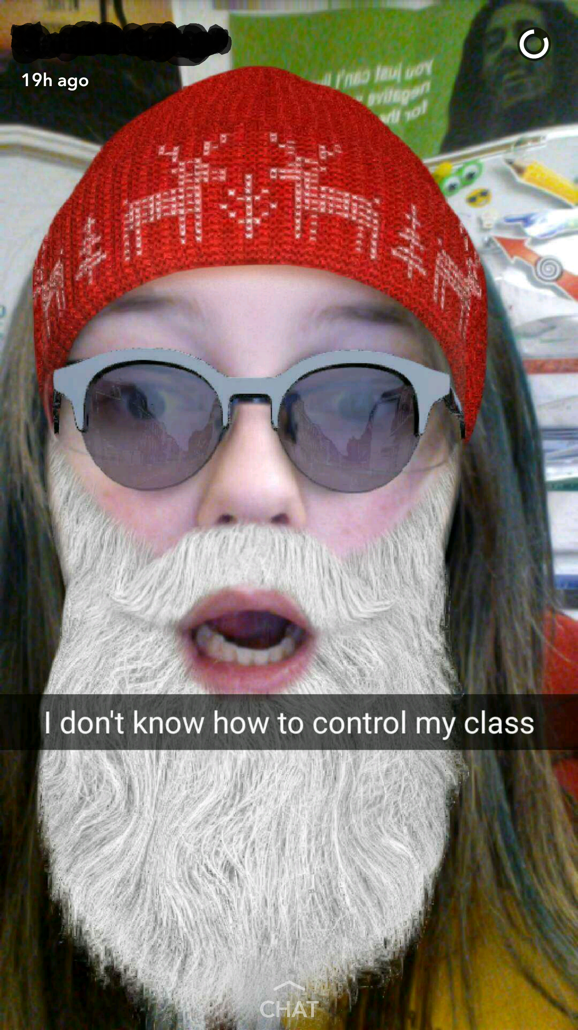
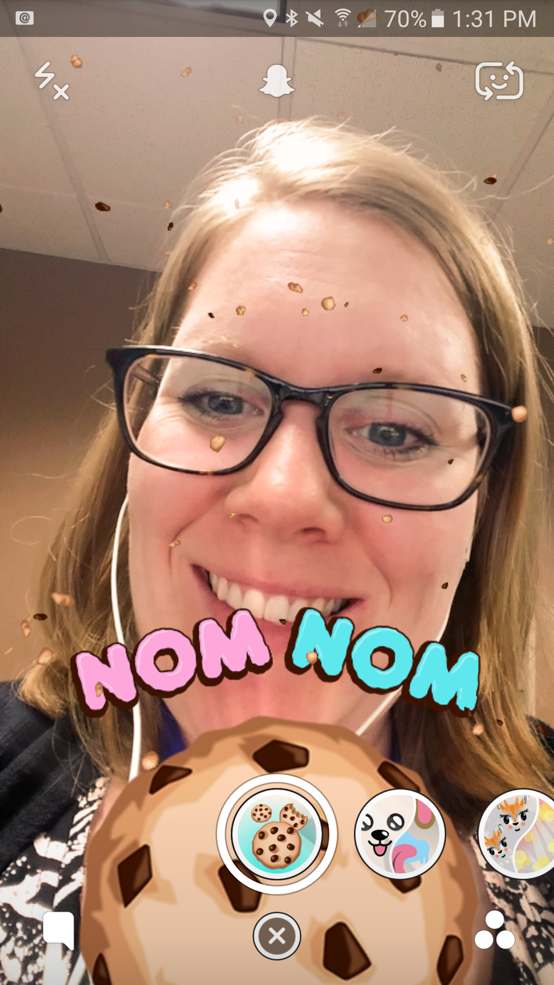
Tool: Snapchat
What is Snapchat?
Preferred social network for Teens April 16, 2016 USA Today, polled 6,500 U.S. teens
An app that automatically deletes sent messages
100 Million+ users since 2011 launch.
8 Billion daily videos
Instant messaging feature

Slide 7
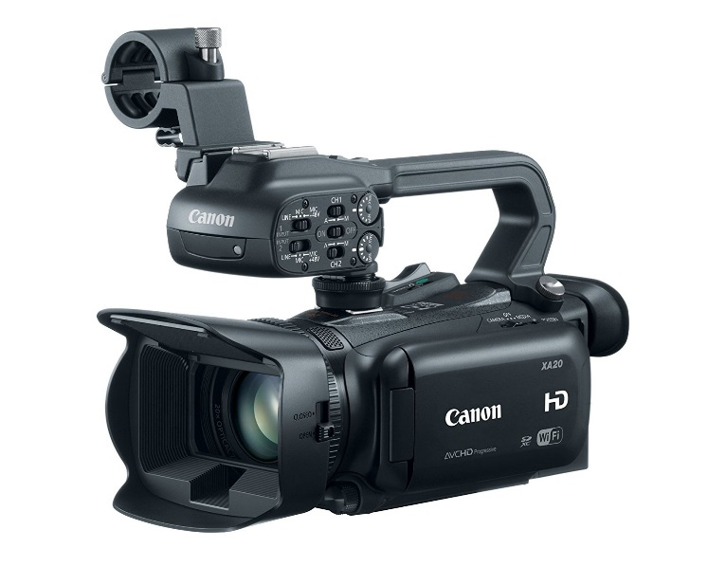
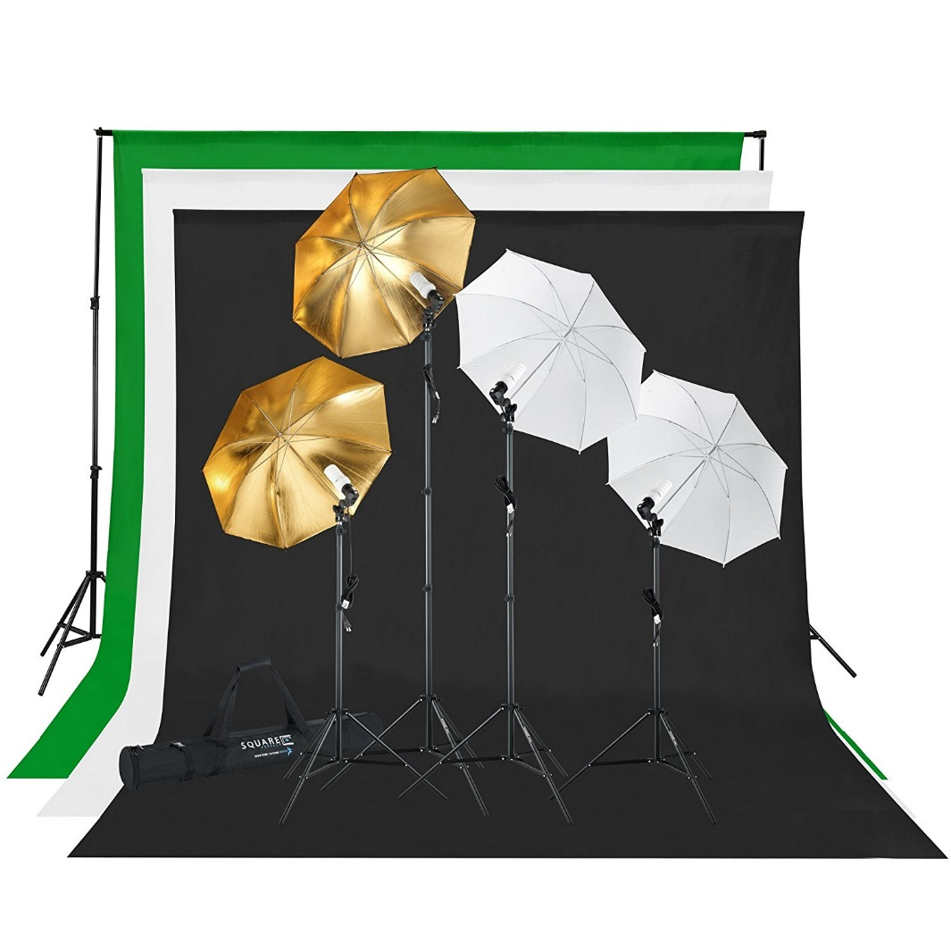
Tools Libraries can use to create videos
Create library accounts for:
Snapchat
Facebook
Twitter
Google+
WAIT. Annnnnnnnnnd→
Let’s get low(ish)tech!

Slide 8
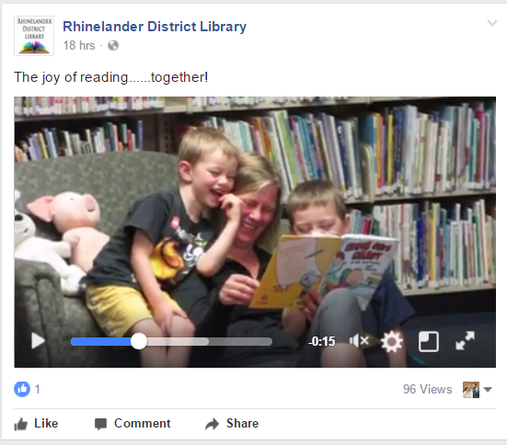
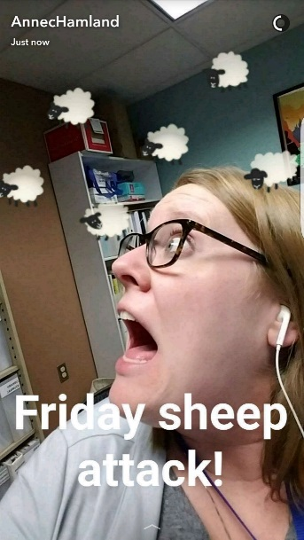
Who is making the videos?
Staff already using social media.
Enthusiastic staff members!
Be personable, be personal.
Ground rules: set expectations beforehand
PRACTICE.
SnapChat Libraries
@cmclibrary Cape May County Library (NJ)
@cincylibrary Cincinnati Public Library
@lblibrary Long Beach (CA) Public Library
@therlpl Rice Lake Public Library (WI)

Slide 9
Ideas for video content
Did you know?!
Scavenger Hunts
Promotions
Special events
Displays
News
Coupons
Insider Information
National Dog Day
Storytime Clips
Fine Forgiveness Programs
Special Projects
New Puppets
New Toys
Staff Talents
Santa Interviews
Collection Highlights
Book Talks
Summer Reading Program Special Guests
Staff Picks
Celebrity Library Users

Slide 10
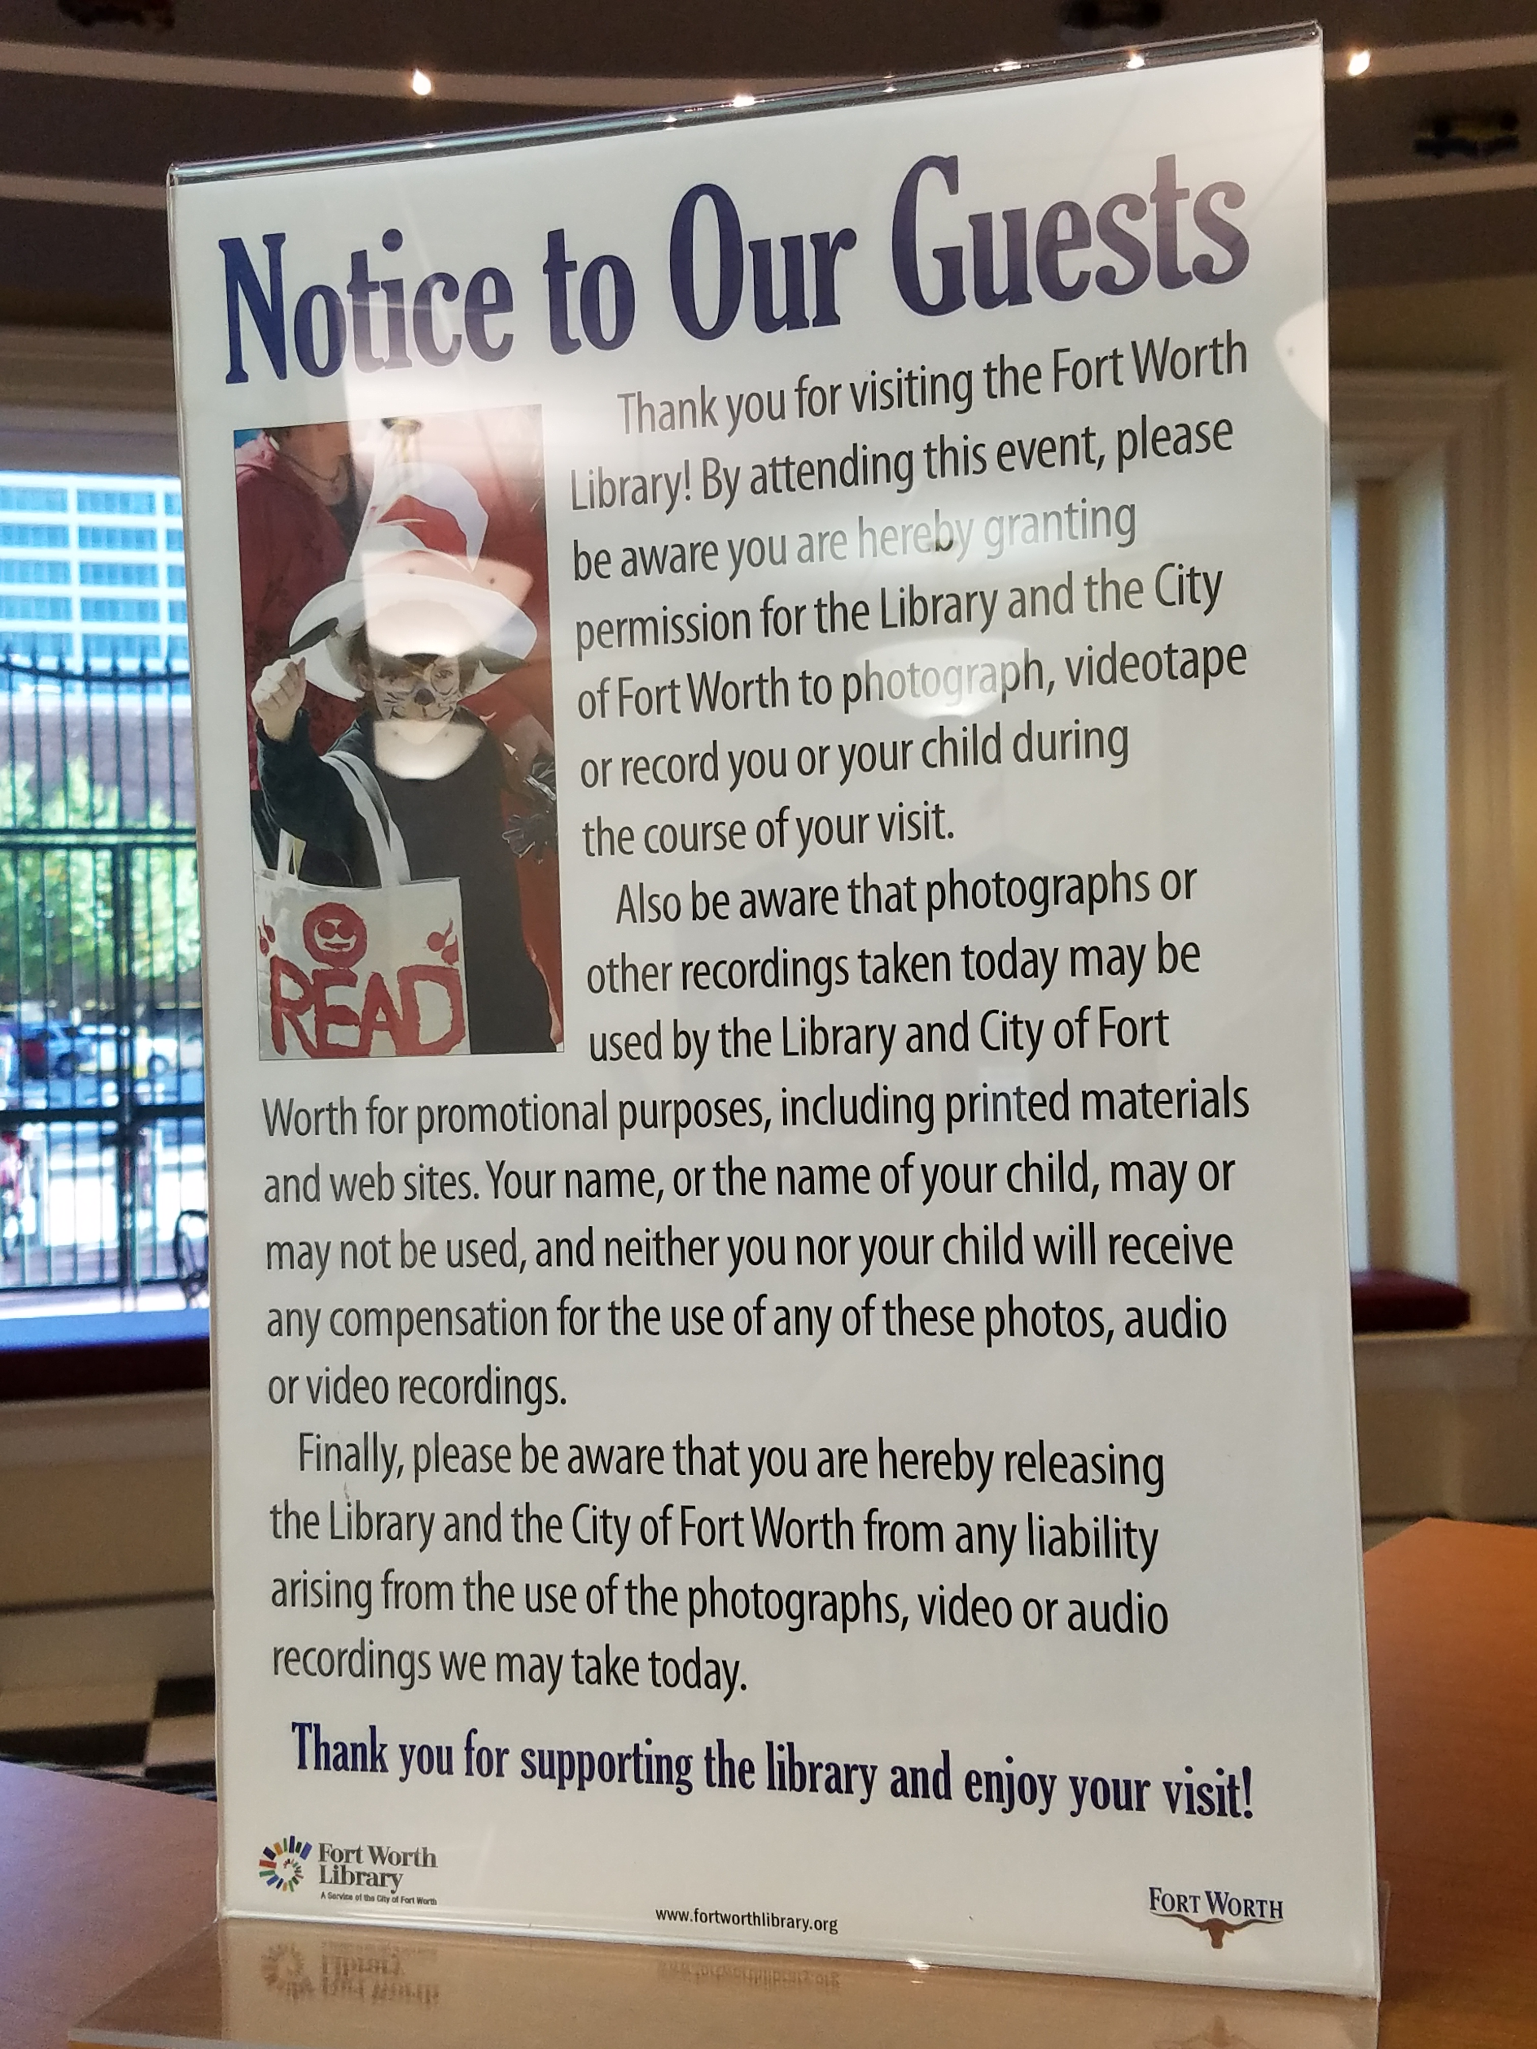
Get Permission
Be “in the moment,” but be thoughtful.
Get permission. Ask BEFORE filming.
Permission slip/Photography form
Municipal legal advice
Snapchat Safety Center

Slide 11
Resources
Alfonzo, Paige. Snapchat in the Library. American Libraries. November 1, 2016.
Beykpour, Kayvon. Periscope broadcasts: live on Twitter. January, 12, 2016.
Facebook. Tips for using Facebook Live.
Graves, Alana. How to Use Snapchat for Readers’ Advisory. School Library Journal, May 2, 2016.
King, David Lee. Snapchat Content for Libraries. April 19, 2016.
Murphy, Mike. Twitter Live is a new thing from Twitter that actually seems useful. Quartz. July 6, 2016.
Pew Research Center: Social Media Update 2016
Ram, A. and A. Shaffer. How to Use Snapchat. Wired. April, 6, 2016.
Trefis Team. Live Streaming on Twitter Should Increase User Engagement. Forbes. December 19, 2016.
USA Today. Teens love Snapchat. Also Instagram. April 16, 2016.

