Slide 1
Part-Time Employees Big Time Impact
Rachel Arndt
Coordinator, General Reference & Customer Service
Milwaukee Public Library

Slide 3
What We Will Cover
Value of part-time work
Types of part-time work
Challenges and opportunities
Managing part-time staff
What if part-time staff leave?

Slide 4
What We Will NOT Cover
Employment Rights of Part-Time Staff
HR Law
Compensation/Benefits
Consulting/Freelancing
The Last Jedi Fan Theories

Slide 5
My Perspective
Personal PT experience
Career began as PT librarian
Coordinator of Circulation & Adult Reference
Large, urban public library
Majority of PT staff are in my work unit.
Majority of staff are FT

Slide 7
Why Part-Time?
Library Budget/Hours
Flexibility
Second Job/Second Income
Predictable income

Slide 8
What Can Part-Time Look Like?
Hourly wage / Salary
Pro-rated benefits, fringe-benefits, no benefits
Flexible hours or standard hours
Rotational; nights, weekends
Para-professional, professional, support staff
Promotional path
Path to full-time work
Job share

Slide 10
Challenges
Opportunities
Other life priorities may take precedence.
Employee is advancing education or side hustle.
Income/benefits may limit interested candidates.
Does not align with career goals.
Different expectations than full-time workers.
Well-rounded employee with varied experiences.
Flexibility to meet organization and employee needs.
Predictable income for candidates not interested in full-time work.
Aligns with career goals.
Job duties identical to full-time staff, equalizing work experience.

Slide 12
Recruiting Part-Time Staff
Is this really a part-time job?
Talent pipeline
Advertise!
Creative evaluation
Be honest

Slide 14
Training Part-Time Staff
Confirm the value of part-time work
Part-time staff ≠ part-time training
Universal skills
Assign point-person
Formalize the process
Record progress

Slide 16
Motivation and Retention
Cross-train
Celebrate success
Communicate
Connect work to goals and strategies
Schedule for highest, best use
Check-in

Slide 17
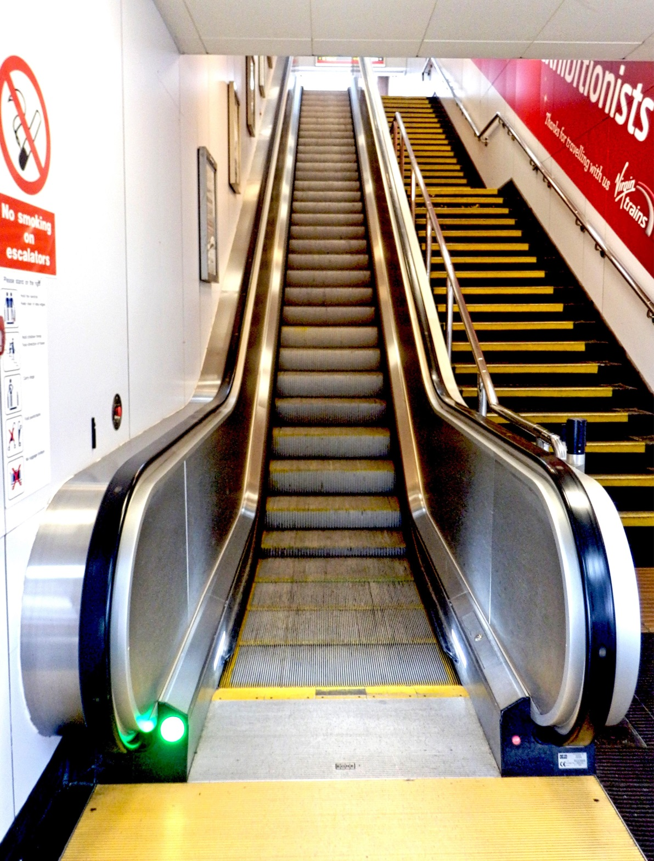

Slide 18
Moving Up
Goal alignment
Coach them up
Promotions strengthen organizations

Slide 19
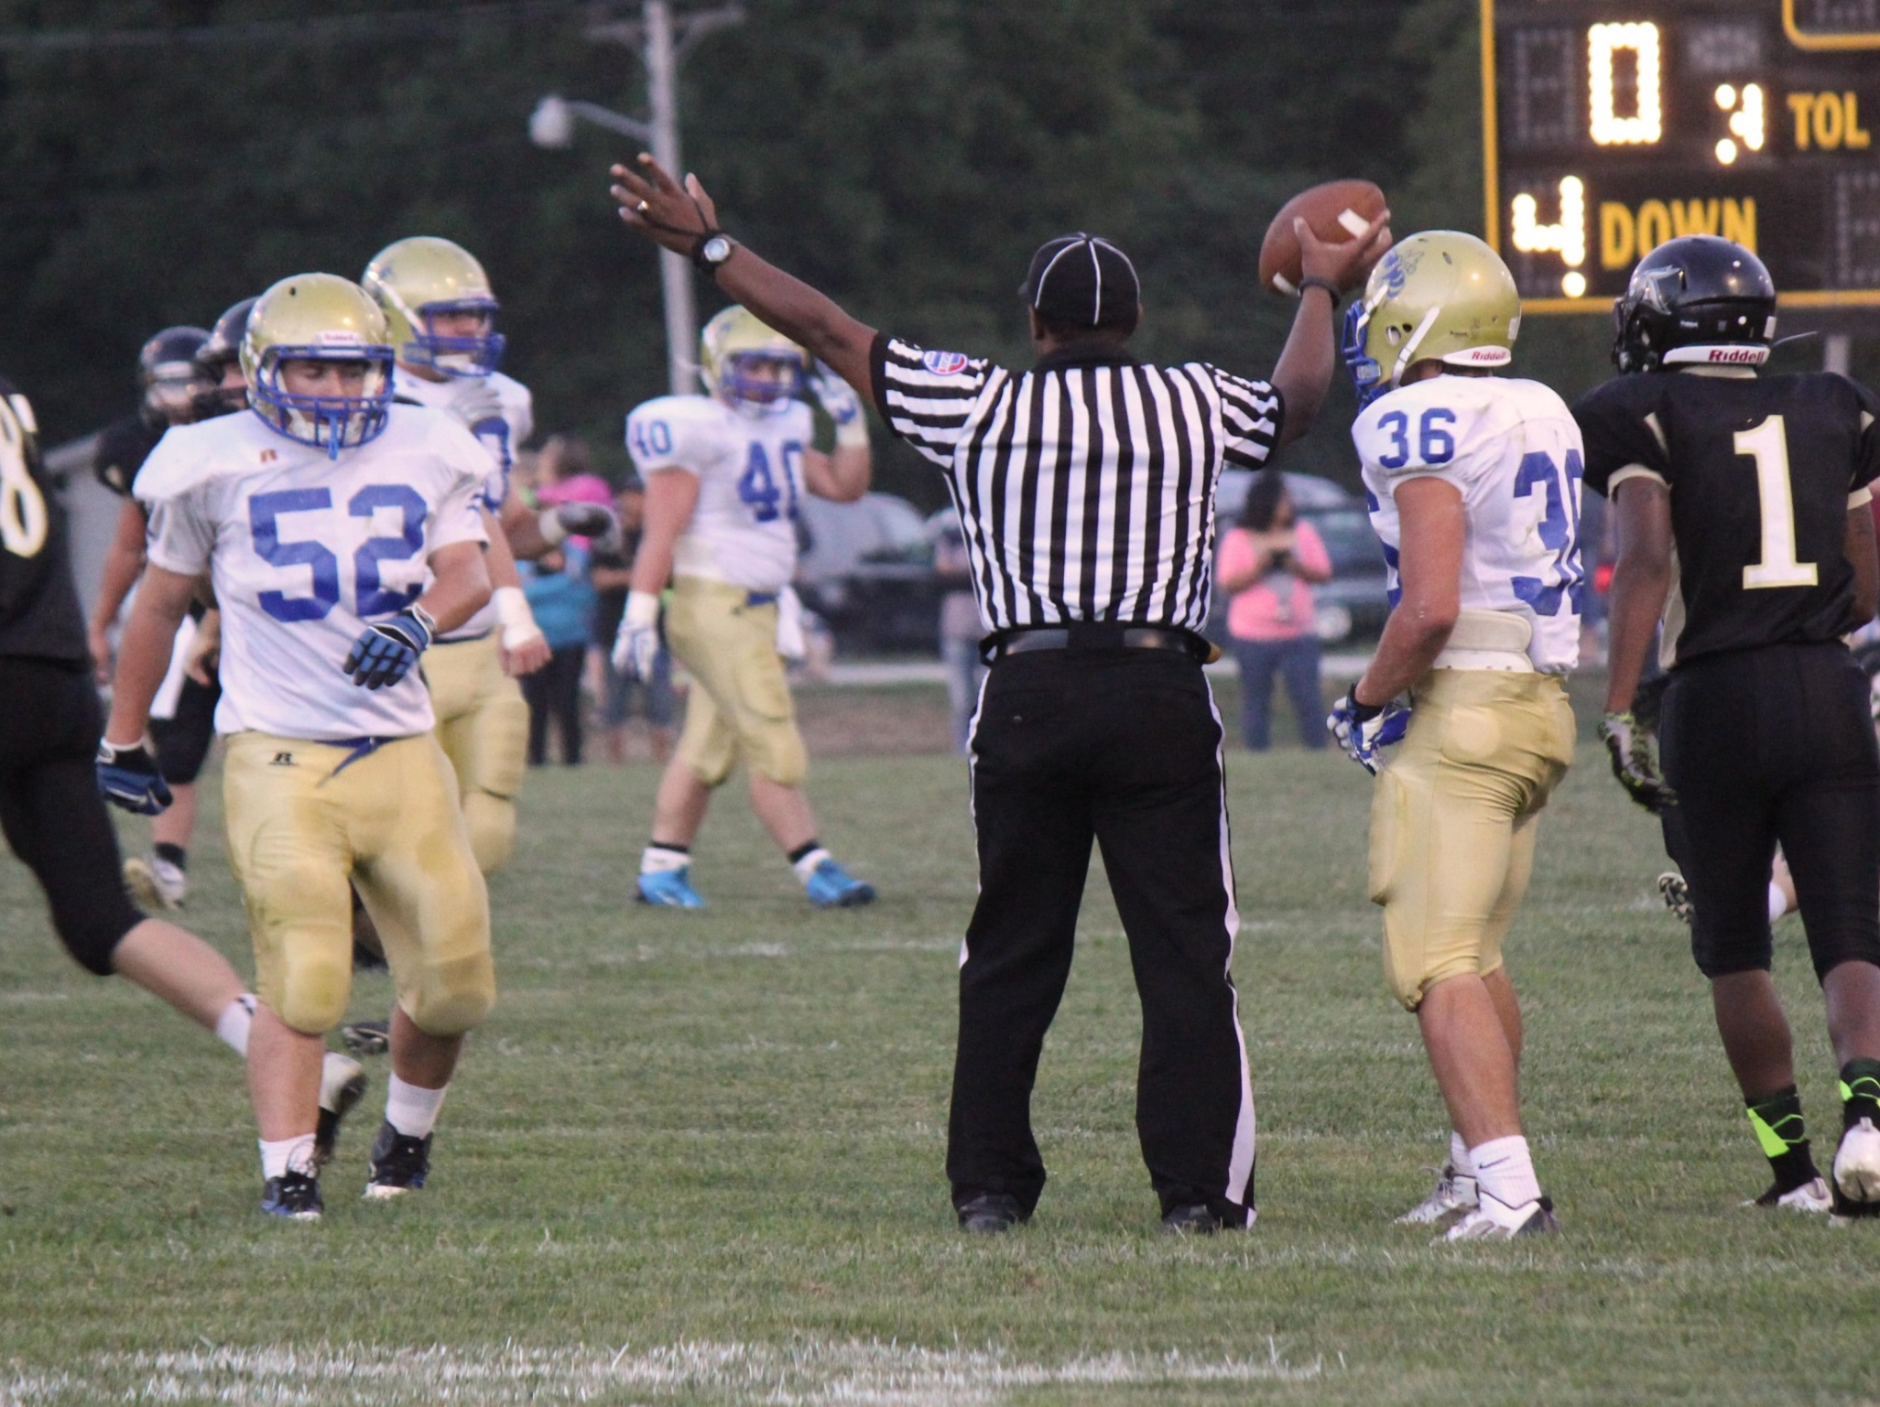

Slide 20
Moving On
Coach them out
Evaluate the job and the individual
Grow your library network

Slide 21
Resource Page
Books and Articles
Berger, L. (2006). The savvy part-time professional: how to land, create, or negotiate the part-time job of your dreams.
Carre. F. [et al] (2000). Non-standard work: the nature and challenges of changing employment arrangements
Mulcahy, D. (2017). The gig economy: the complete guide to getting better work, taking more time off, and financing the life you want!
Nelen A. & de Grip A. (2008). Why do part-time workers invest less in human capital than full-timers? Research Center for Education and the Labour Market, 23(s1), 61-83, March. Retrieved from https://cris.maastrichtuniversity.nl/portal/files/1659296/content
Scicchitano, J. (2013). Part time income enterprise: your road map to make full time income with part time efforts.
The Harvard Business Review https://hbr.org/
All images used in slides come from https://morguefile.com/

Slide 22
Part-Time Employees Big Time Impact
Rachel Arndt
rlarndt@milwaukee.gov
Twitter : @RachelLoAr

