Slide 1
Super Searcher Secrets
Mary Ellen Bates Jan. 20, 2016
BatesInfo.com

Slide 2
Tweeting this?
#wwwc16
@mebs

Slide 3
What we’ll cover
G**gle
Search hacks
Unsung heroes
Insights from social media

Slide 4
Google!

Slide 5
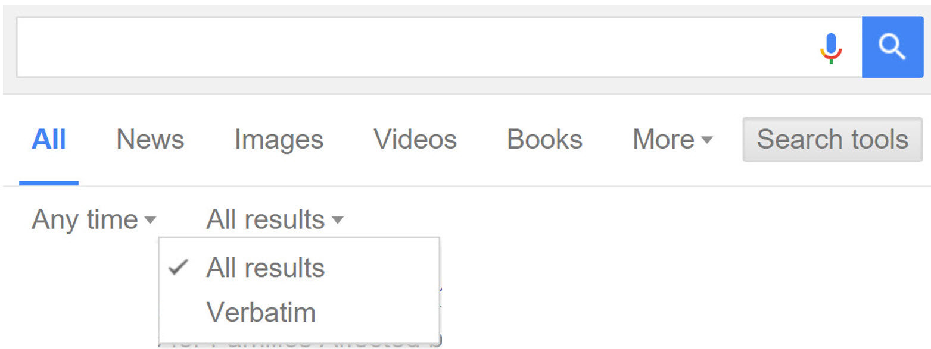
What DOESN’T work anymore
+ no longer searches exact matches
“Use” “quotes” “instead”
or Verbatim option

Slide 6
Parentheses DON’T WORK
You type:
(A AND B) OR (C AND D)
Google searches:
A and (B or C) and D

Slide 7
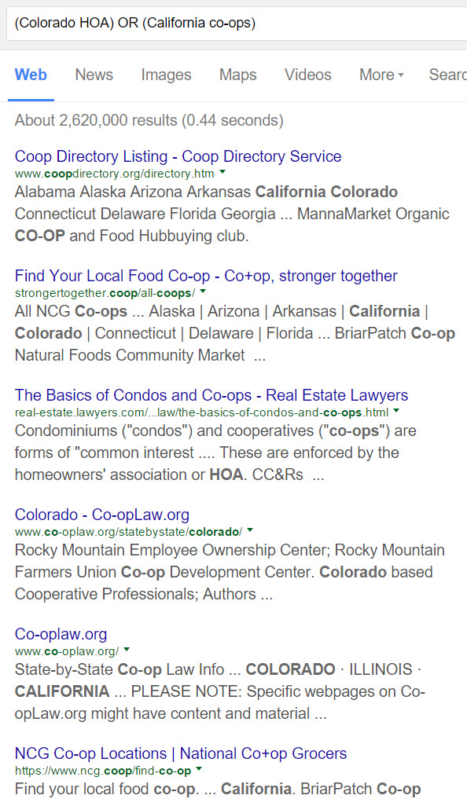

Slide 8
Google search operators
site: to limit to a URL
site:msf.org ebola
.. to search a range
noise cancelling headset $50..$125

Slide 9
Use * strategically
* replaces any term in URL
For educational sites at NASA:
site:*.nasa.* inurl:education

Slide 10
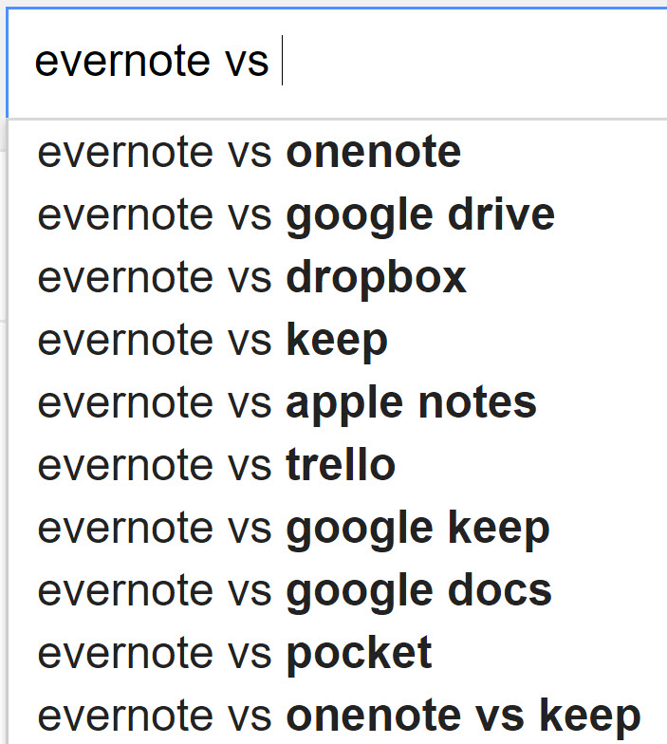
Google Autocomplete
Find alternatives to a product / service

Slide 11
More tricks
AROUND(n) still works!
climate AROUND(4) human
Search Google Books for background info

Slide 12
Search hacks

Slide 13
Use MS Academic for insight
Key authors
Key conferences
Key journals
Keywords
academic.research.microsoft.com

Slide 14
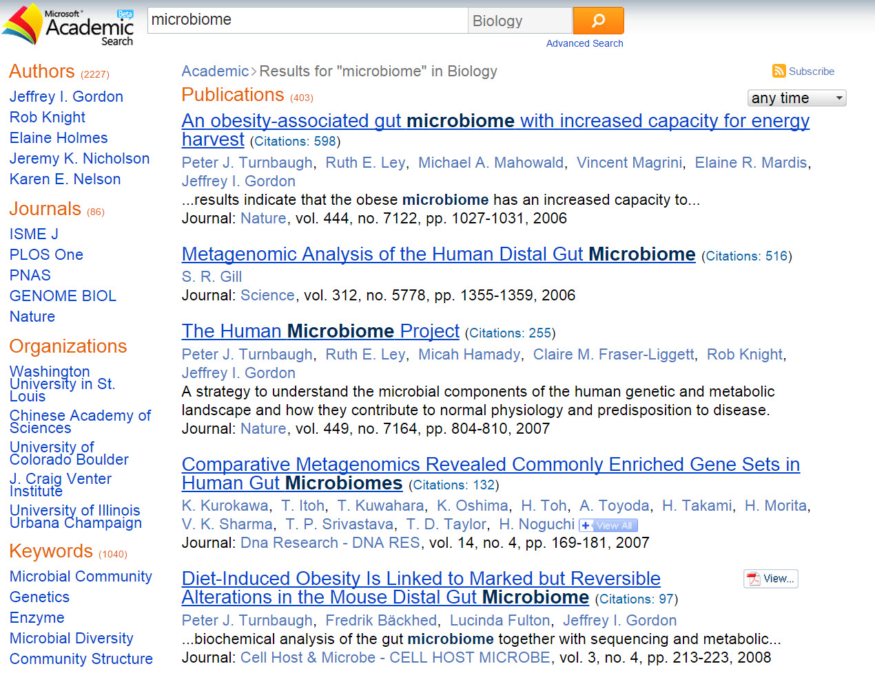

Slide 15
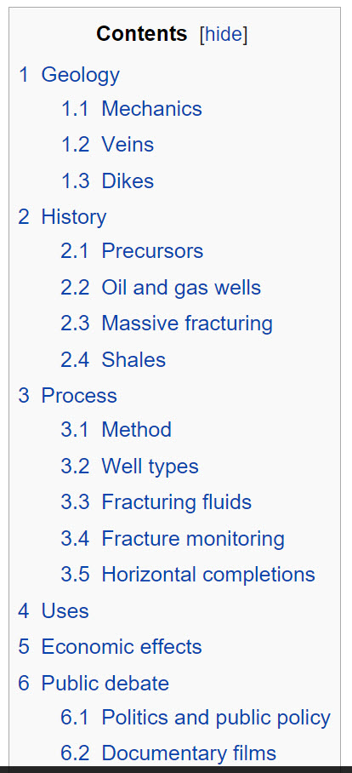
Hydraulic fracking - en.wikipedia.org

Slide 16
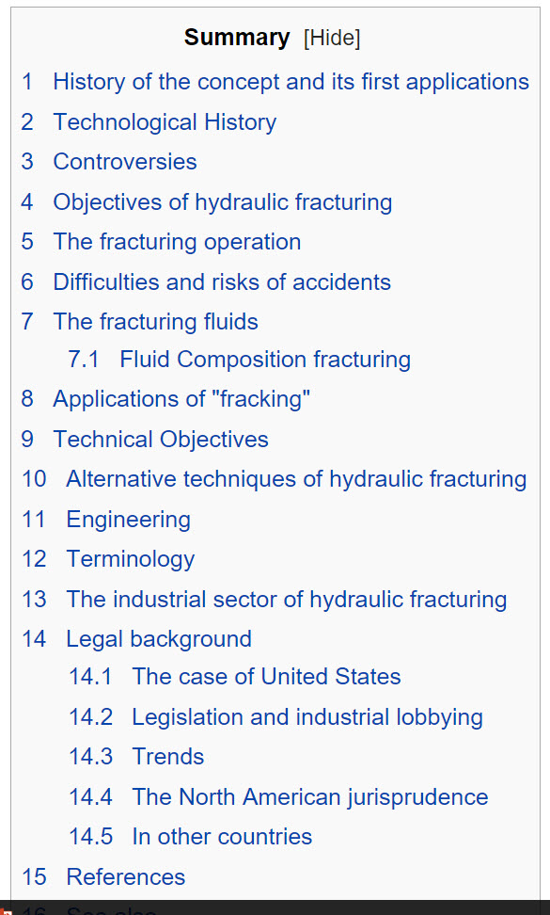
Hydraulic fracking – fr.wikipedia.org (translated)

Slide 17
Search strategy matters!
Uber market strategy
2,340,000 results
What is Uber’s market strategy
12,000,000 results
Uber “market strategy”
42,200 results

Slide 18
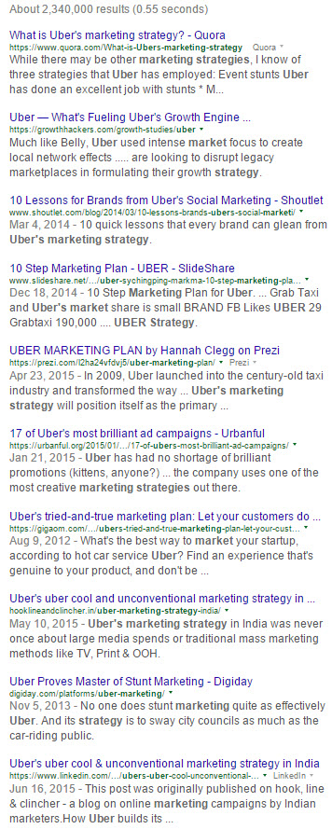
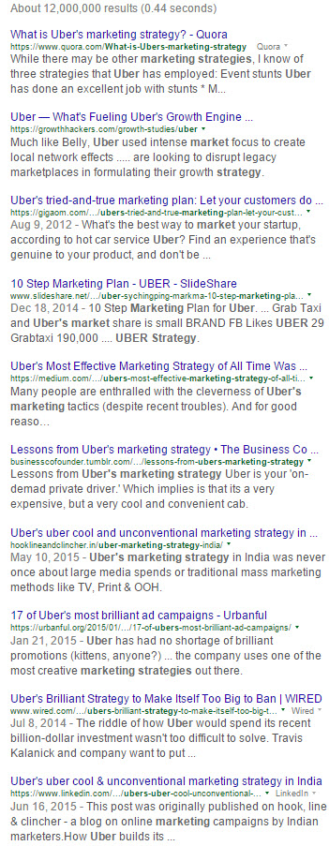
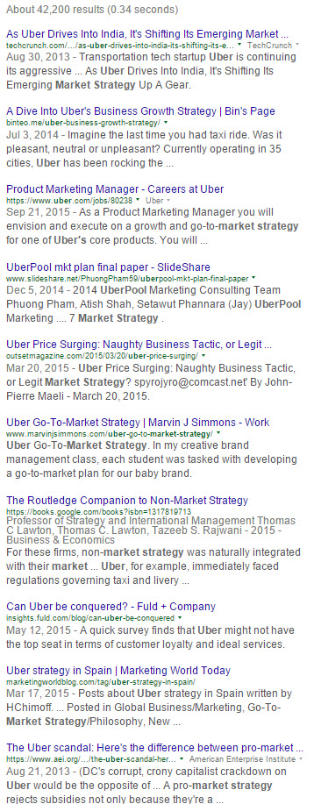
Notes:
Circles are what you WOULDN’T get with the “good” search

Slide 19
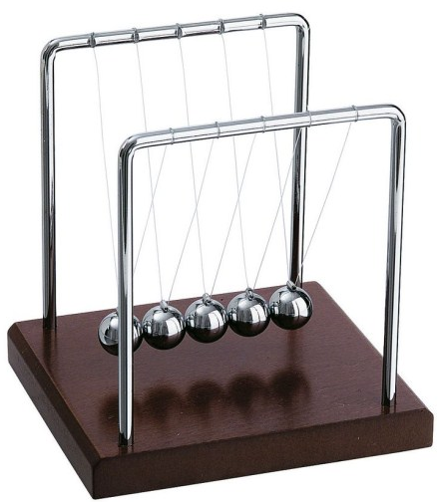
What’s this called?
Notes:
Newton’s Cradle

Slide 20
Using image matching
Tineye.com, Google Images "related images", Bing "Image Match"
Is anyone using our photos?
ID an infographic from the report, look for uses of that image

Slide 21
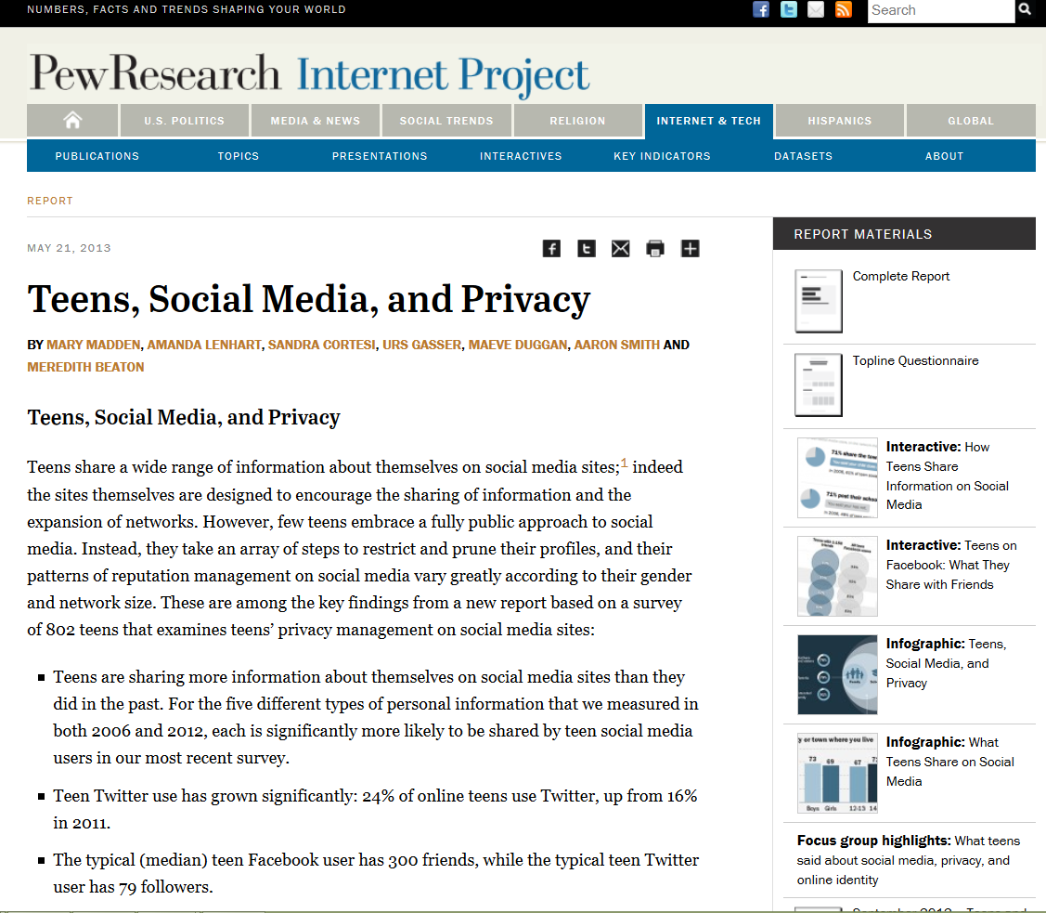

Slide 22
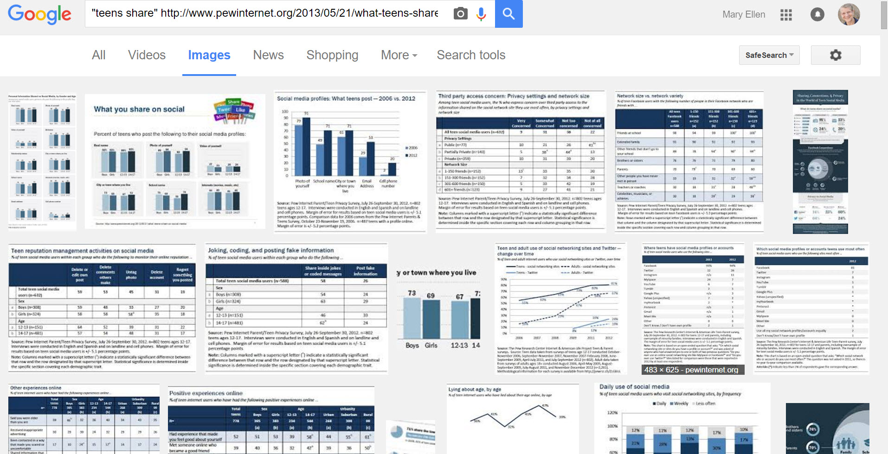

Slide 23
Unsung heroes

Slide 24
Millionshort.com
‘What haven’t you found?’ ^{tm}
Filter by site popularity
Eliminate ‘click-bait’
Essential for people-searching, other long-tail niche searches
Notes:
See municipalization

Slide 25
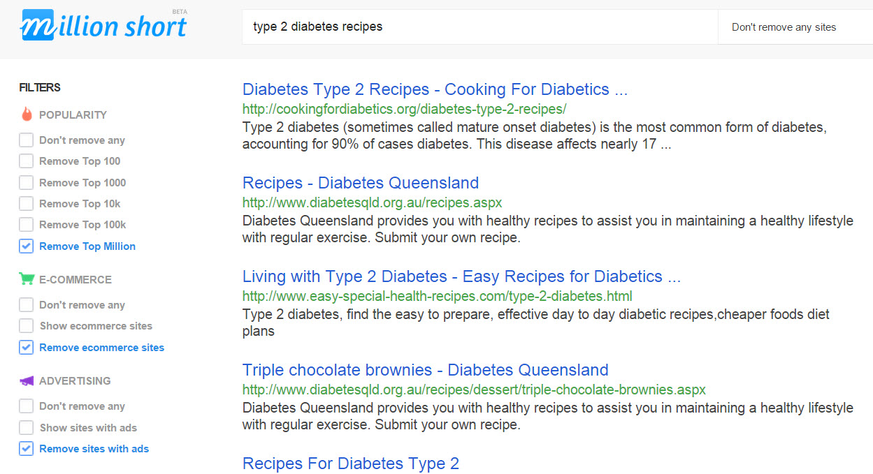
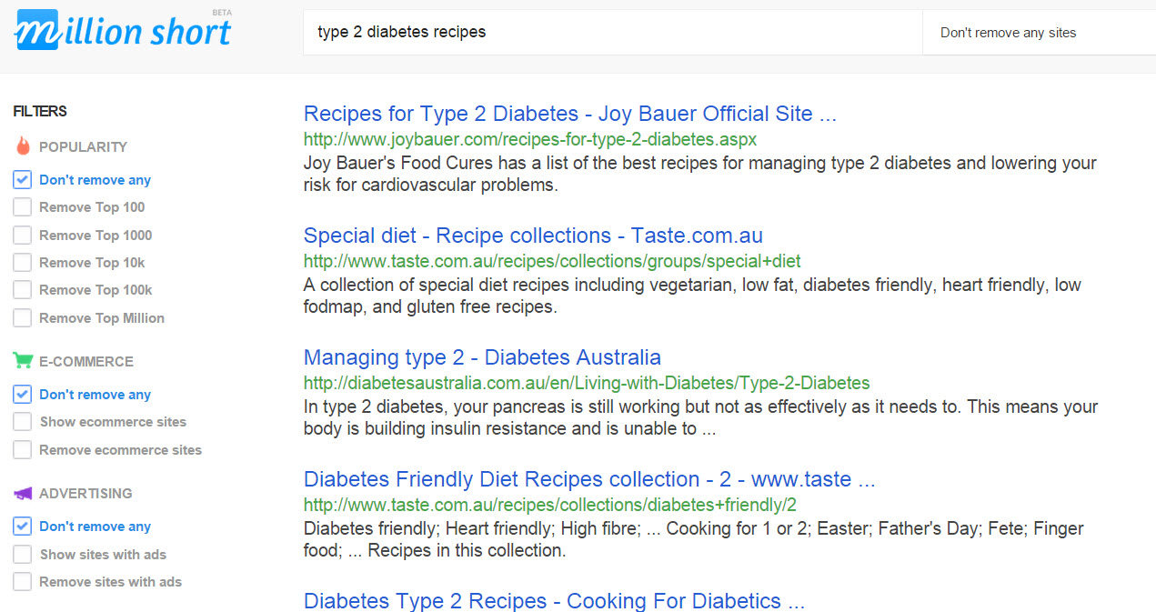
Notes:
See municipalization

Slide 26
Zanran.com
“Google for data”
Web crawler looks for images on web pages
Algorithm IDs tables and graphs
Extracts text surrounding image
Notes:
biomass fuel use latin america

Slide 27
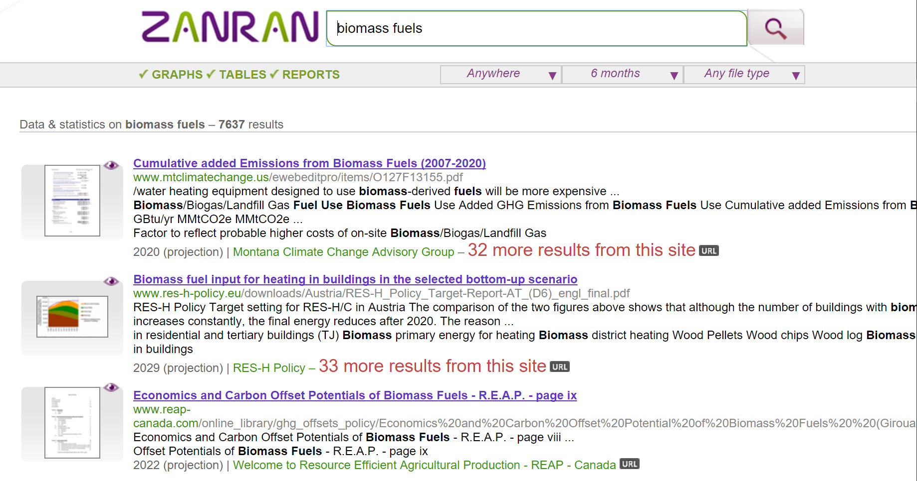
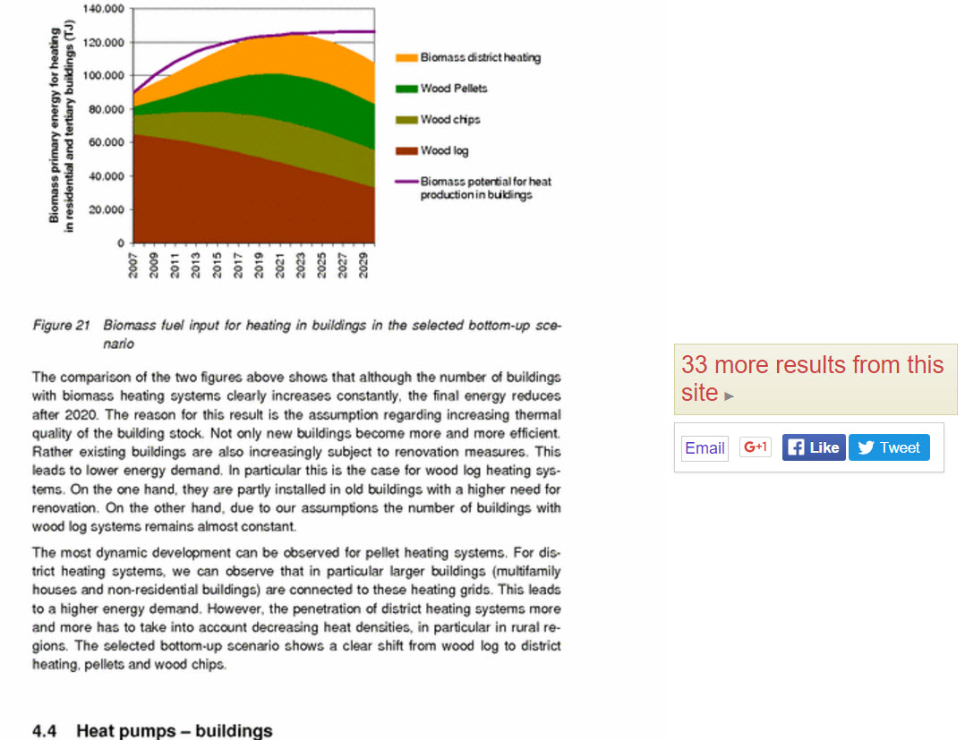

Slide 28
WolframAlpha.com
‘Computational knowledge engine’
Answers, not search results
Nice for comparisons, ready-reference

Slide 29
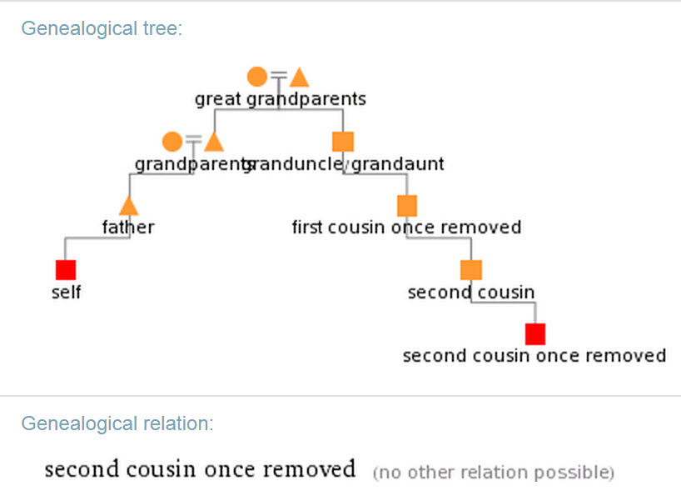
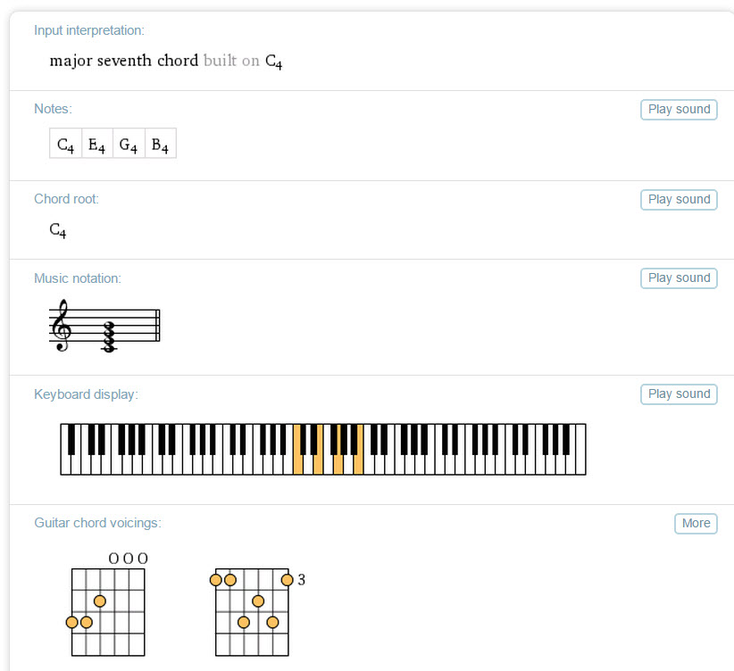
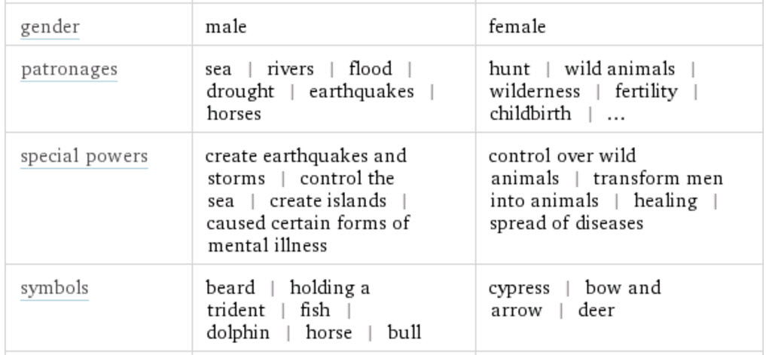

Slide 30
Quick scan-the-horizon
instya.com
Pre-selects search tools for web, video, news, images, social, etc.
Good reminder to users – look in multiple sources!

Slide 31
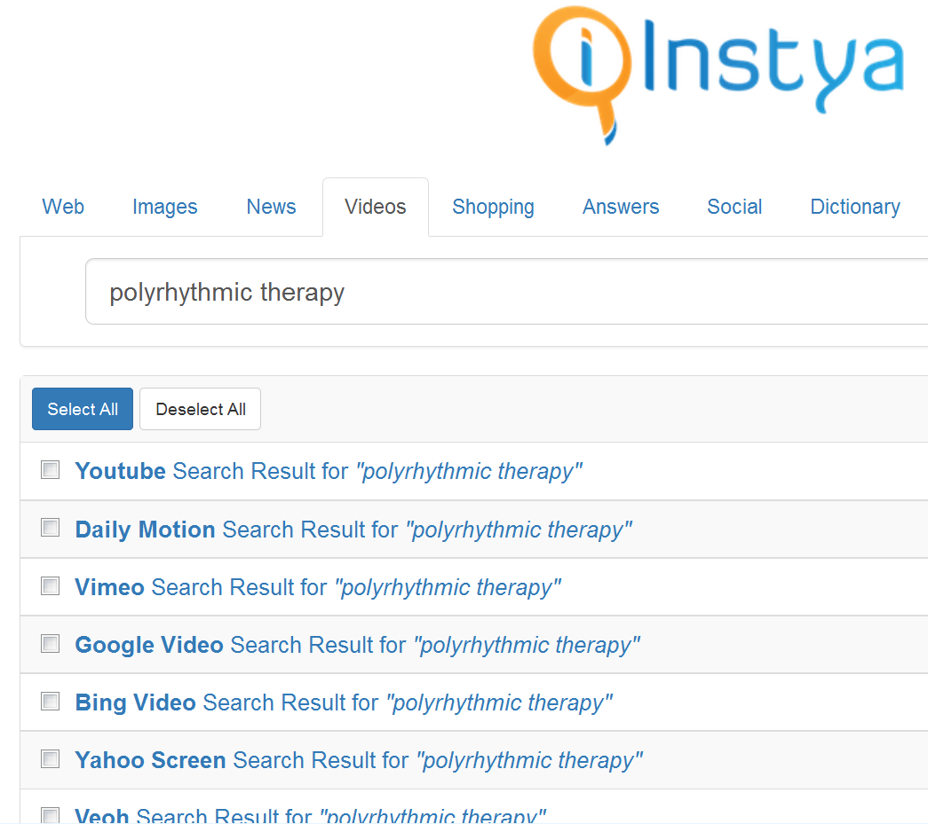

Slide 32
Insights from social media (no, really!)

Slide 33
Search social media on Google
site:facebook.com name
site:twitter.com name
site:twitter.com “John * Doe”
Add location, job, etc. if needed

Slide 34
Searching Facebook
Good luck ☺
Looking for a person:
“People named Joe Blow who live near Pensacola”

Slide 35
Searching Facebook
“Universal” search
Except non-public posts
Good for unusual topics
ID support groups
Sort by relevance, not date ☹
Notes:
Gorham’s Disease – Addie Moser

Slide 36
Searching for individuals
Watch for name variants
LinkedIn: Katherine J. MacArthur
Facebook: Kathy MacArthur
Twitter: CatMac

Slide 37
Following breaking news
Twitter
#keyword NEAR:location WITHIN:n mi
Use keywords used by locals
Skim tweets for trending #hashtag

Slide 38
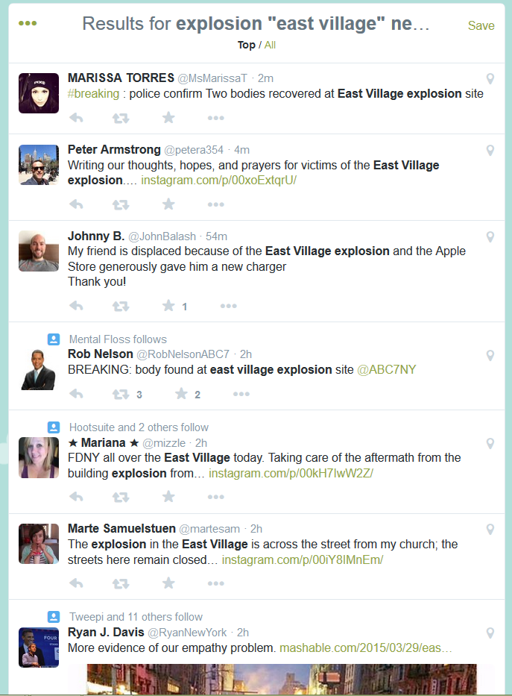
explosion "east village" near:"New York" within:5mi

Slide 39
Twitter search hacks
Look for engagement
min_retweets:n
min_faves:n
Millennials (brands OR marketing) min_retweets:5

Slide 40
Find Tweets w/ links to a URL
Find any tweets that link to a site
(even in shortened URL)
Track mentions of a press release, org
epa.gov “food recovery"

Slide 41
Finding the next source
Look for tweets with links
Topsy has “Links” filters
Twitter search: keywords filter:links

Slide 42
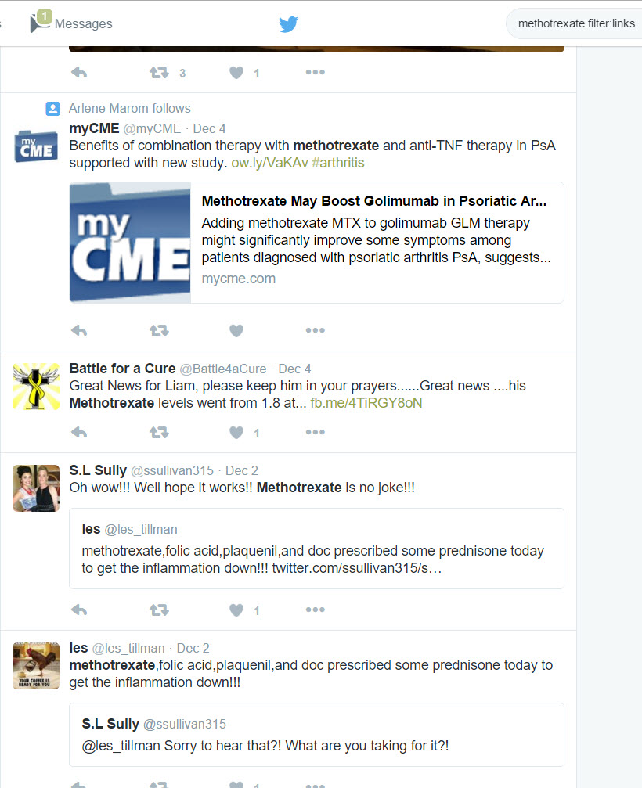

Slide 43
LinkedIn insights
Use Advanced Search to find experts
Use Advanced Search
Search with keywords, location
Filter with Industry: Libraries to find librarians

Slide 44
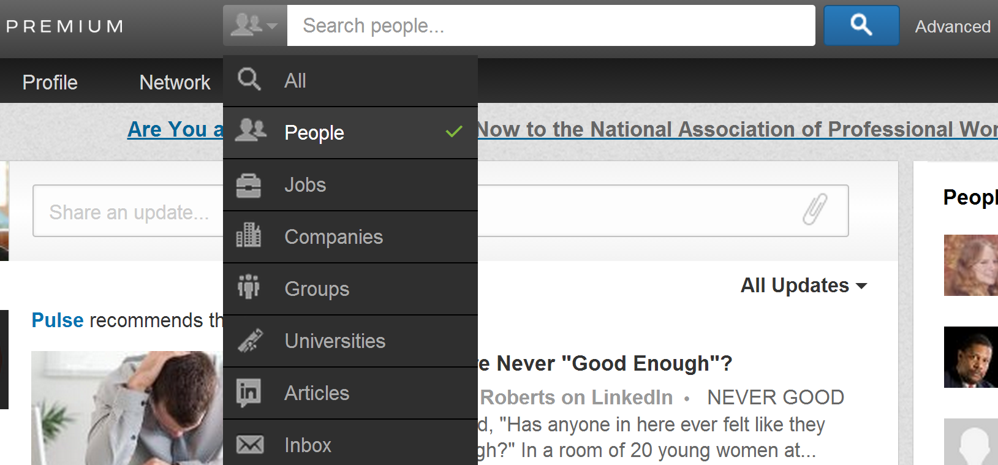
LinkedIn’s Advanced People search

Slide 45
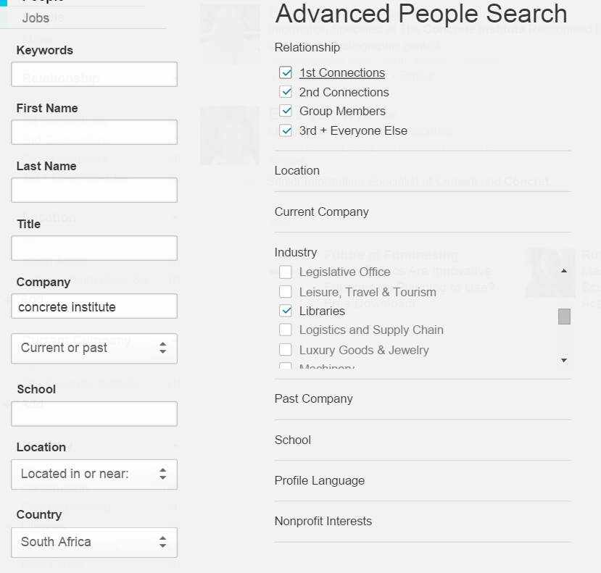
ID info pros to consult

Slide 46
Final thoughts
Stay curious
Cultivate DISsatisfaction
Be prepared to shift as search tools change

Slide 47
Reach Mary Ellen at
mbates@batesinfo.com
BatesInfo.com
Reluctant-entrepreneur.com
Twitter: @mebs
LinkedIn: maryellenbates
Facebook: maryellenbates

