Slide 1
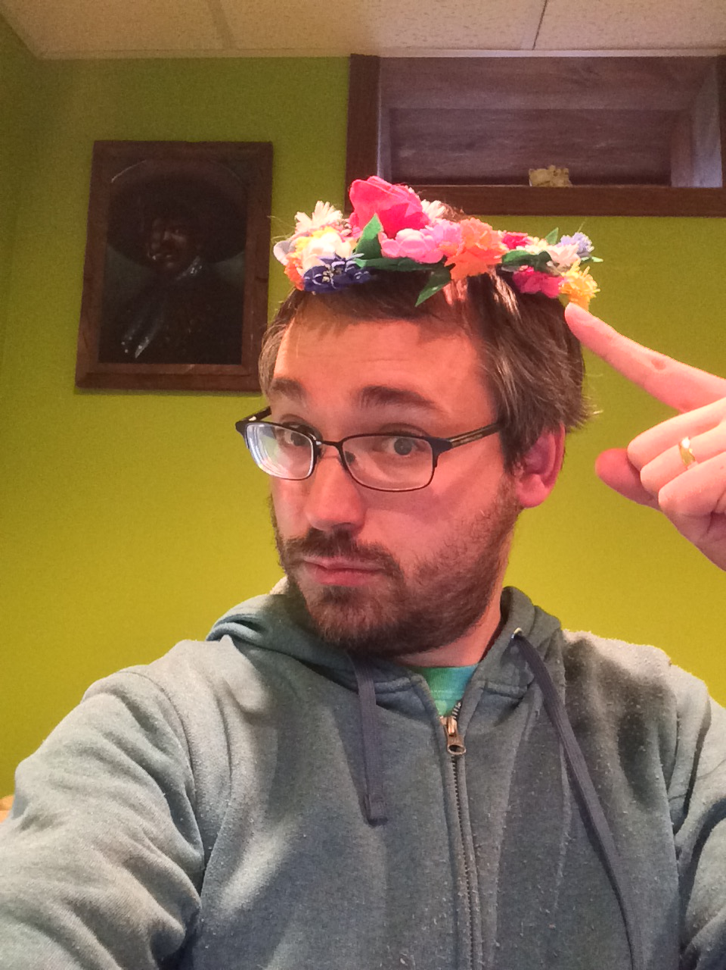
WINNER!!!!
From Bored Member to Board Member
Ben Miller
Resources for Libraries and Lifelong Learning
Sauk City Library Board of Trustees
@bmmsben

Slide 2
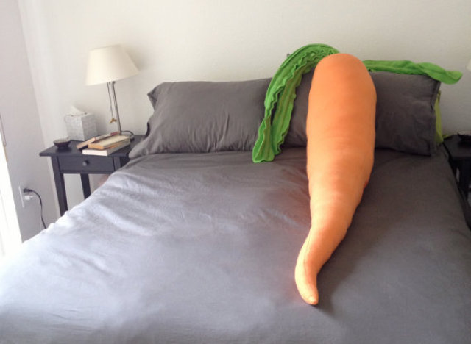

Slide 3
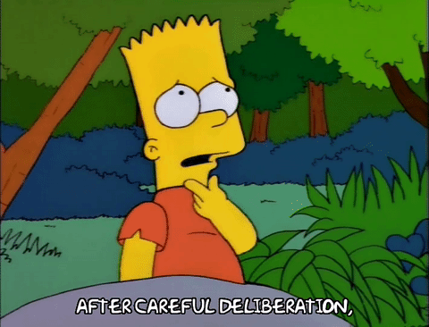
Tell them what you want

Slide 4
Guide Discussion
Provide a recommendation on action items
Don’t take it personally!

Slide 5
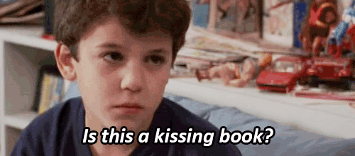
Tell them stories

Slide 6
OUTPUTS
OUTCOMES
# of computer sessions
Storytime attendance
Circulation
The Princess Bride only grossed $30.8 Million
He got a job!
Parents report being more confident reading aloud to their kids
Literacy rates increase
Every wedding is more fun because an uncle inevitable quotes the “Mawwige” speech.

Slide 7
Tell them how to help

Slide 8
“Avoid micromanagement. Give your board members something to do.”
-Ben Miller

Slide 9
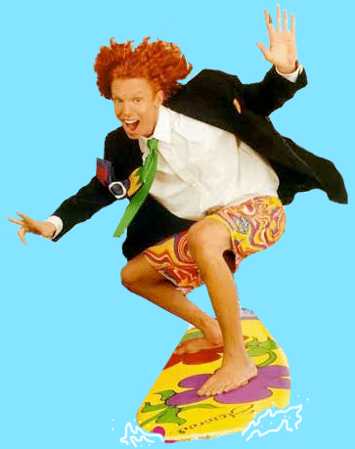
DO IT!
AWESOME JOB BEN!
Best presentation EVER.
Jamie says, “Vote for Ben!”
Ben is the best!
Vote for…
Jean agrees!
EPIC!
Seriously, vote for Ben!
Ben Miller
Resources for Libraries and Lifelong Learning
Sauk City Library Board of Trustees
@bmmsben
BEN RULZ
BEST TWEETS EVER!

