Slide 1
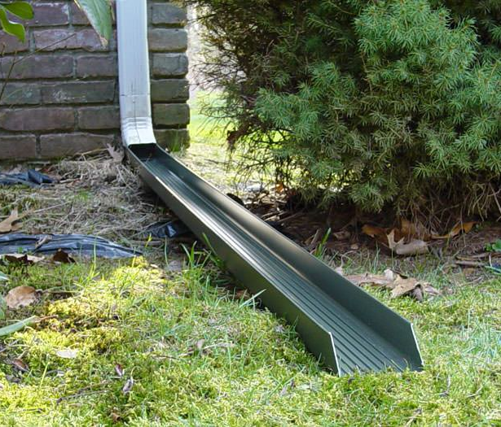
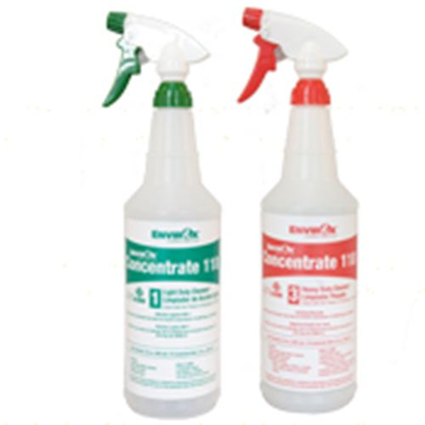
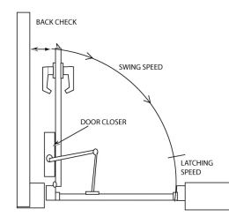
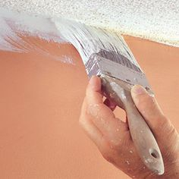
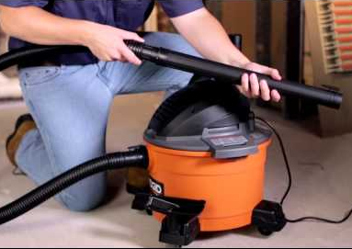
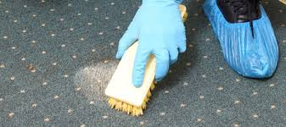
Library Maintenance DIY Curt Beyler Facilities Manager for Brown County Library

Slide 2
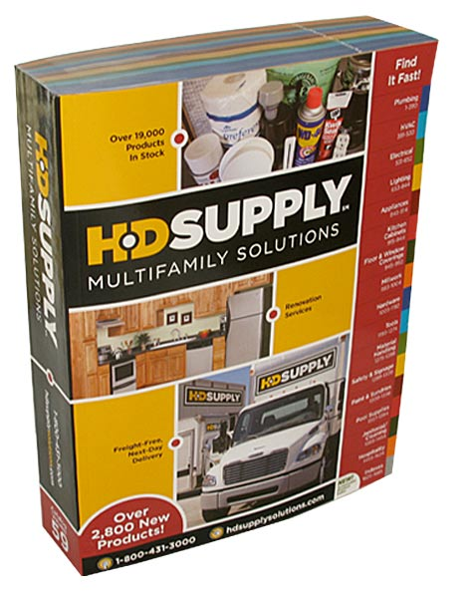
Resources:
Notes:
I will have these at the end too

Slide 3
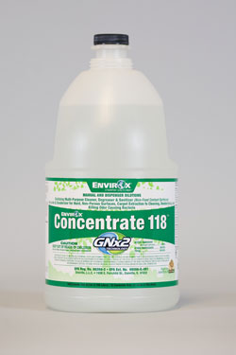
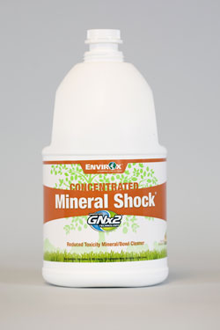
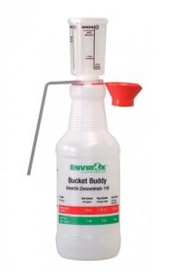
Cleaning Concentrate
Notes:
Green: mopping, carpet, tables, counters, windows, mirrors, doors, walls, computer screens, anything 500 32oz bottles/gal; $45
Red: toilets, urinals, sinks, bathroom door and accessory handles, tough stains; 50 bottles/gal
Mineral Shock: hard water deposits like drinking fountains and toilet rings 25 bottles/gal
Health, reactivity and flammability are all 0 besides MS- health is a 1, 0-3

Slide 4
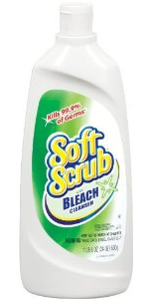
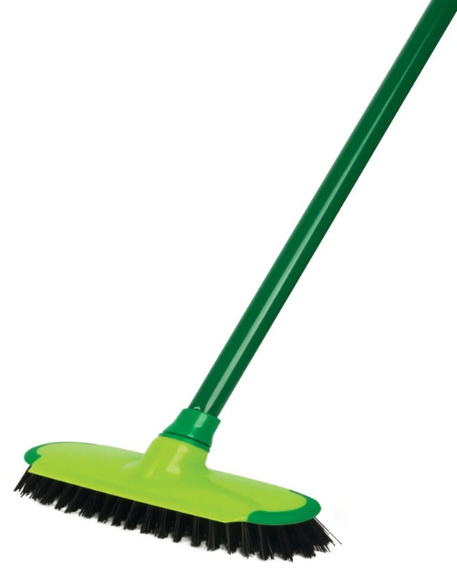
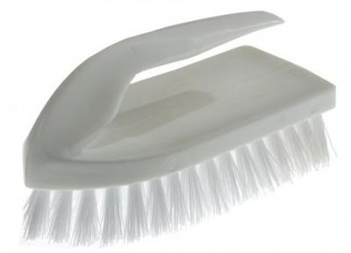
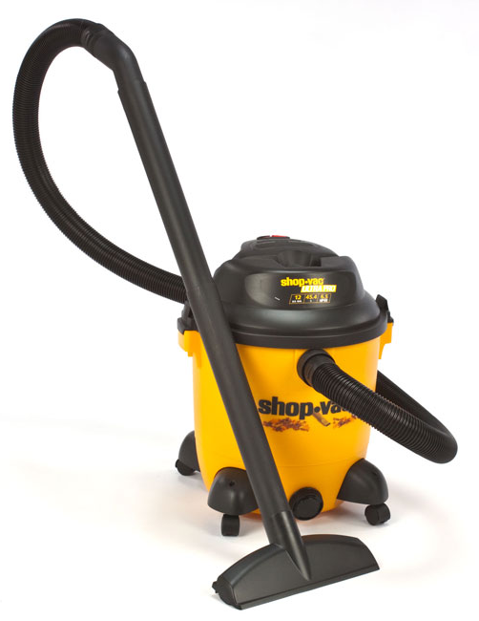
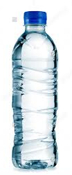
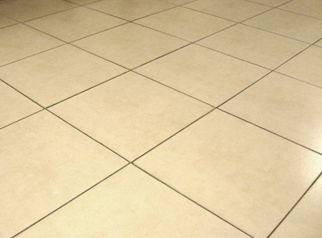
Floor Cleaning
Notes:
I am a firm believer in extraction
1st extract all that you can
2nd apply cleaning solution and in some cases water too
3rd extract all that you can
4th apply water
5th repeat 3 and 4 until cleaning solution is out

Slide 5
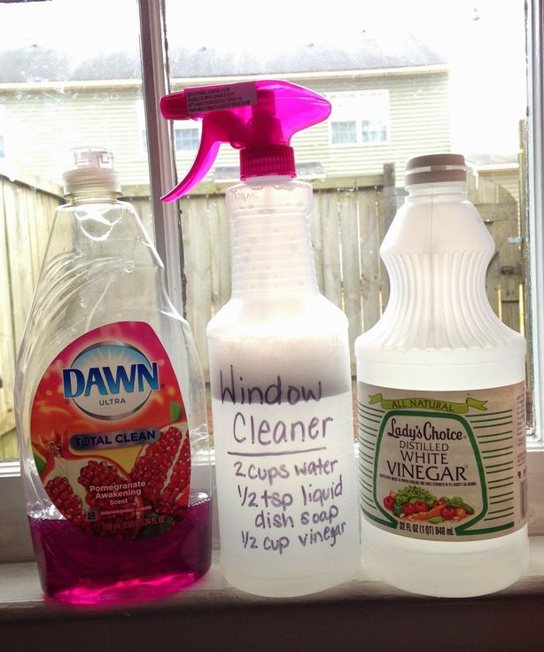
Window Cleaning
Notes:
8:1 water to vinegar, 1 teaspoon liquid soap/gallon
Better that paper towel, terry cloth, even microfiber
If you so a lot of them you may want gloves if you hands start to get black

Slide 6
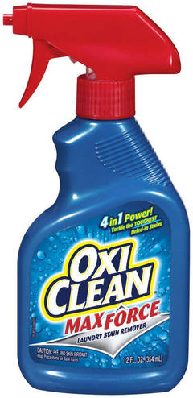
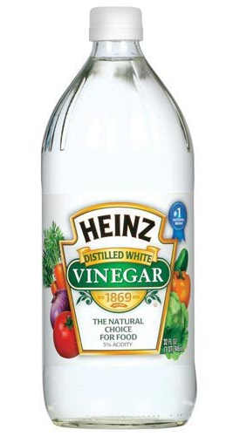
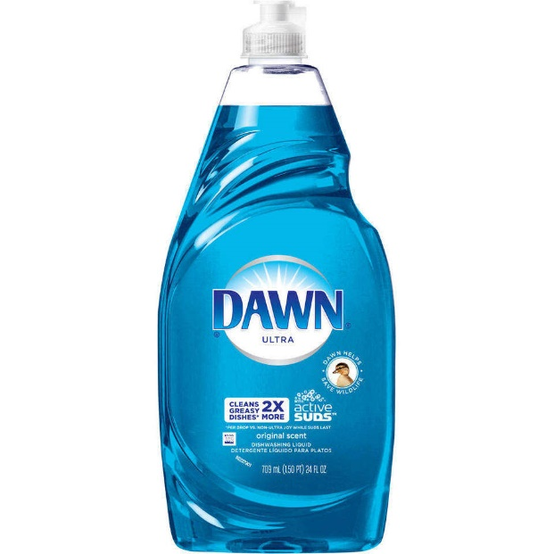
Tough Stains
Coffee Blood
Oil Grease
Notes:
On carpet, upholstery, laundry…depending on what is you would use a different one
The first 3 more for organics like coffee and blood. Commercially-made unseasoned meat tenderizer on dry blood
while the last 3 more like grease, oil or pipe dope.
Dawn on cycling jersey.
Carb cleaner is the end all though; ink
Obviously test on an inconspicuous part first

Slide 7
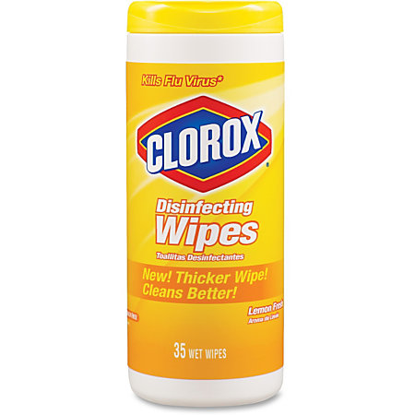
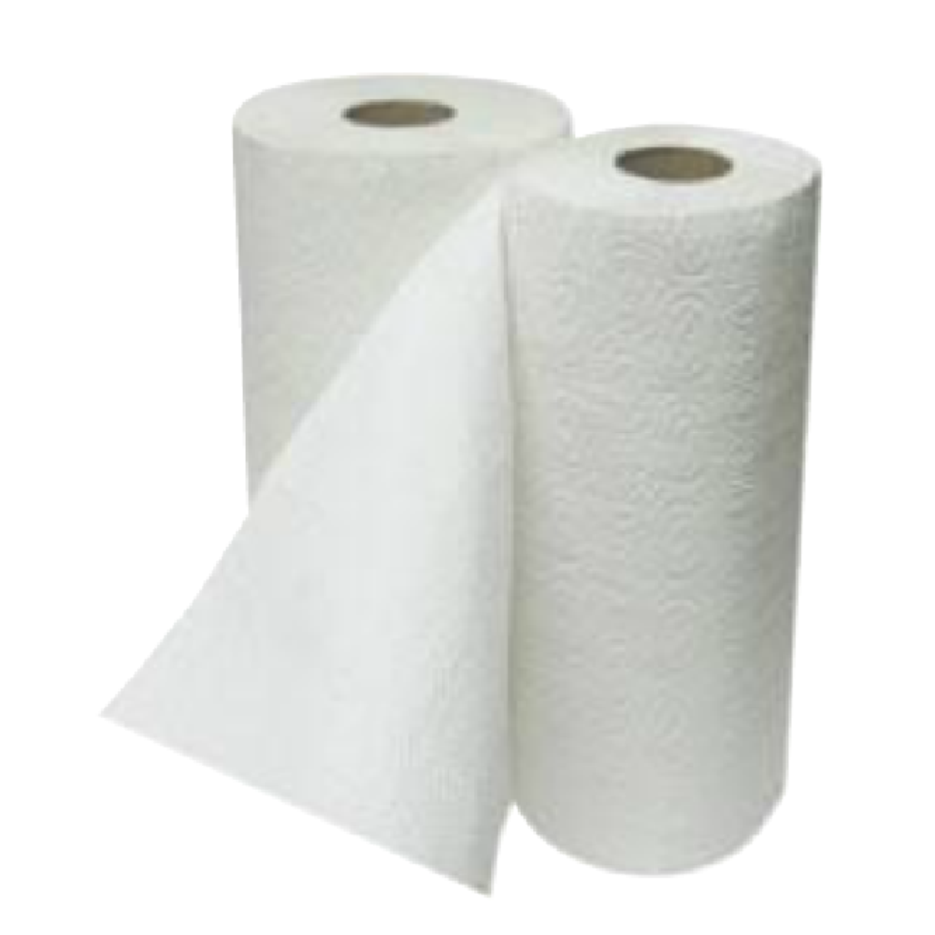
Sticky Spills
Notes:
Like soda or juice
After you wipe them up it often times still feels sticky, even after repeated cleaning attempts
Absorb until dry,
wipe with damp cloth or paper towel,
buff dry with very dry cloth or paper towel turning frequently until slippery

Slide 8
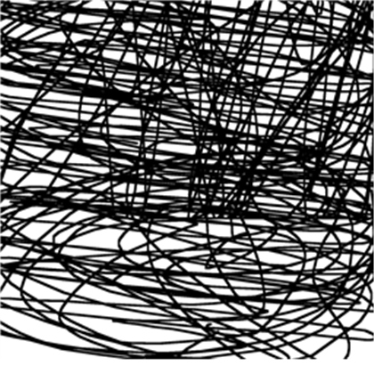
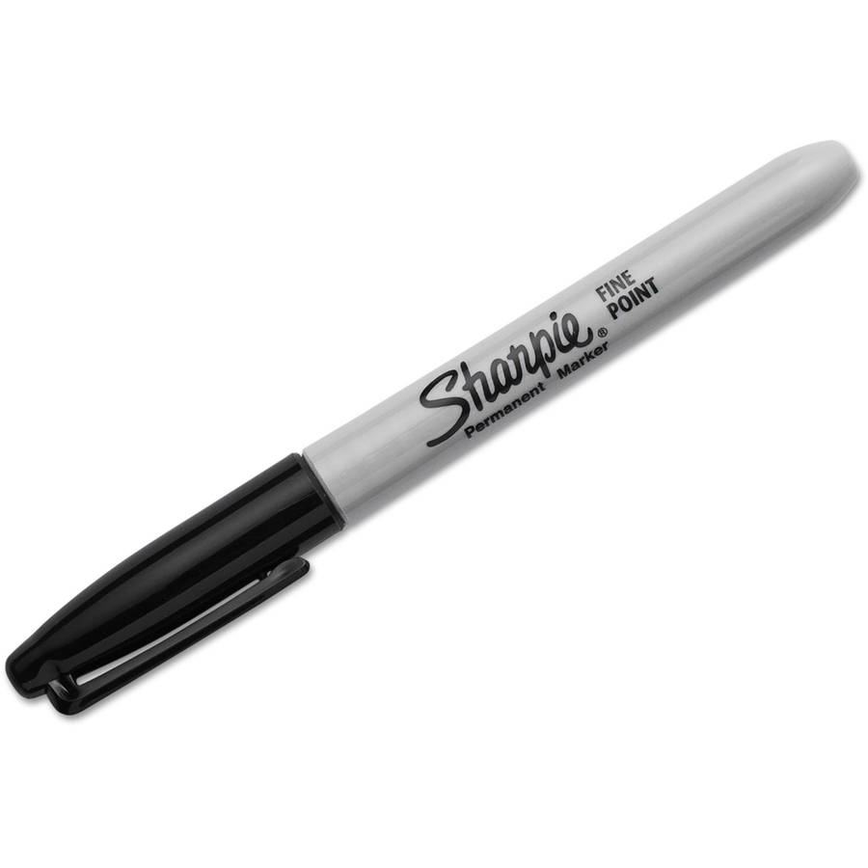
Kate!!!

Slide 9
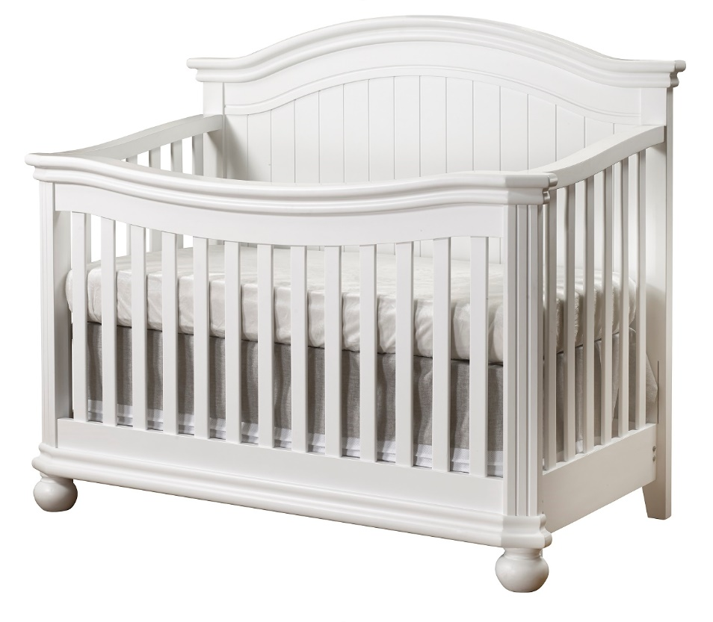
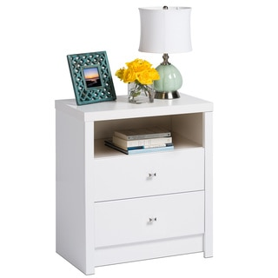
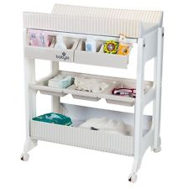
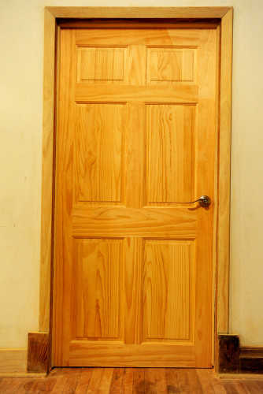
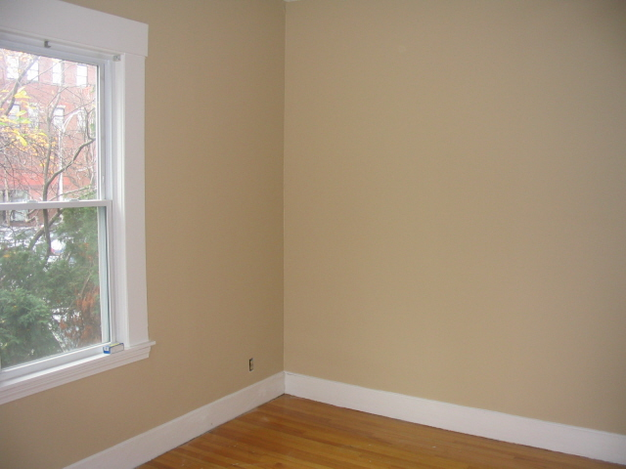
Notes:
We wanted to die or maybe burn the house down.

Slide 10
Magic Eraser
Notes:
Mostly dry, but wet too

Slide 11
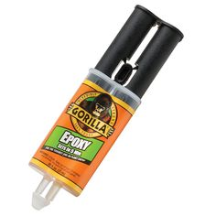
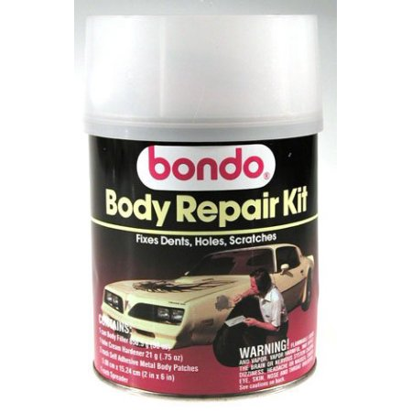
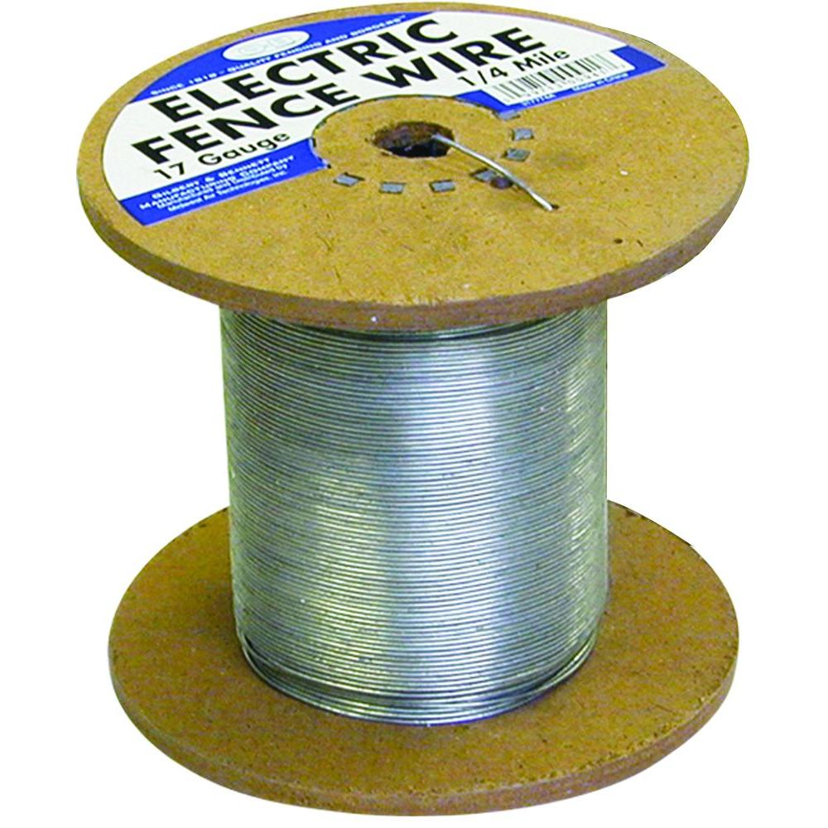
Miscellaneous Repairs
Notes:
5 minute epoxy
Bondo
Plumbers epoxy
Muscle man powder

Slide 12
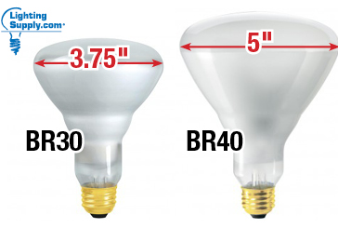
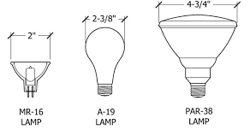
Lighting Basics
Notes:
Bulb description often includes the lamps diameter in 1/8 of an inch
T12=1 ½”
T8=1”
A-19=1 3/8”
R-30=3 ¾”

Slide 13
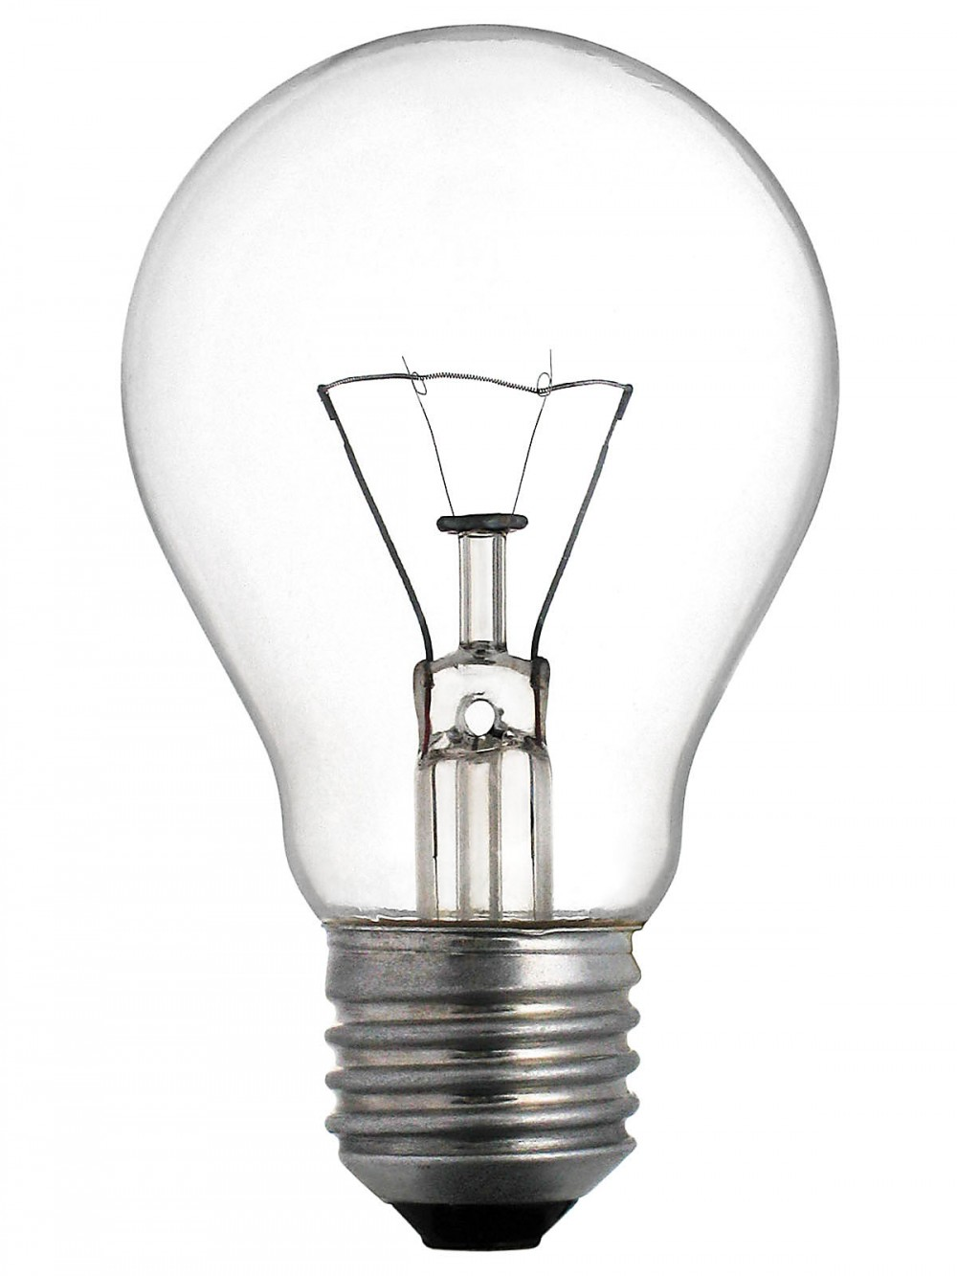
Lighting Types
Incandescent
Florescent
High Intensity Discharge (HID)
Light Emitting Diode (LED)
Notes:
Least efficient, 120 volts

Slide 14
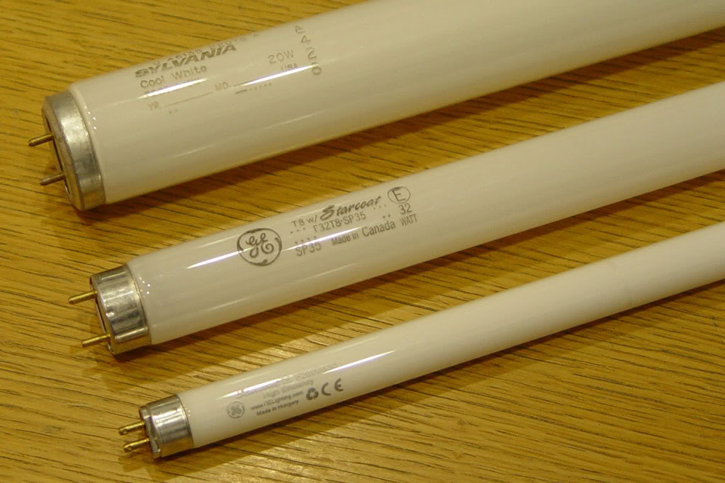
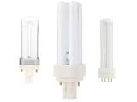
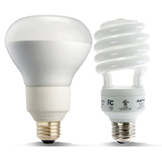
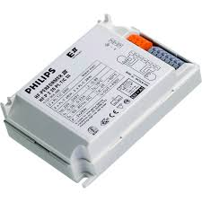
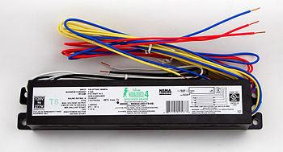
Lighting Types
Incandescent
Florescent
High Intensity Discharge (HID)
Light Emitting Diode (LED)
Notes:
Fairly efficient, most common inside the library
Linear and plug in require a ballast which is a separate part that changes 120 v to the required voltage
CFL have a ballast inside of them that cannot be changed separately
Lots of options; can be good or bad; need the correct lamp
Electrician required to Ballasts and some lamps can be difficult to change

Slide 15
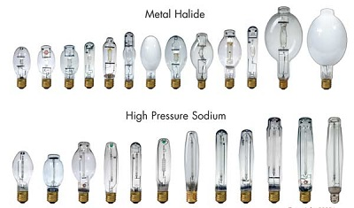
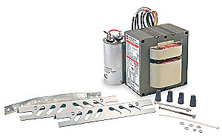
Lighting Types
Incandescent
Florescent
High Intensity Discharge (HID)
Light Emitting Diode (LED)
Notes:
More efficient, last longer, expensive
Exterior, parking lots, street lights
Electrician required to change ballast
We have been changing HID to LED-deballasting
250W to 19W

Slide 16
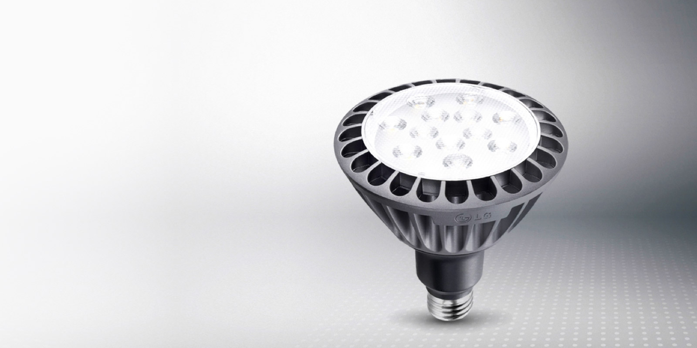
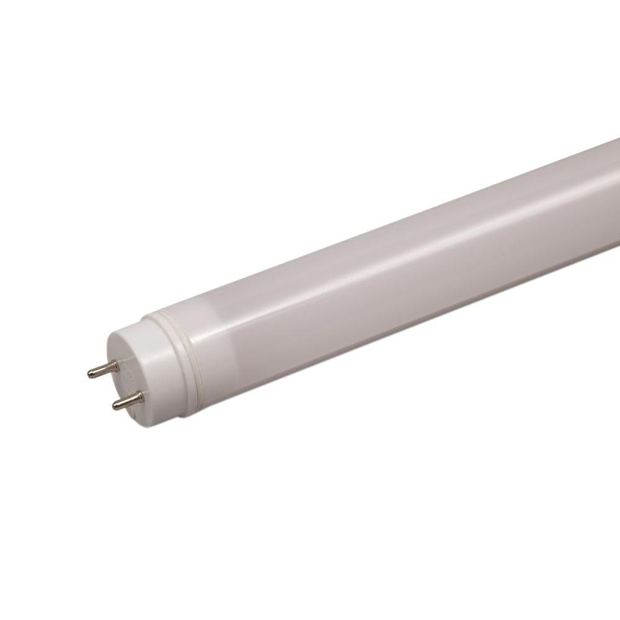
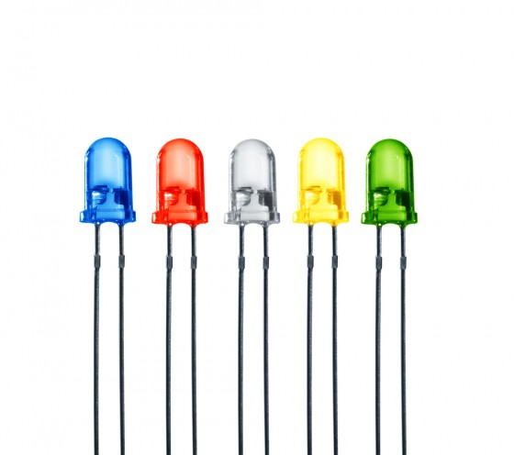
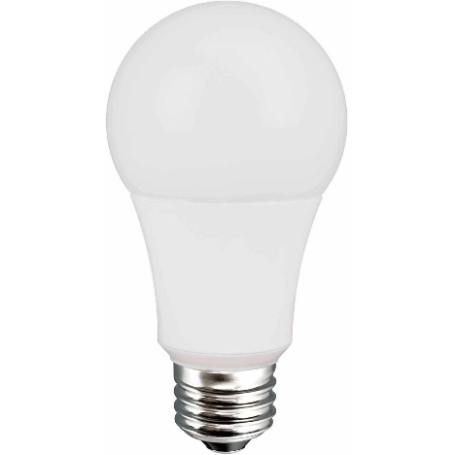
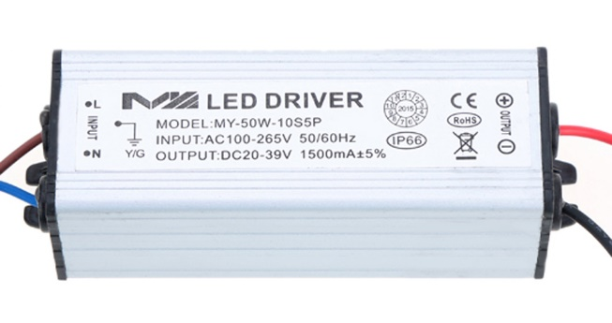
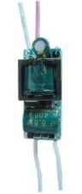
Lighting Types
Incandescent
Florescent
High Intensity Discharge (HID)
Light Emitting Diode (LED)
Notes:
Have come a very long way in the last couple years
Good color, relatively inexpensive, dimmable

Slide 17
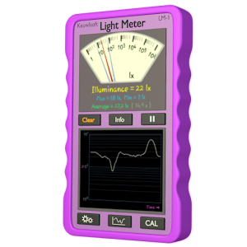
Lighting Selection
Light Level Requirement 35-45 ft-c
Compatibility
Watts/Lumens
Color
Notes:
If you want to get into it, Smart phone app, measure vertical foot candles
Too much, not enough or just right
other outdoor .1
parking lots, entrances=5
General, stairs lobby hallway 10-20
Most usable spaces, offices, stacks 35-45
Telephone books, 6 pt. type, 50-75
Sports or operating room 100-200

Slide 18
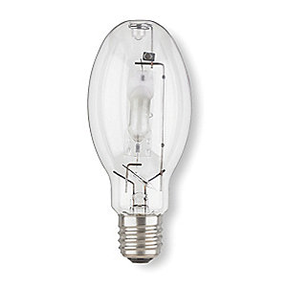
Lighting Selection
Light Level Requirement
Compatibility
Watts/Lumens
Color
Notes:
If it has a ballast, you need to replace what you removed
You can change color
T8 can be an exception
Modern ballasts can operate 25W, 28W, 32W

Slide 19
Lighting Selection
Light Level Requirement
Compatibility
Watts=X(Lumens)
Color
Notes:
If you want more or less light, you may be able to use a different lamp

Slide 20
Lighting Selection
Light Level Requirement
Compatibility
Watts/Lumens
Color Temperature
Notes:
2700 lounge, dining
3500 meeting space
4100 offices
5000 parking lots

Slide 21
Ladders
5’ or 6’ Fiberglass
1 step is 1 foot
Stretch the legs
Press down on a step and rock
Notes:
3 points of contact
Step stools from the stacks are great too
Do not step on the top 2

Slide 22
Extension Ladder
Notes:
Hopefully you never need to get one of these out
4 up, 1 out,
3 over

Slide 23
Painting Tips
Test Colors
Tape & Tarps
Notes:
Test paint on the walls where it will be
Not like this though, next to carpet, ceilings, trim, shelving etc. and on different surfaces;
Let it dry as it is a different color when it does
No tape, no tarps, that way I can see my mistakes and clean them before they dry.
If you catch them within a few minutes, even in carpet, you can get them out with a damp cloth or in the case of carpet, a wet cloth

Slide 24
Painting Tips
Notes:
On most walls use an 18” roller, even, don’t let it dry,
9” only on old wavy walls
Bag set ups
Wash brushes
Roller lines
Back roll
Roller line paint caulk

Slide 25
Americans with Disabilities Act
Notes:
Accessible routes must be 36”, but 42” is preferred
A U turn where the middle is less than 48”, you need 42” routes
Same for a 90°

Slide 26
Americans with Disabilities Act
Notes:
You can have up to ¼”
Threshold height ½” but the ramp must be 2 X longer than high
Over Floor Raceway no more than ½”
$25/ft. Legrand OFR, $3/ft. Grainger or Graybar

Slide 27
Door Closers
Notes:
This is something you can do
If they start to slam or not close
Often in spring and fall

Slide 28
Door Closers Adjustment
Notes:
Some printed on the closer, some under the cover, some have tiny holes in the cover to access Allen screws
Use the latter or the stool from the stacks to hold the door open
90° to 12° (swing)>5 sec.

Slide 29
Ice Melt
1. Calcium Chloride (-25º F)
2. Magnesium Chloride (5º F)
3. Sodium Acetate (5º F)
4. Calcium Magnesium Acetate (5ºF)
5. Potassium Chloride (12º F)
6. Urea (15º F)
7. Sodium Chloride (20-22º F)
8. Various Blends (usually 20-22º F)
Notes:
About 1 handful per 2-3 sidewalk squares.
Bowling
Frisbee

Slide 30
Landscaping
Do not Water fast!
Water low and slow…
Notes:
Standing over
a few inches into the ground
roots will be shallow
faster evaporation
Hose to a trickle it will go down, not out
Lay it on the ground at base, uphill from base if not level
Water the bottom of the hole when planting

Slide 31
Herbicide
20% Acetate Vinegar
Notes:
Ground clear
I would rather have storytime on something I put on my salad that something engineered to kill everything by the scientists at Monsanto

Slide 32
Pre-emergent
Notes:
Corn gluten is used as animal feed
Very high in nitrogen
forsythia bushes begin to bloom (or when your county extension agent says crabgrass germinates in your area
10-20 pounds per 1,000 sq. feet

Slide 33
Water in the Basement
Notes:
Even if your basement walls and floor are nor cracked, you will eventually get water if it is pitched toward the house

Slide 34
Resources:

Slide 35
Questions?
Curt Beyler
Facilities Manager
Brown County Library
515 Pine St.
Green Bay, WI 54301
Office: (920) 448-5849
Cell: (920) 676-6236
beyler_cl@co.brown.wi.us

