Slide 1
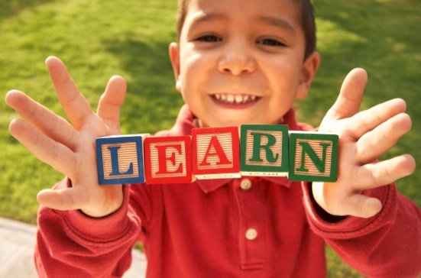
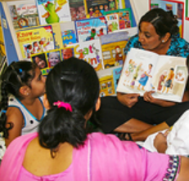


Building Family Engagement Systems Within and Across Library Services
Margaret Caspe and Elena Lopez
Global Family Research Project
January 25, 2018

Slide 2
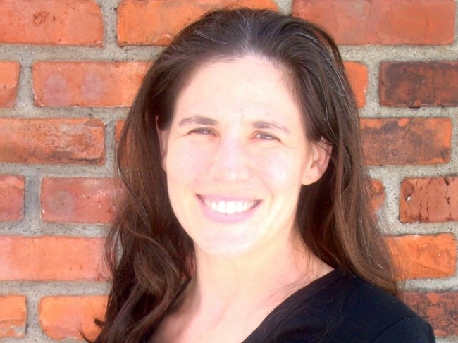
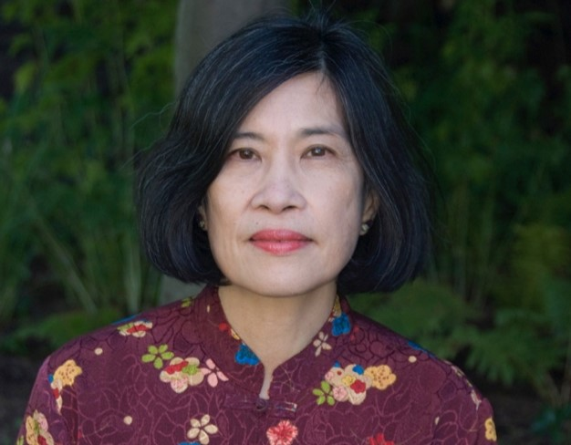
Global Family Research Project
Margaret Caspe
M. Elena Lopez
Notes:
Hi, we are XXX

Slide 3
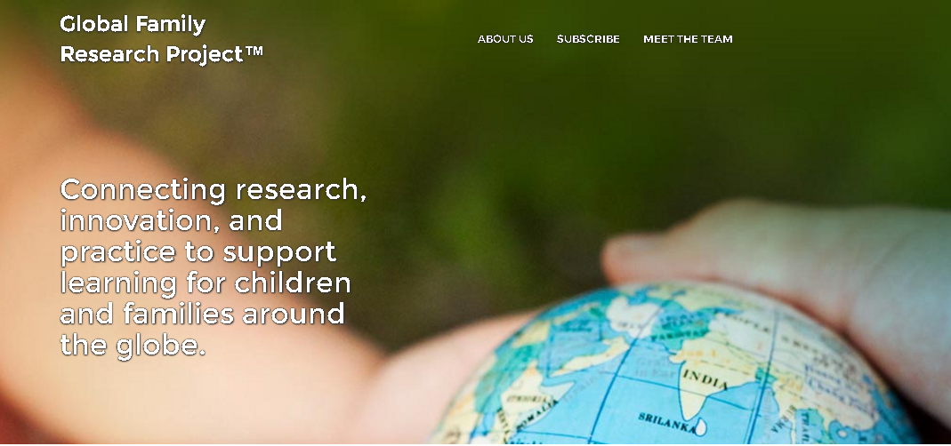
Global Family Research Project
globalfrp.org
Notes:
And the mission of Global Family Research Project is to
connect research, policy, and practice
to promote innovative strategies in family engagement
ultimately to advance family well-being and children’s success in school and beyond.

Slide 4
Did you know?
Notes:
So we thought we’d start off with a quick lightening round of did you know….

Slide 5

Families Impact Children's Success
Improved school readiness
Higher student achievement
Increased likelihood of
high school graduation
Notes:
Did you know that families are one of the strongest predictors of children’s success –
It’s true –
Over forty years of research- from fields like neuroscience, developmental psychology, economics – show that family engagement improves children’s outcomes – it leads to
And families exert these impacts through a variety of ways: through the way they parent, support learning, link children to different learning settings, and develop relationships with providers in those settings.

Slide 6
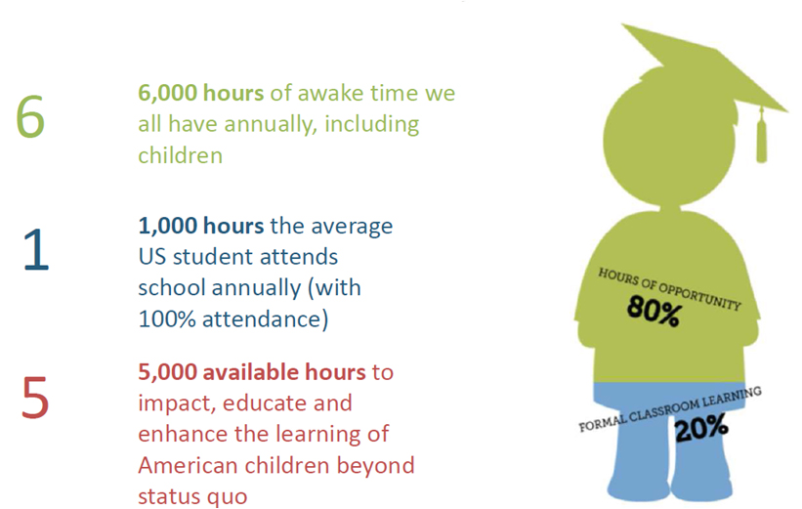
Children Spend More Time Learning Out of School Than in School
Source: Expanded Learning & Afterschool: Opportunities for Student Success
Notes:
And did you know that Children spend more time learning out of school than in school –
As this visual shows, n average, children spend only 1,000 hours of their 6,000 hours awake time in school – leaving 5,000 hours to complement their school learning.
So it’s not that schools are not important – but it’s that schools alone cannot meet students needs – especially those who are most vulnerable –
So children are learning anywhere, anytime – and family engagement can take place anywhere, anytime too
When most people think of family engagement they think of schools –BUT as this visual attests to – it happens in all types of places

Slide 7
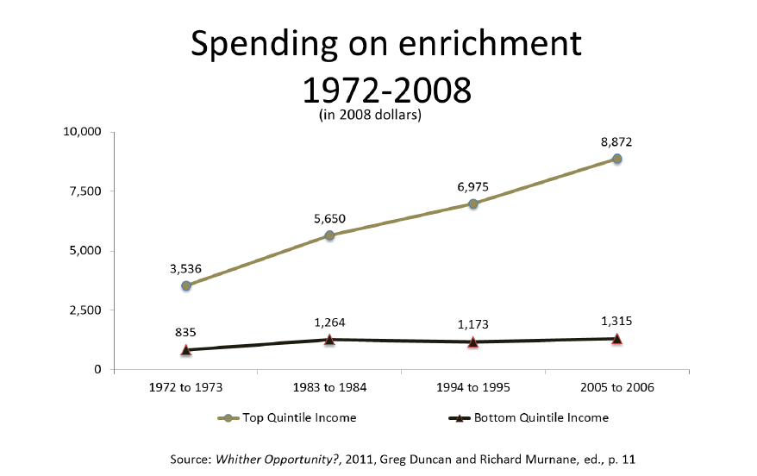
Libraries Can Level the Playing Field
Notes:
We also know that there are inequalities in children’s and famimilies access to out of school learning opportunities based on socioeconomic status -
Today Families with high incomes spend nearly seven times more money on out-of-school enrichment activities—such as music lessons, summer camps, and travel—than families from low-income homes.
And they show that this inequitable access to out-of-school learning has an enormous influence on children’s long term educational outcomes, -
So did you know – that libraries are big part of creating equity in our society and leveling the playing field so that all children and youth have opportunities to succeed is to create equitable opporutnities for out of school learning for family engagement –
Libraries are free, trusted, anchor institutions in nearly every community with the people, place, and platform that can support children and families alike – especially those from low-income homes

Slide 8
Libraries Are Places Families Want to Be
Source: National Center for Education Statistics, Parent and Family Involvement in Education, from the National Household Education Surveys Program of 2012.
Notes:
A survey from the National Household Education Survye shows that families [READ]
So they matter because they are places where families are and want to be
And libraries are already having a good amount of success in engaging families around literacy particularly in the early hyears –
You are all likely familiear with ECRR which has shown that XXX
And Family Place Libraries --- XXX
Libraries have really become a space where families –
Get information to support children
Get connected to resources
Get connected to other parents.

Slide 9
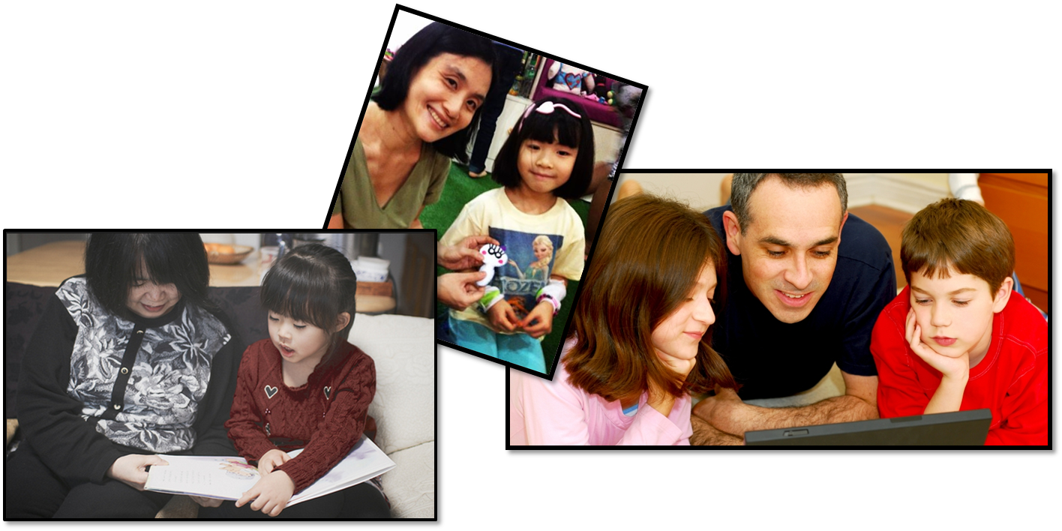
Take a Moment to Reflect
When you think of FAMILY ENGAGEMENT in your library, what comes to mind?
Notes:
So let’s all think like for us to all think for a moment.
When you hear FAMILY ENGAGEMENT, what word comes to mind?
Go ahead and type your idea or words in the chat pod to your right – and I’ll call them out as they appear.
Just a few more seconds.
OK! – that’s great – and very much in line with how we think of family engagement in our work….
These are great practices - --- and over the past two years we have been learning about what libraries all over the country are doing to enhance their services for children, youth and families -
Over

Slide 10
What’s Inside
Ideabook: Libraries for Families?
Notes:
So what we’d like to do today is talk about a resource that we developed with the Public Library Assocaition called Ideabook for families that can be a tool for you to grow and build family engagement systems in your libraries -

Slide 11
Notes:
And this resource is the Ideabook: Libraries for Families
It is free to download at www.globalfrp.org
WE created the Ideabook so that librarians can:
Learn from one another
Find inspiring ideas
And create meaningful learning experiences for families
And we’d like to spend some time walking through what’s inside and how you might use it.

Slide 12
Notes:
So Part 1 of the ideabook is an introduction

Slide 13
Notes:
We begin with what we know about family engagement – and here are some of the ihglights:

Slide 14
It’s About Relationships
Families:
Promote and advocate for children’s learning and development from early childhood to young adulthood
Librarians, Teachers and Community Educators:
Open doors for families to meaningfully participate in children’s learning anywhere, anytime
Notes:
We know it’s about relationships and shared responsibilities among families, schools, and communities to promote children’s learning
It’s not a one-size-fits all curriculum or program
But instead, it’s the way that families promote and advocate for children’s learning and development from EC to young adulthood – in whatever way feels comfortable and appropriate for families
And it’s the ways that teachers and librarians open doors for families to meaningfully participate in children’s learning

Slide 15
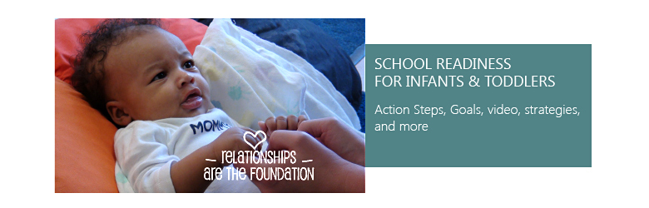


It’s About Thinking Across Place & Time
Notes:
And we also know that family engagement happens across time –
It might look different at different points in a child’s life –
For example,
for a young child family engagement might take the form of reading books,
in elementary school, it might be doing homework or linking children to different learning settings,
or, in high school, helping children develop high expectations for learning
But regardless the age – learning is important, and families make a difference

Slide 16

It’s Systemic
What would you do to build the world’s best car?
Notes:
We also know that family engagement is systemic –
This means that different elements are not siloed but come together towards certain goals –
To, to help illustrate what I mean by systemic – I like to think of a thought experiment from Tony Bryk.
He asks us to imagine we want to improve and build an effective and efficient car
Some people might say – I’ll get a Porsche engine,
Ferrari breaks,
and a BMW body, you get the point.
But he asks – when you put it all together, what do you get?
He would answer an expensive pile of junk –
His point is that adding more parts (e.g., more people, tools, or resources) does not ensure a quality result – what matters is how the parts all fit and work together - that is a system
If one part doesn’t work – then all of it doesn’t work…
this is what the Ideabook Provides – Let’s look inside
SO from our qualitative work – one of the things that we heard most was that while libraries are doing amazing work in the areas of family engagement – perhaps with great programs for adults in health, or maybe great teen programming that involves families in makerspaces, or great family literacy workshops
What libraries aren’t having a lot of success at – and what they want to be able to do – is to find ways to make all of the distinct parts in a library work together to support more systemic and integrated and intentional famiy engagement
So what we’ve done – is we’v created a framework to help libraries think about and begin to do this work.
And the framework has 3 parts:

Slide 17
Notes:
And the system that the Ideabook provides is that which has 3 elements:
Leadership –\
Engagement –
Support services –

Slide 18
Notes:
In the leadership section of the Ideabook we explore -
Leaders—and by this mean including library directors
and youth or children’s librarians— drive the vision and commitment to engage families in children’s learning, from early childhood through young adulthood.
Leaders:
• Create possibility - meaning that they make it their mission to promote equity by transforming library practices to meet family needs
• They build professional capacity – giving library staff the skills, knowledge and beliefs they need to engage families effectively -
• Secure resources.
• Use data to learn and improve –

Slide 19
Notes:
In the support services section we look at how the physical library space, collections and technology enhance contribute to family engagement and create welcoming spaces where families want to be.
mework has 3 parts:

Slide 20
Notes:
And the last is element of the framework is engagement – the ways that libraries on the ground are building relationships with families– and this we call the Five Rs’
The 5 Rs are the ways that libraires reach out to families, especially those in special circumstances, to promote the programs, collections. and services
• They ways they Raise up families voice and include them in planning
• They reinforce families role as their child’s first teacher – all the way from birth through young adulthood
They create opportunities for families to relate to one another and build peer-to-peer networks
And they reimagine – and expand their community partnerships to reimaging what learning in a community can be and fill gaps where needed.

Slide 21
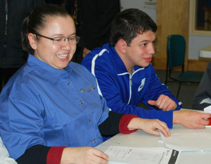
Reach Out
Waukegan Public Library (IL)
Notes:
So So for example, in Waukegan Illinois, staff started a community amabassador or promotoras program – you see, over the past 10 years, the community had seen some changing demographics – with many Spanish-speaking Latino families moving into the area – and although the library was committed to including immigrant families – and had many services to support them – families never came. After engaging with community leaders – they learned that in Mexico – where many famileis were from – the idea of a library was that it was a place for academics – and not for families – so they started this program where community members go out into the community knock on doors and talk about what families would like – and how the library can fit that need.

Slide 22
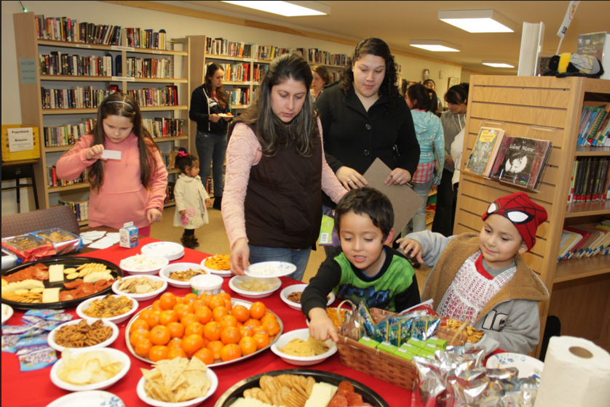
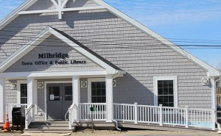
Raise Up
Milbridge Public Library (ME)
Notes:
The second R is raising up –
It’s the idea that Libraries elevate family perspectives to develop and improve programs and services.
This is important because by asking for, listening to, and rsponding to family members’ views, libraries empower families and improve library services.
A great example of this is in Milbridge, ME which similar to Waukegan experienced a large influx of migrant laborers from Mexico – but they found that very few families were using the library – so after a survey and conversations with families, they learned that not many families were coming to the library b/c there weren’t many books in Spanish –
So for a children‘s day event the library held a community fundraiser and the fundraiser was used to buy more than 150 children’s books in Spanish and Spanish language magazines that parents had wanted.
And when the books came in the library had a processing party where 10 parents for the community helped put bar codes and placed Dewey decimal numbers on them – giving them real owndership of the collections

Slide 23
Reinforce
Columbus Metropolitan Library (OH)
Notes:
And once you reach out and raise up family voice – there are then oportuntities to reinforce families role as their child’s first teacher – and to help parents develop knowledge, skills, and confidence to support learning – across all of the development
This is an extreme example, but in Colombus Ohio, librarians wanted to reinforce learning so started a library home visiting program for children who were not in preschools and were most isolated form the community
And if you don’t have resources to start your own home visiting programs – many libraries don’t! – the Idaebook can inspire you to find out about home visiting programs in your area, and perhaps to find ways to patner with them -

Slide 24
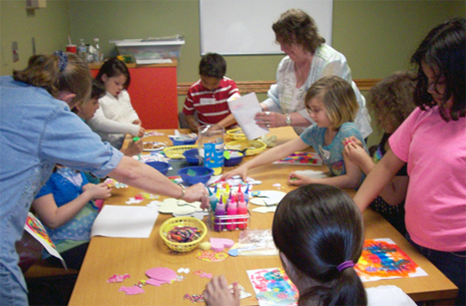
Relate
Carrol County Public Library (MD)
Notes:
So throughout Maryland – libraries hold parent cafes where parents have opporutnities to interact, engage and ask questions of one another while kids do crafts
And it can be even simpler than that – in San Mateo – at the start of story hour –parents have a chance to introduce themselves to one another -
Library cafes – and San Mateo ice breakers
Don’t have staff or space to start a library café?
You can connect parents in your program by simply taking three minutes at the start of storytime to help parents build relationships, share ideas – or even just create a small discussion board or or bulletin board where families can learn about events in the community

Slide 25
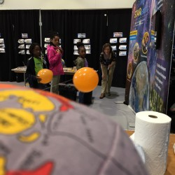
Reimagine
Contra Costa County Library (CA)
Notes:
And the Final R is Reimagine –
Libraries are reimagining and changing what learning looks like in a community – and giving parents new opportunities to get involved in their children’s learning and improve their health and well-being
So for example –
In Contra Costa County Library – they teamed up with a program calle STAR_Net which basically transforms for a period of time libraries into afterschool museum, insterstellar learning spaces – This is a program funded through National Science Foundation – and basically libraries apply for funds in partnership with afterschool programs to really transform the library as a free space where students and famileis can go to a museum – which is often cost prohibitory
Don’t have funds to invest in STAR_Net – you could try partnering with a science teacher and using materials from the science lab over the summer….

Slide 26

Poll
Which of the 5Rs could you use the most support in?
Reach Out
Raise Up
Reinforce
Relate
Reimagine
What learning setting do you work in?
Notes:
Let’s take a temperature check:
Which of the 5Rs do you need the most support with?

Slide 27
How can I use the Ideabook?
Notes:
So at this point we wanted to highlight how to use the Ideabook….

Slide 28
Notes:
Each idea has 5 different components:

Slide 29
Notes:
First we proide a description of what the idea is –
In this example within support services we show the changing role of librarians as media mentors for families and how librarians guide family media use

Slide 30
Notes:
We provide an explanation of why the idea is important and the research rationale behind it.

Slide 31
Notes:
WE provide examples of the ideas in action in different libraries across the country

Slide 32
Notes:
And we then have a section on what library leaders recommend – and what you can do in your library

Slide 33

Ways to Use the Ideabook:
Personal reflection
Professional development workshops and staff meetings
With other family service providers in your community
Notes:
And in our converastions with librarians around the country we’ve found that the Ideabook is being used for XXX

Slide 34
Notes:
And we realize that many o the ideas are big – but there are ways to tweak them…

Slide 35
What’s next?

Slide 36
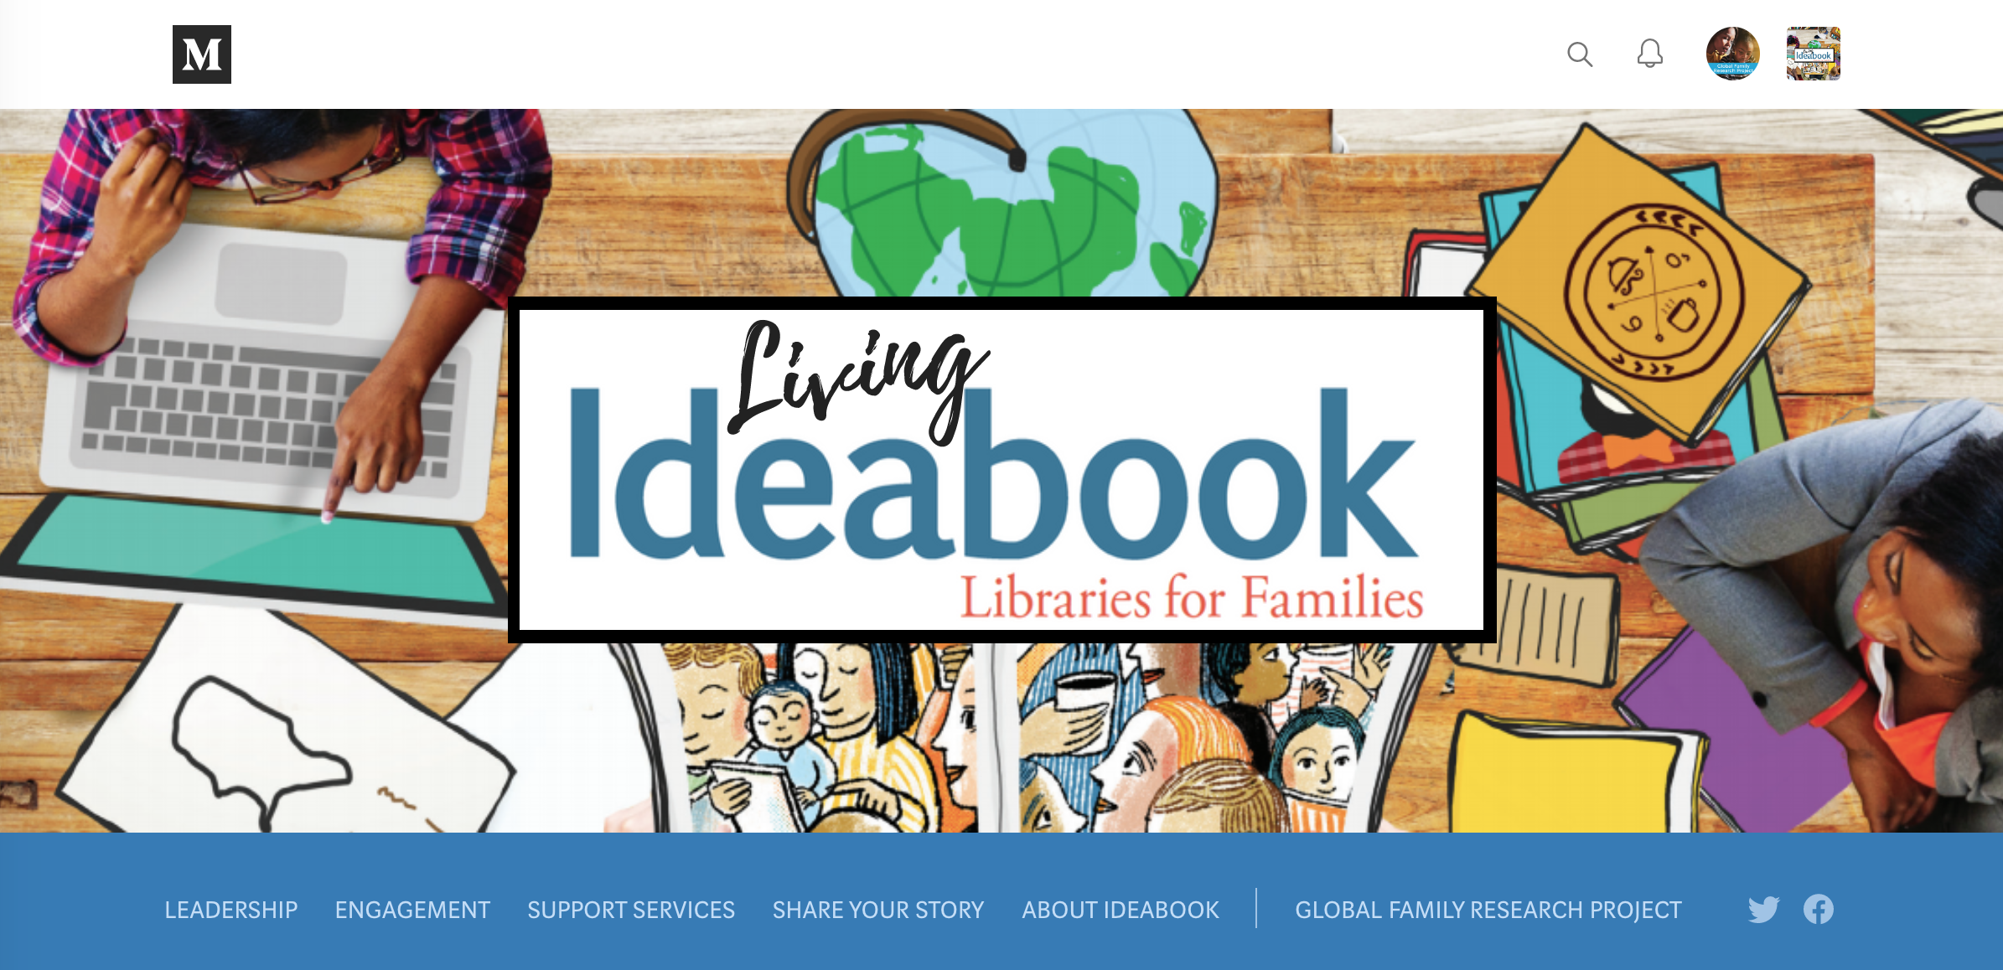
Medium.com/Ideabook
Notes:
This is really exciting –
We just put it online which you can find at Medium XXX…

Slide 37
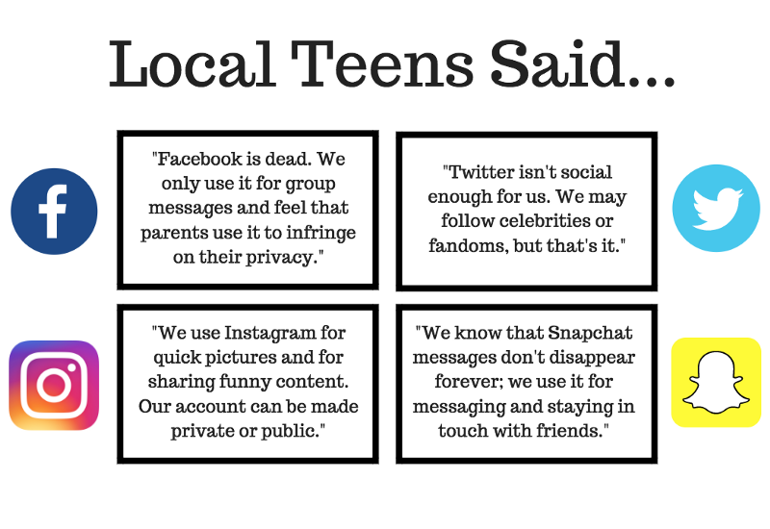
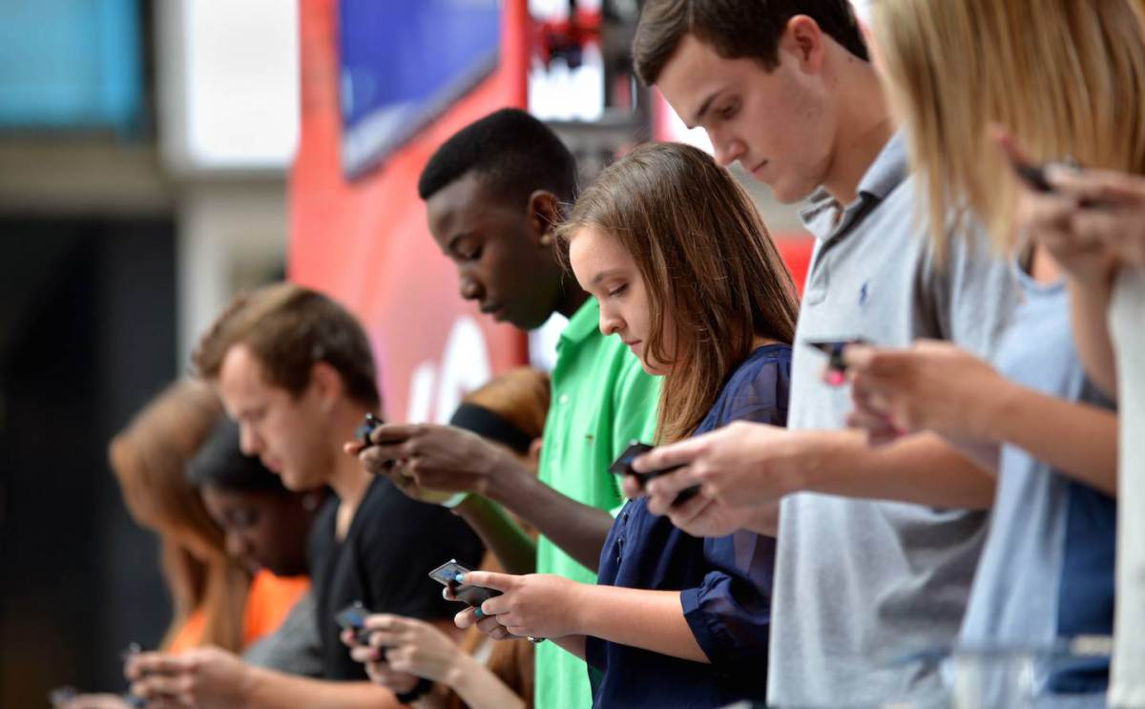
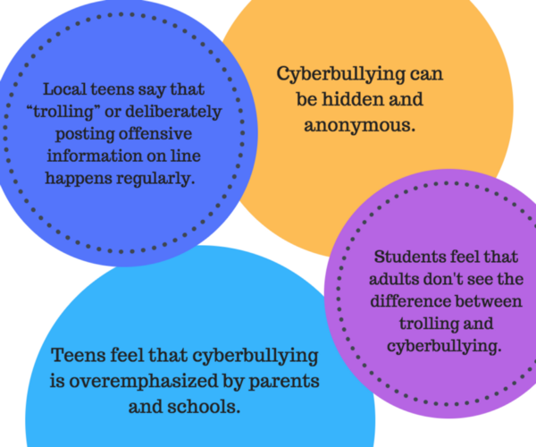
Marathon County Public Library
Notes:
And in the living ideabook we’re collecting new stories and innovatie ideas….so that we can continue the conversation –
Here’s an example from right here in Wisconsin ….
Julie Kinney, the youth services librarian at Marathon County Public Library in Central Wisconsin [TELL SUCCINCT STORY]: https://medium.com/@globalfrp/b42412eb5cfb

Slide 38

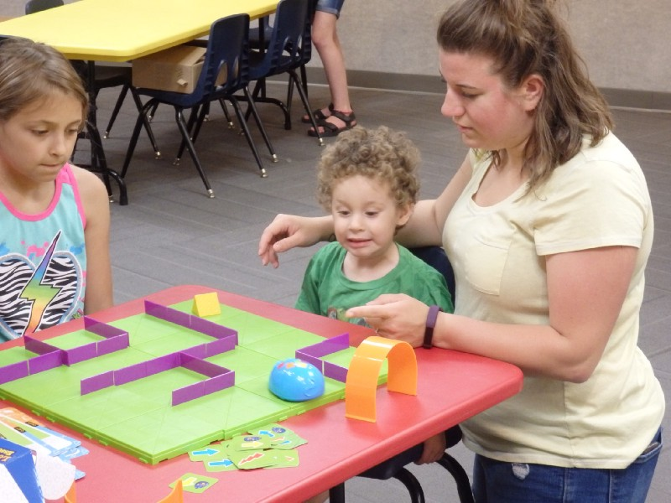
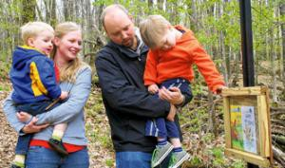
Waupaca Area Public Library
Notes:
And here’s another example from Sue Abramson [Tell succinct story]…. https://medium.com/@globalfrp/fcdb108636b4

Slide 39
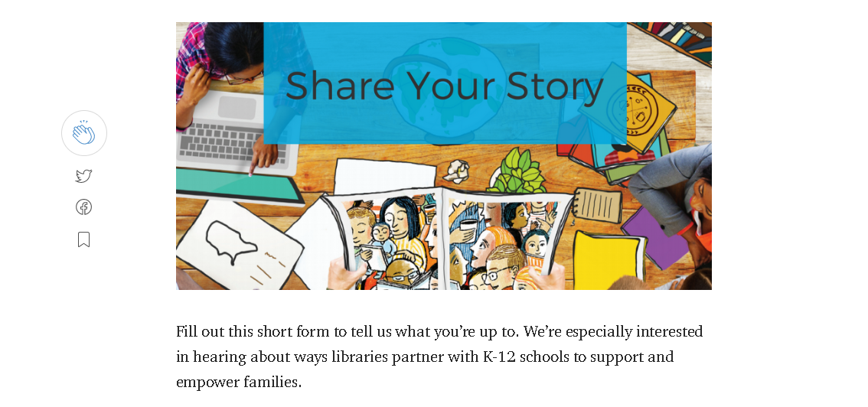
Bit.ly/IDEABOOKStories
Notes:
We’d LOVE if you share your story with us…..
WE ALSO have a compendium coming out to use the Ideabook to assess your practice….

Slide 40

Questions & Discussion

Slide 41
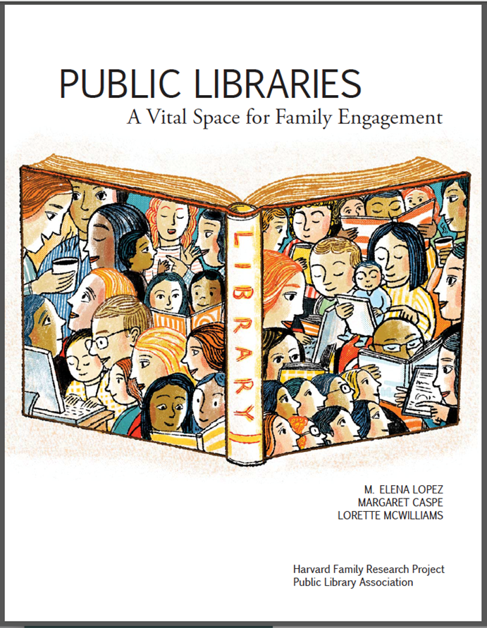

Slide 42




Thanks & Stay In Touch!
Margaret Caspe: margaret_caspe@globalfrp.org
Global Family Research Project
@globalfrp
www.globalfrp.org

