Slide 1
Harnessing the Power of Small Libraries
Molly Rach
Blairstown Public Library

Slide 2
A little about moi…
Iowa native with serious Wisconsin roots
Have spent almost 16 years working in public libraries
Currently Library Director for Blairstown Public Library in Blairstown, Iowa
Pursuing my MLIS online from the University of Wisconsin-Madison
Live in a 101-year-old house with my husband and 6 members of the feline persuasion

Slide 3
Blairstown, Iowa Population 692

Slide 4
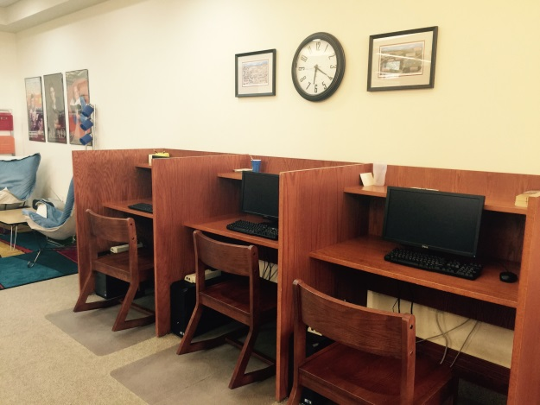
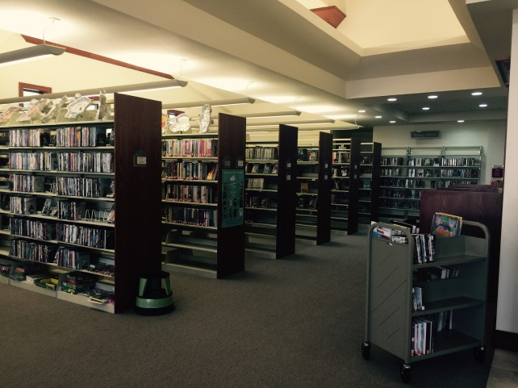
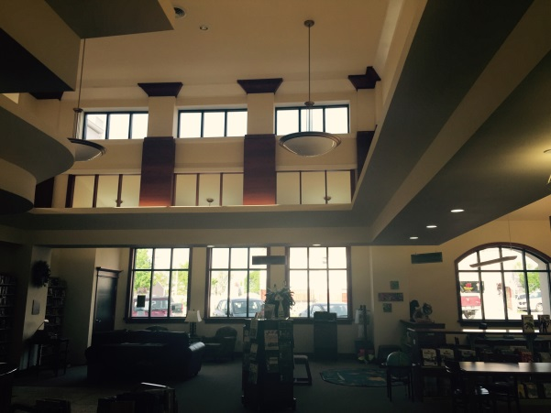
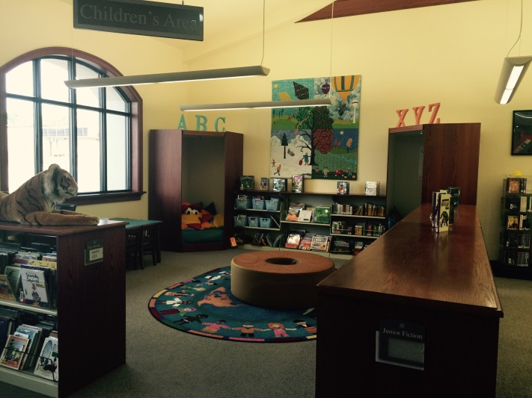
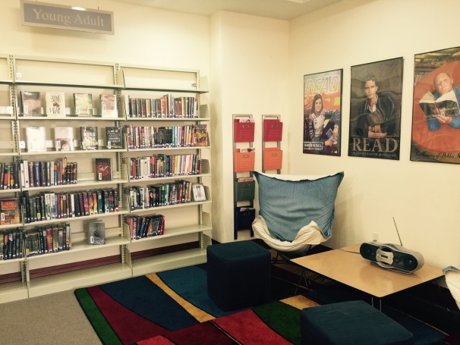
Blairstown Public Library

Slide 5
And now…(drumroll please)…
for the top ten!

Slide 6
#10 We are the epitome of “do it all” (clean the toilet? every week)

Slide 7
#9 We literally know it all (why yes, I know the post office hours)
Our communities know that we are the keepers of information. Use that to your advantage and keep up to date on all the events going on in your community.
Also, don’t forget that because you know it all, you can promote it all too!

Slide 8
#8 We definitely don’t do this for the money (my salary keeps decreasing, not increasing)

Slide 9
#7 We are well-versed in “small town-isms”
There’s a certain language and flow to small towns that takes some time to learn and understand.
Serving our communities means being privy to this way of life and what it all entails.

Slide 10
#6 We know you (where you live, who you’re related to, when you graduated)
Gives us the opportunity to offer more personalized service to our patrons.
Allows us to tailor our programs towards our community and their interests
We also have the opportunity to be a little more intimate with our patrons.

Slide 11
#5 We are many things to many people (therapist? babysitter? weather man? you betcha)
Allow yourself and your staff to be that one person that makes someone’s day.
Remember that really nothing we do is a life or death situation. Our primary purpose is always to serve the public in the best capacity possible.

Slide 12
#4 We’re resourceful (because “money doesn’t grow on trees”)

Slide 13
#3 We’re very invested in our communities (we love them, we really love them)
We are often the hub of our communities. Use that as a way to become invested even more in your community.
Get involved, join a local civic group, help with a community wide celebration. By giving a face to the library, you are showing your community that you care.

Slide 14
#2 Our communities are very invested in us (they love us, they really love us)
Don’t be afraid to ask for help (physical, financial, etc.) when you need it.
Show your appreciation for your community members and businesses whenever given the chance.
Good service always pays off in the end.

Slide 15
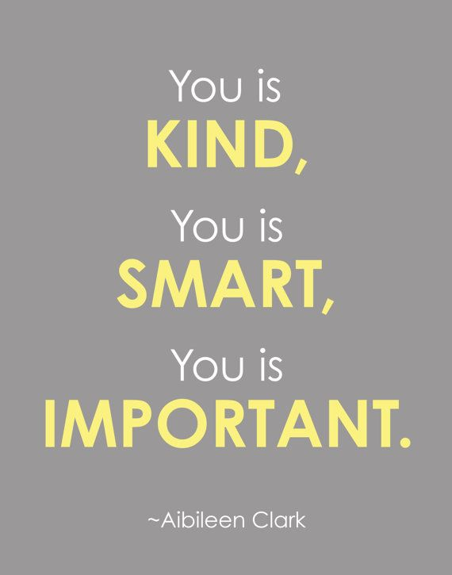
#1 We’re just freakin awesome (so own it)

Slide 16
Thank you!
Molly Rach
btown@netins.net
(319) 454-6497
www.blairstownpubliclibrary.com

