Slide 1
Teaching Patrons to be Successful in the Library
Managing Patron Behavior

Slide 2
In this session, we will
Discover how policies, procedures, and guidelines can support a safe and welcoming environment for patrons and staff
Learn techniques for engaging staff in solution
Discuss community and police partnership opportunities
Consider the impact of facility design in creating a safe library environment
Discuss training topics that will support staff in managing the library environment

Slide 3
King County Library System
No longer a “suburban” library system
Not just a “south end” problem
Intentional approach to managing patron behavior
Community Conduct Coordinator hired in 2012
JLMC Safe and Secure Libraries project begins 2014
Notes:
If King County Libraries are to maintain the support of the community, and voters, and continue to fulfill our mission of free and open access to all, our libraries must be safe, secure, and welcoming to all members of the community.
While staff were once managing annoying, but not dangerous behaviors the are now navigating dangerous situations involving assaults, weapons, threats of violence and criminal activity.
In 2007 in an effort to develop a holistic response to security issues KCLS convened a Security Task Force that made recommendations to increase awareness through staff, the system and community of security concerns and appropriate responses. These responses includes facilities improvements, staff training, community involvement and the hiring of off duty police officers for two of the locations with the most issues (in 2013 they were removed from the libraries).
In the subsequent 7 years since the task force made its recommendations - the system has added a Community Conduct Coordinator dedicated to helping libraries navigate disruptive behavior, to help connect community resources and KCLS, and to develop policies and procedures to support staff in consistent rule enforcement in the libraries. This position has been essential in providing support for staff and creating consistent rule enforcement.
These concerns are no longer isolated to being ‘south end ‘ ‘urban’ ; issues they have spread throughout the county to rural communities such as North Bend, and even municipalities such as Issaquah, Bellevue and Redmond.

Slide 4
Community Conduct Coordinator
System-wide position over 48 libraries
30+ police jurisdictions
18 School Districts
Support management and staff to navigate patron behavior
Trainings
Explore relevant trainings for staff
Provide system training
Security

Slide 5
Managing Your Environment - KCLS Style
Presence on the floor – be proactive
“Know your patron” – Joe Fithian, SPL
5 Universal Truths – Verbal Judo
Universal Greeting – Verbal Judo
Consistently enforce COC/Bans/Trespasses
Do not “police” environments – our goal is to have people in the library
“You see it, you own it”

Slide 6
Five Universal Truths
All people want to be treated with dignity and respect.
All people want to be asked rather than told to do something.
All people want to be told why they are being asked to do something.
All people want to be given options rather than threats.
All people want a second chance.
Verbal Defense and Influence
Notes:
Verbal Defense and Influence was developed as a style of tactical communication to be used by police officers when handling difficult people. I have been through the training years ago and a couple of years ago was able to attend a week long training for instructors. I took some nuggets away that I feel are extremely helpful when working with people. This is the first one.
Verbal defense and influence is grounded in the 5 universal truths. Dr Thompson the founder of Verbal Judo states that no matter all the ways we are different: age, gender, socio-economic status etc, there are 5 ways in which we are all the same:

Slide 7
Universal Greeting
“Hi, my name is Melissa,
I work for the library.
I noticed that your voice was carrying across the library and I could hear you at the desk.
Could you please keep it a little quieter so others are not disturbed?”
Appropriate greeting with name (if known)
Identify yourself/affiliation (if unknown)
Explain reason for contact
Ask a relevant question
Verbal Defense and Influence
Notes:
Universal greeting is something that is so easy to do and eventually becomes habit.
When you do all of these things when you begin conversations, especially about behavior, you have already begun to deescalate the situation. You have answered any questions that they may have been ready to throw at you: Who are you? Why do you get to tell me to do something/why do I have to listen to you? What do you want?
Practice the Universal Greeting
Approach someone in the room whom you do not already know
Choose a conduct issue (either from the KCLS Rules of Conduct or your own)
Practice the greeting
Repeat five times with five new partners

Slide 8
Policies and Procedures
Code of Conduct
Guidelines for Bans
Patron Behavior Tool
Incident Report
Guidelines for Trespasses
Online Trainings

Slide 9
Code of Conduct
Expectations of Behavior
Prohibited Behaviors
Be Safe
Be respectful of other patrons and library staff
Be respectful of library property
Obey the law
Comply with requests from library staff
Unsafe or disruptive to others
Inappropriate use of library privileges or property
Illegal
Non-compliance with staff

Slide 10
Consequences
Ban
Trespass
Local
Range from one day to one year
Issued for:
Unsafe or disruptive behavior
Inappropriate use of the library
Non-compliance with staff direction
System-wide (48 libraries)
3 months – 1 year
Illegal Behavior
Drugs
Violence
Police Issued

Slide 11
Instruct. Warn. Ban.
Guidelines for Bans

Slide 12
Engaging Staff in Solution
Joint-Labor Management Committee
Burien Safe Environment Work Group
Management Accountability
Training (and more training)
Notes:
Burien Safe Environment Work Group (BSEWG)
Product of the JLMC
Committee work
“On the Floor” Guidelines
Needle disposal
Trainings

Slide 13
Community and Police Partnerships
Every police agency is different
Working with multiple police agencies
Mission clash
Legal Aspect

Slide 14
Your Library in the Community
Social services and addiction resources
Hot-spots and their proximity to your library
Police resources
Number of officers?
SROs?
Joint task forces? Gang units, drug units
Community Resources

Slide 15
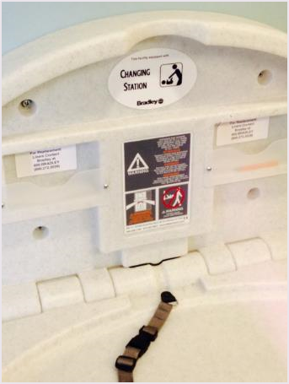
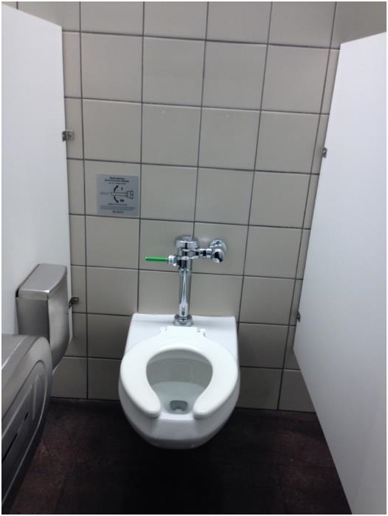
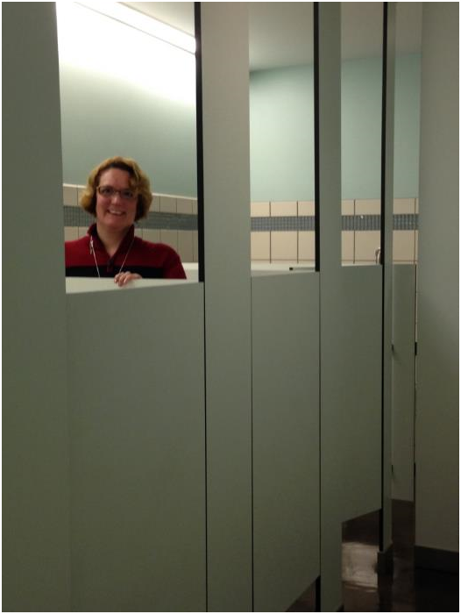
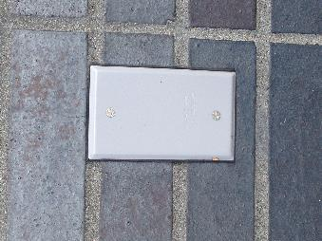
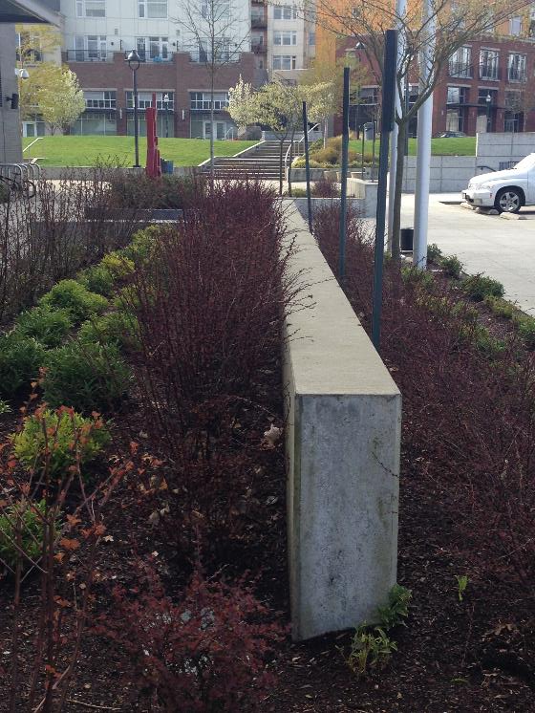
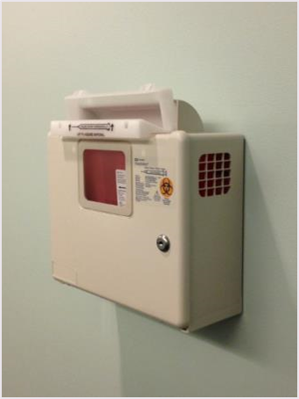
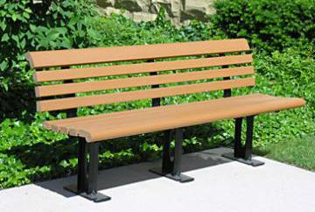
Facilities solutions

Slide 16
Training: Focus on de-escalation and self-care
Prepare
Safe Environment Training - SPL
Sound Mental Health
Trauma Stewardship
Responding to Critical Situations

Slide 17
Questions?
Melissa Munn
Community Conduct Coordinator
King County Library System
mjmunn@kcls.org

