Slide 1
The Engaged Heart > The Managed Heart
Rachel Arndt
Coordinator, General Reference & Customer Service
Milwaukee Public Library

Slide 3
Emotional Labor in Libraries
Public Service/Customer Service
Interpersonal Relationships
Financial/Political insecurity
Safety or Security concerns
Lean staff
Multi-tasking
https://pixabay.com/photo-65336/

Slide 4
Authenticity
Sustained effort
Gratitude
Loyalty
Commitment
Insincerity
Varying levels of effort
Bitterness
Untrusted
Rejection

Slide 7
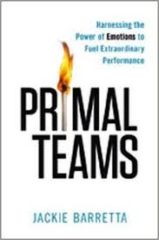
Satisfy the human craving to feel by replacing venting or gossip with inspiration and gratitude.
Make room for negativity.
Connect to a deeper purpose.
Be mission-minded.
Create a team membership.
Connect services with human needs like safety, freedom, accessibility, respect, and empowerment.

Slide 8
Acknowledge stress - it’s hard to give from a source of depletion.
Teach and practice mindfulness
Create spaces for restoration.
LAUGH !
Support employees taking vacation.
Encourage employees to focus on one task, one customer at a time.

Slide 9
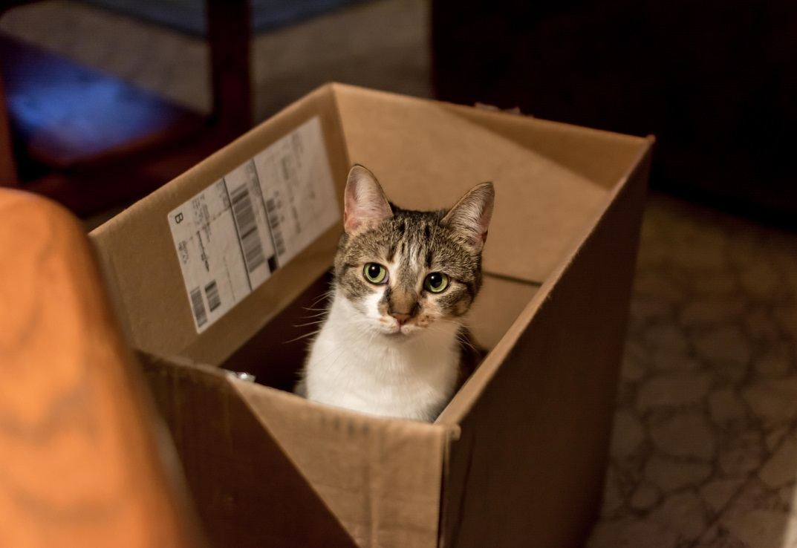
Engagement > Management
rlarndt@milwaukee.gov
Twitter: @RachelLoAr
Images from morguefile.com
Book covers from amazon.com

