Slide 1
Exercise Your Mind READ!
Trigger Decks
Wild Wisconsin Winter Webinar 2016
Rhonda Gould, presenter

Slide 2
Intro
Goals
Programs
Prep
Promotion

Slide 3

Wellness

Slide 4

Healthy Minds

Slide 5
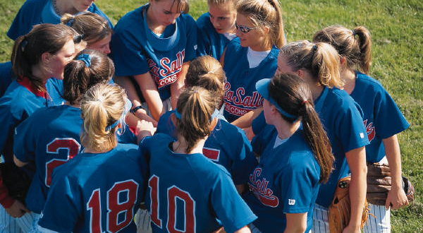
Get Moving

Slide 6

Read for Your Life

Slide 7

Hale and Hearty Habits

Slide 8
Thank
You!

