Slide 3
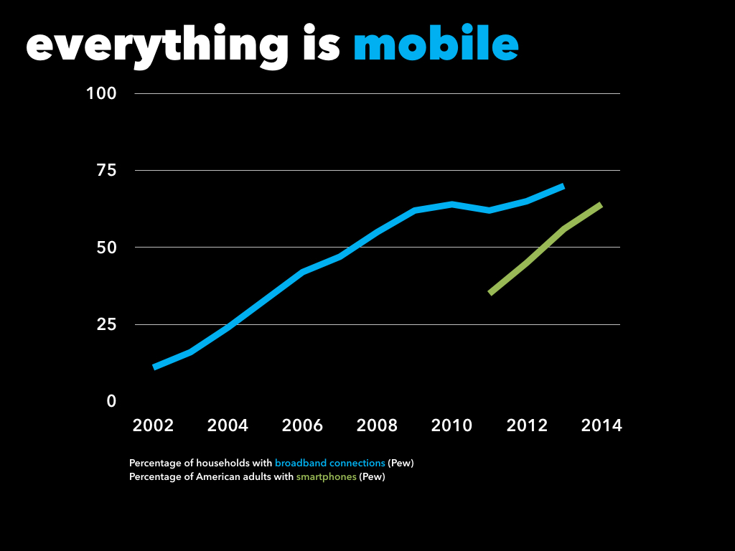

Slide 5
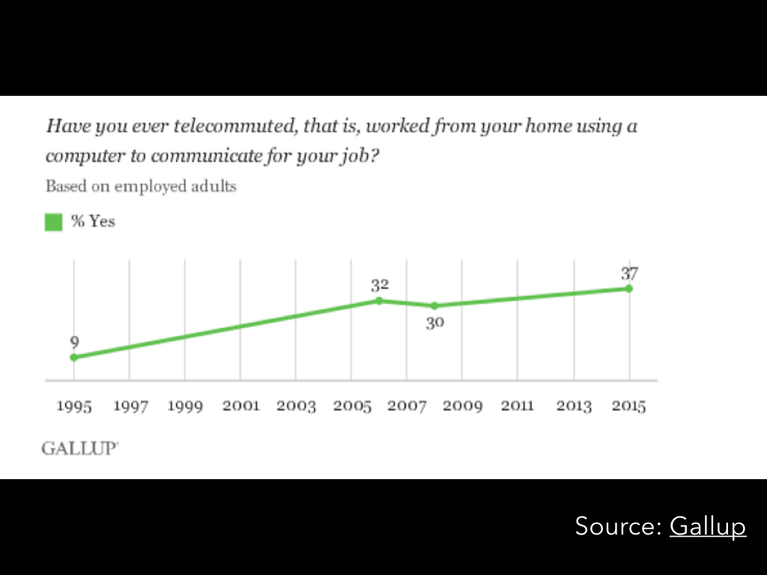

Slide 6
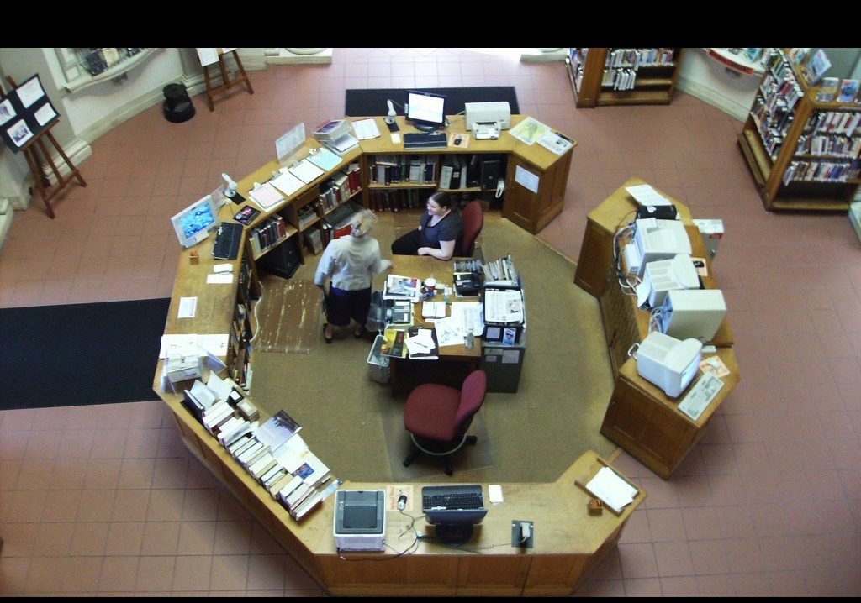
Source: Manchester City Library (Flickr)

Slide 7
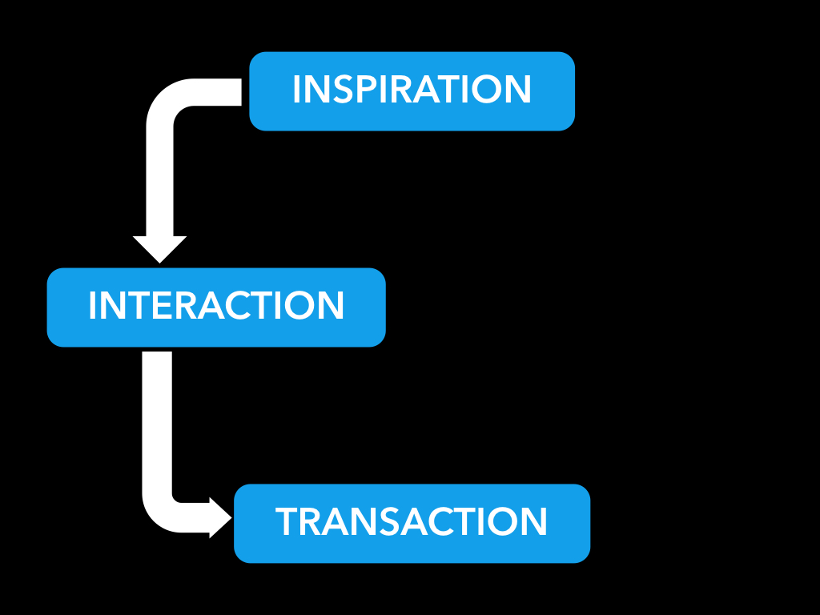

Slide 8
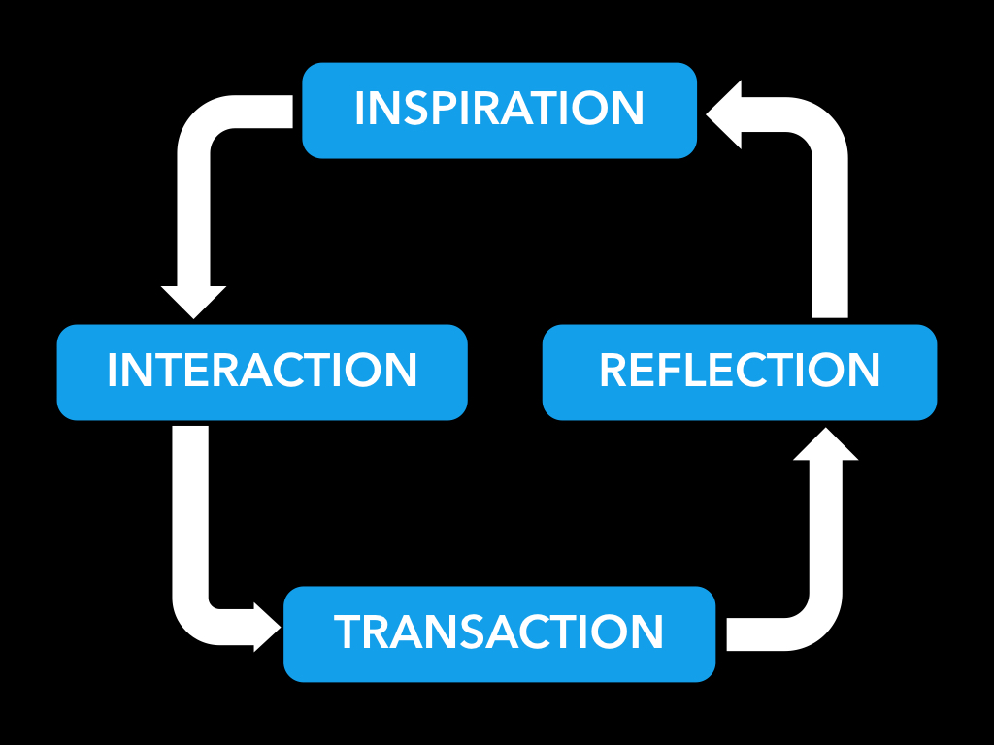

Slide 9
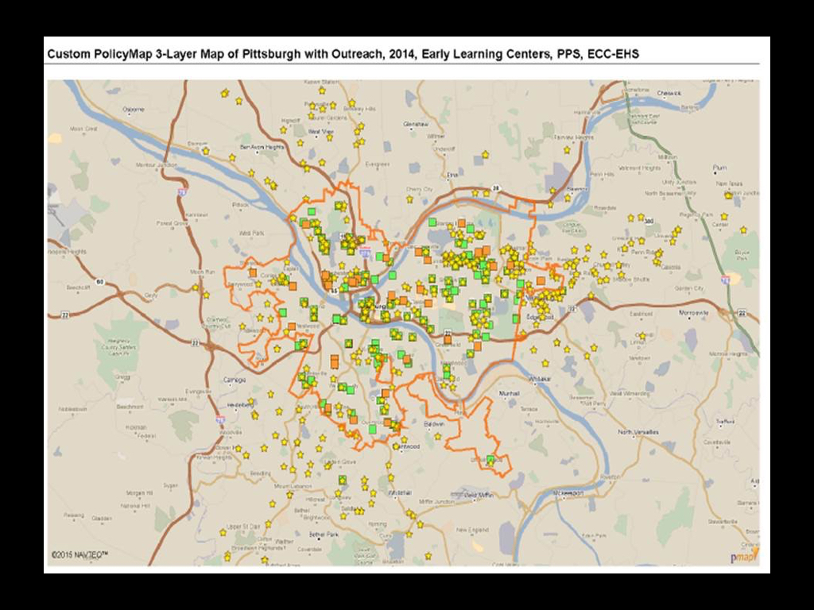

Slide 11
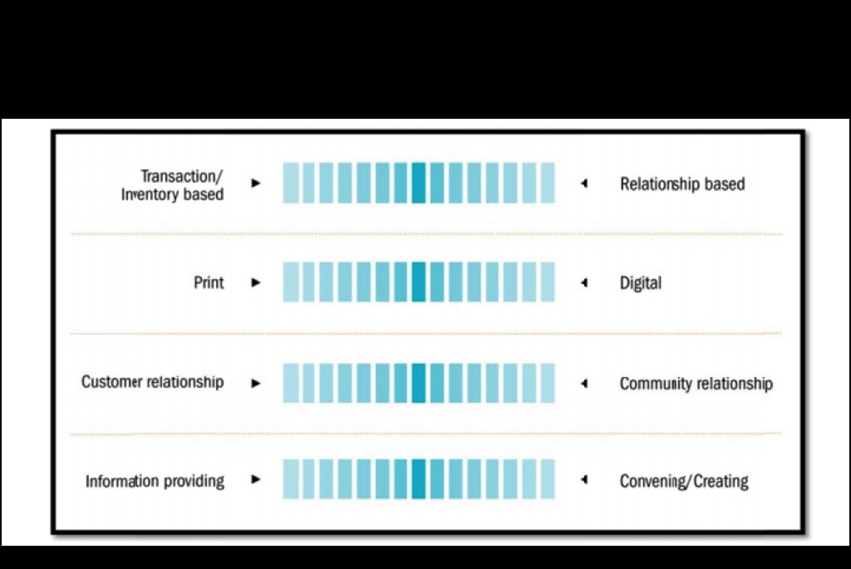
Source: CLP Strategic Plan

Slide 12
Notes:
(notes on privilege)

Slide 19
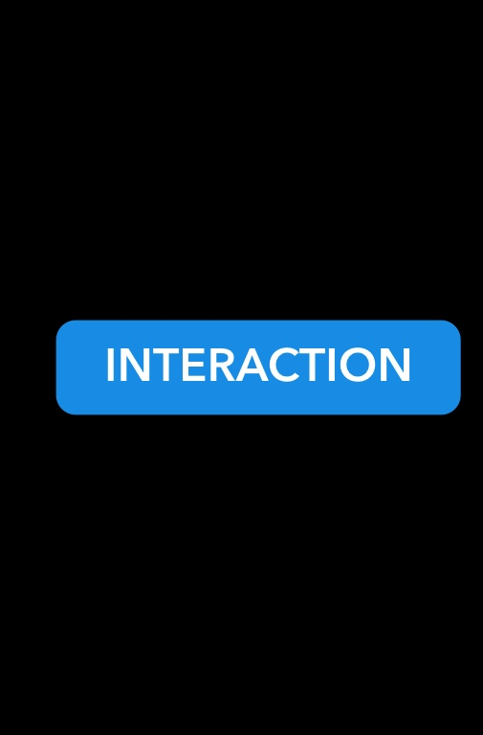

Slide 28
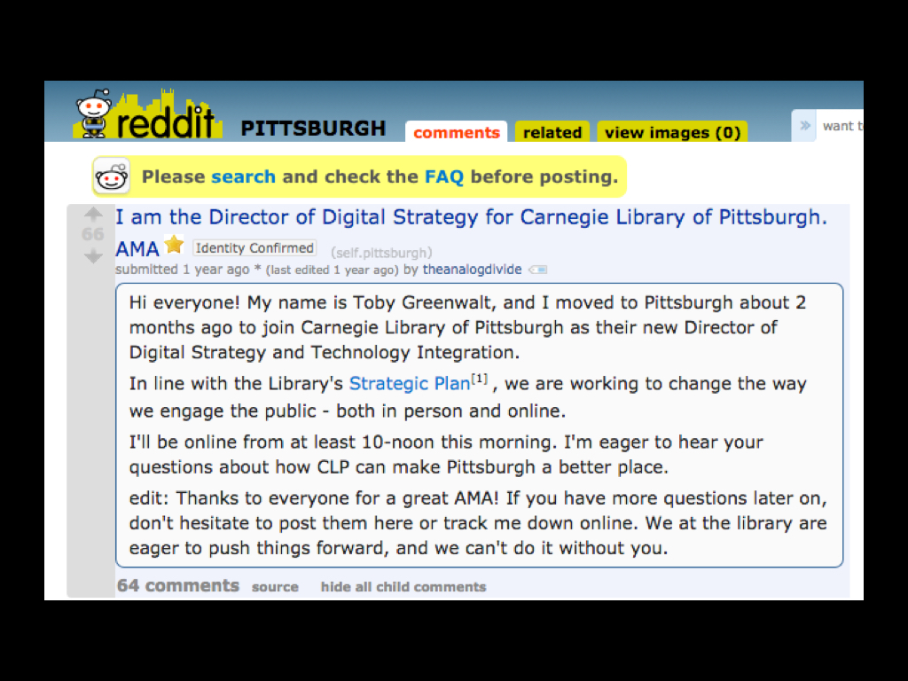

Slide 29
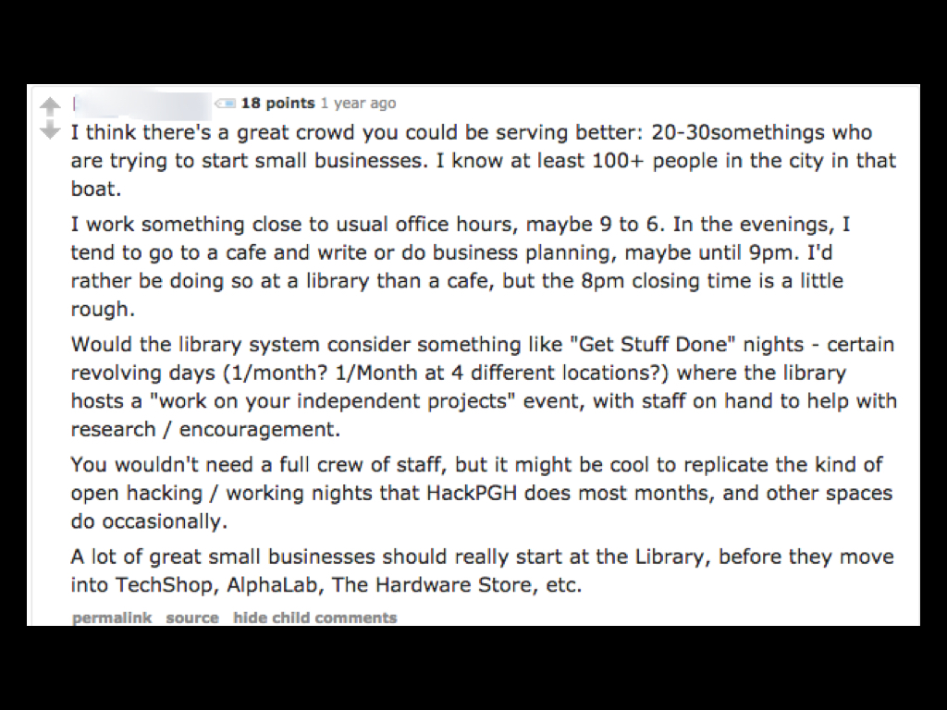

Slide 32
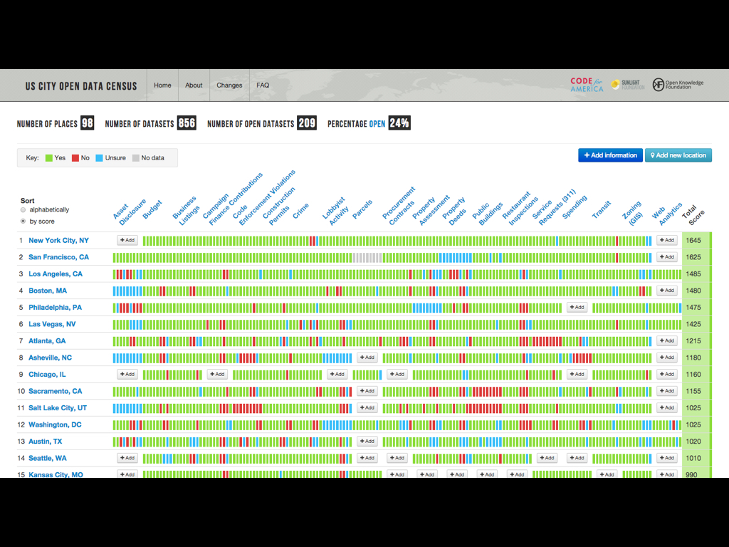

Slide 33
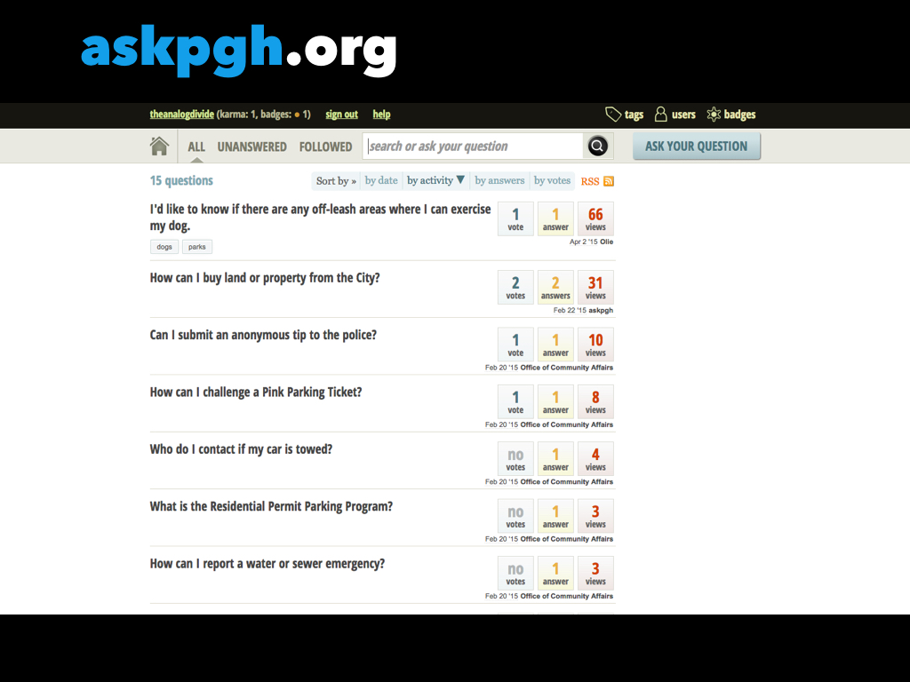

Slide 37
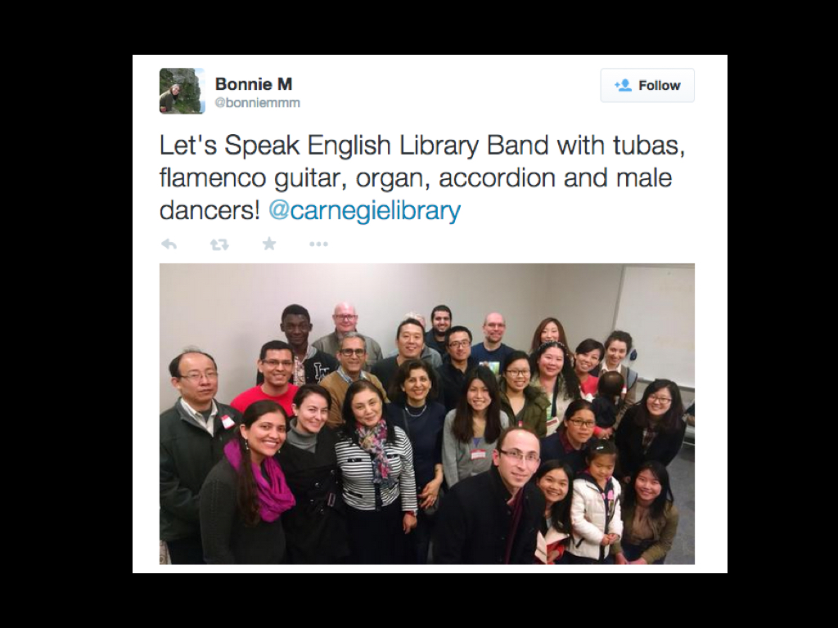

Slide 38
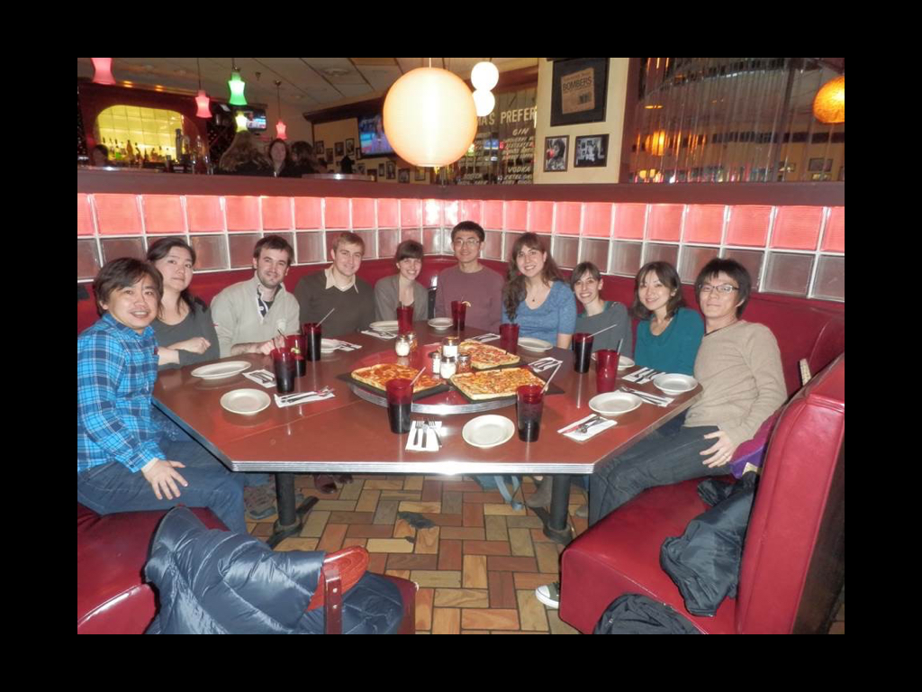

Slide 39
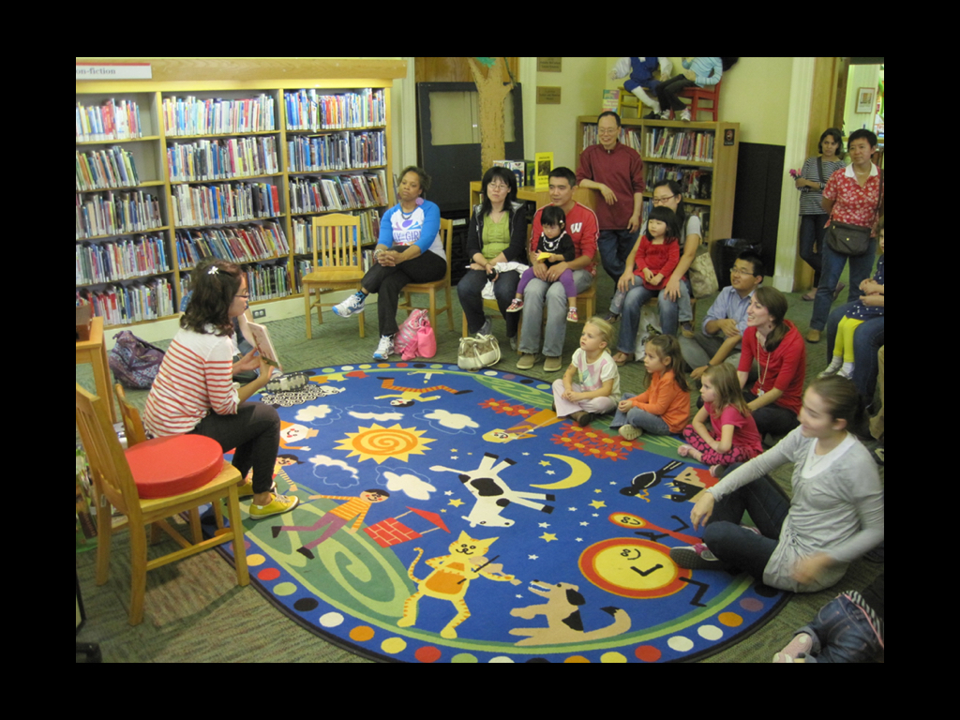

Slide 40
Notes:
We’ve now walked through this process with regard to our internal staff.
We can see how to use tools to spark conversations and inspire folks at all levels.
We can use additional tools and prompts to get staff interacting with one another.
We can build transactions and services to facilitate ongoing learning for skills development.
We can reflect on the entire process to reexamine our past blind spots.
Finally, we can turn the whole process outward to embed library impacts in the work of our stakeholders.
This is a snowball effect.
Thinking long-term. How can we use this model to give our staff greater skills even further down the road?
Management/mentorship
Creating a deeper bench
Giving staff who leave greater individual skills - and making sure others can effectively take their place.
The other part of this is the uncomfortable question of when it’s time for staff who’ve been around for a long time to understand when it’s finally time to let go.
Entrenchment - “30 years of 1 year’s experience” - that doesn’t fly in an organization that’s supposed to be a model for lifelong learning.

Slide 41
Notes:
All of speaks to the other type of connections the library is building - connections over time. My son just turned 4, and he’s already starting to lap me in terms of his understanding of tech. He has a little brother coming soon. When we asked him what we should name him, he said “Netflix.” I start to think about how we’re going to create links between our existing services, so that his library use doesn’t vanish at teenager hood, or when he goes to college, or when he becomes an adult. We’ve got to find the connective tissue to prevent this drop-off and truly reflect on our role as institutions of lifelong learning.
All of this ties into one last asset libraries have at their disposal - that of nostalgia. Digital Public Library of America founder John Palfrey talks about how libraries need to create nostalgia for the future. What are the memories you’re creating, and how will they affect their regard for the library years down the line?
By building these connections and making them visible, libraries can not only own their role in the information ecosystem, but create irrefutable arguments about their impact that will reap benefits years down the road. These memories can go a long way toward reinforcing the essential role we play to our communities. Making visible, outward-facing connections to our community partners is the first step in that direction - no matter what technique or technology you use to get there.

Slide 43
Notes:
Thank you.

