Slide 1
On My Honor: Creating an Ethical Work Environment Marge Loch-Wouters

Slide 2
Career Long Youth Librarian/Manager
Kind of Retired
(aka Consultant)
Educator
Like to get into the guts of why we do what we do

Slide 3
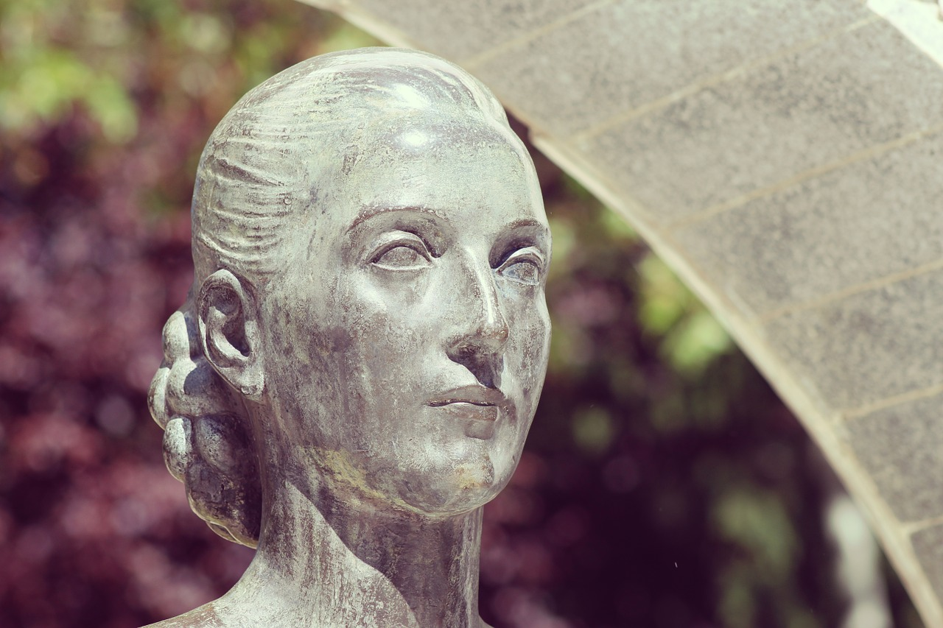
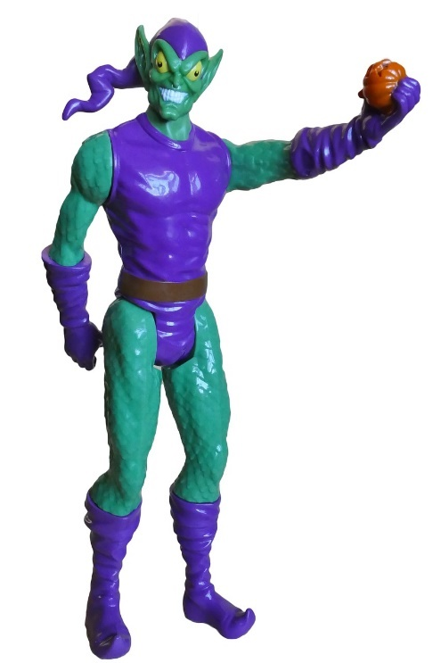
Who Influences Our Ethics?

Slide 4
Ethics Moral principles that govern a person's or group's behavior.

Slide 5
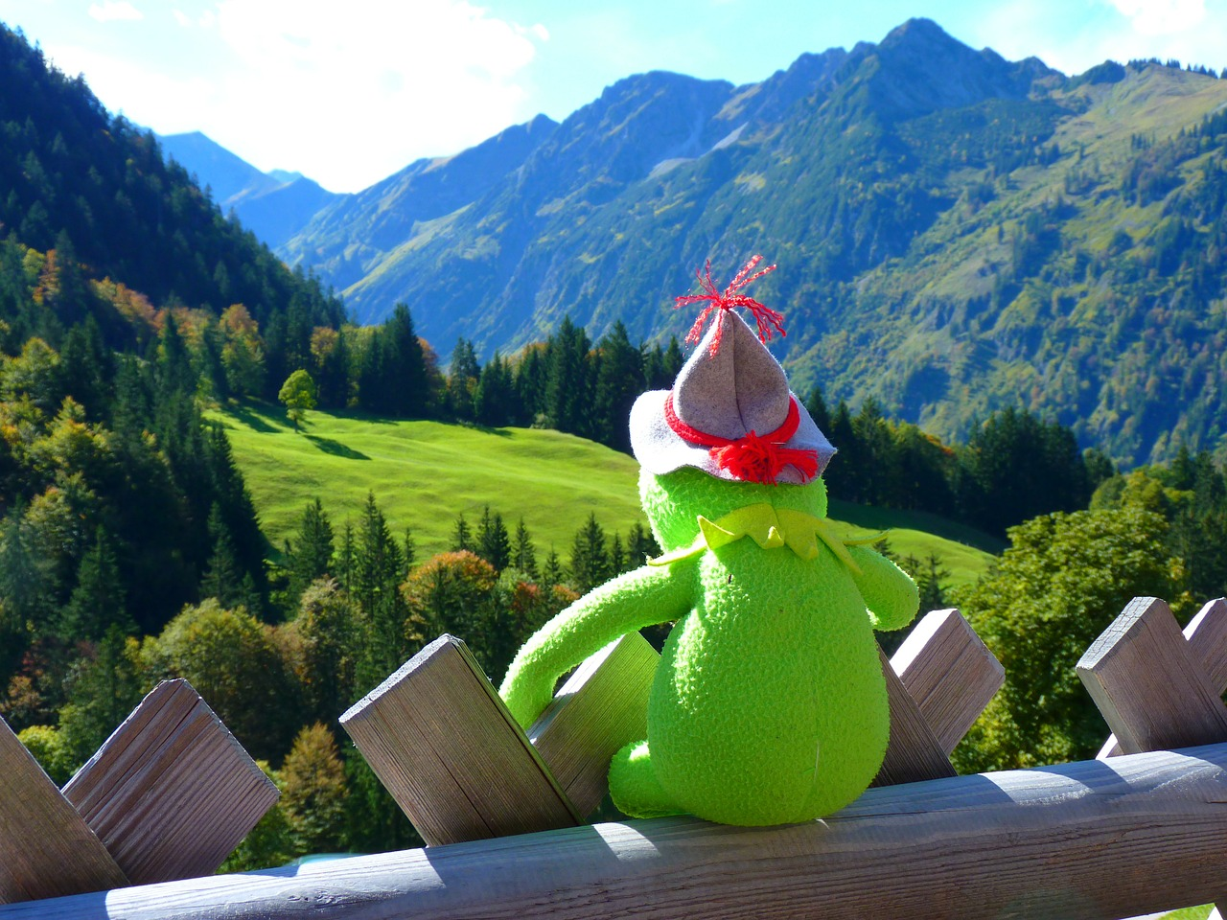
Where Do We Start?

Slide 6
Servant Leadership

Slide 7
Characteristics of a Servant Leader
Listening
Problem Solving
Take the Blame
Share the Credit
Tell the Truth
Work hard

Slide 8
Who do you work for?

Slide 9
Organizational Culture

Slide 10
Examining Our Work

Slide 11
Questions?

Slide 12
Practical Side of Ethics in Library Leadership

Slide 13
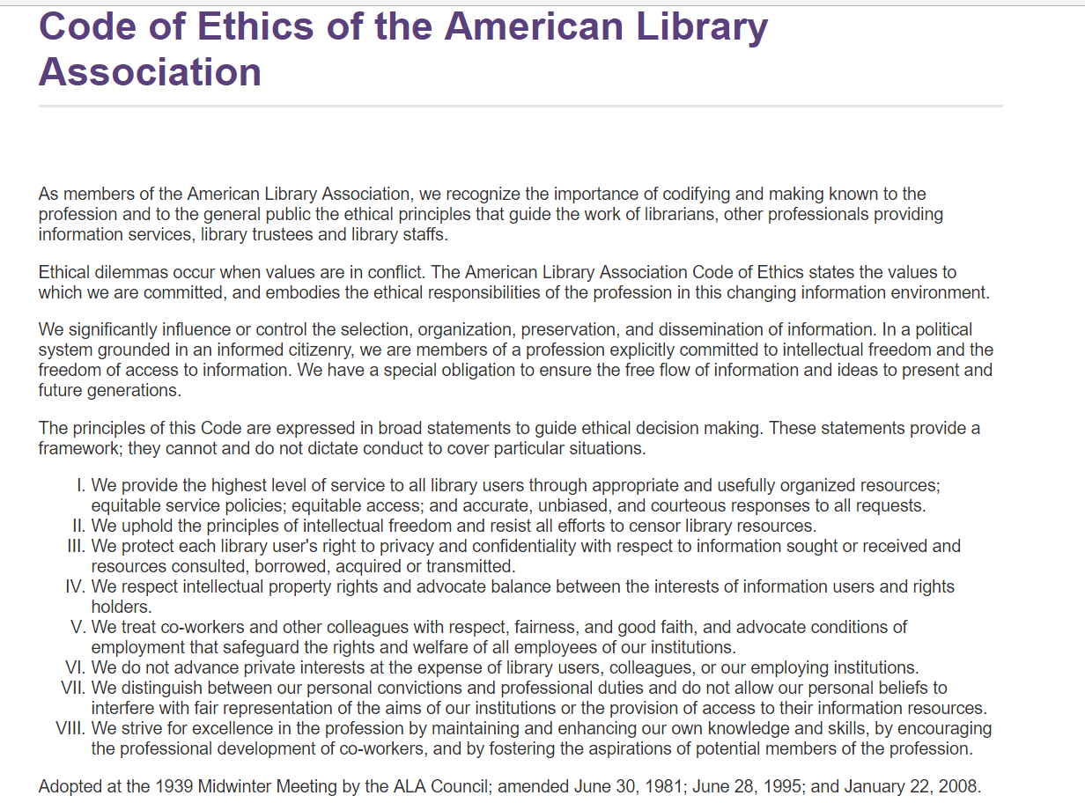

Slide 14
Who Owns the Library and it’s Stuff?

Slide 15
Time IS Money

Slide 16
No Double Dipping

Slide 17
Association Work

Slide 18
Fines, Fees, Discounts

Slide 19
Respect Your Patrons

Slide 20
Questions?

Slide 21
Your Place in Space

Slide 22
Communication is Key

Slide 23
Working in Support of Your Staff

Slide 24
Dealing with Unethical Behavior

Slide 25
Ways to Work Ethically as a Leader

Slide 26
Resources
American Library Association. Code of Ethics. http://www.ala.org/advocacy/proethics/codeofethics/codeethics
Amercian Library Association. Conflicts of Interest. http://www.ala.org/advocacy/advocacy/proethics/explanatory/conflicts-of-interest
Private Lives. Julie Jurgens. Hi Miss Julie blog. December 30, 2015. https://himissjulie.com/2015/12/30/private-lives/
The Things You Might Be Doing That Will Force Your IT Guy to Start Spying on You. Jake Swearingen. August 26, 2016. New York Magazine http://nymag.com/selectall/2016/08/how-to-be-so-dumb-that-the-it-guy-is-forced-to-spy-on-you.html
Martin Luther King: A True Servant Leader. James Perry. Huffington Post March 20, 2010. http://www.huffingtonpost.com/james-perry/martin-luther-king-jr-a-t_b_427417.html

Slide 27
Questions?
Marge Loch-Wouters
Loch-Works Consulting lochwouters@gmail.com

